Slide 1
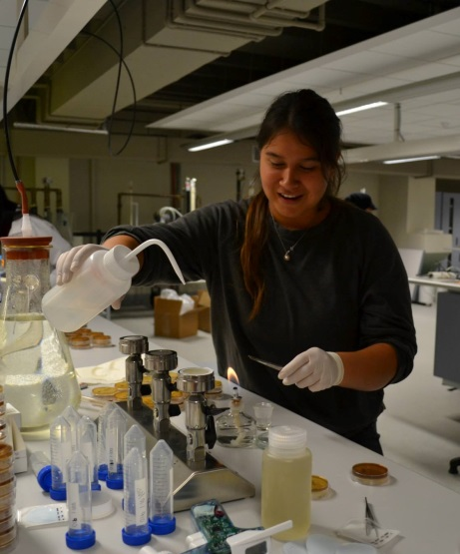
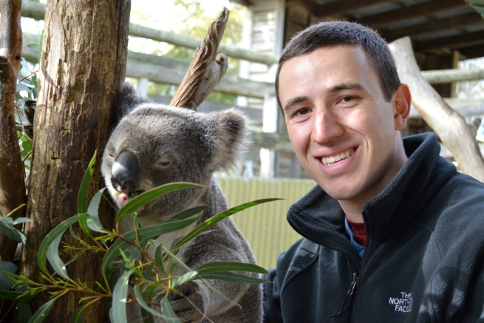
Removal of Stormwater Contaminants in Wetlands and Biofilters
Amanda Jimenez
Environmental Engineering
UCI
Kevin Tran
Civil and Environmental Engineering
UCI
Sam Zabb-Parmley
Civil and Environmental Engineering
UCLA

Slide 2
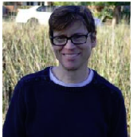
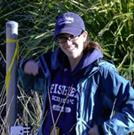
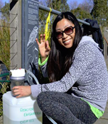
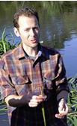
Stan Grant Principle Investigator
B.S., Stanford University, Geology, 1985 M.S., California Institute of Technology, Environmental Engineering and Science, 1990 Ph.D., California Institute of Technology, Environmental Engineering and Science, 1992
Megan Rippy Research Specialist
Fate and transportation modeling; pathogen removal in biofilters
Sunny Jiang Pathogen Detection Team Leader
Ph.D. Marine Science, University of South Florida
Andrew Mehring Ecology Team Leader
Post-doctoral research associate
Scripps Institution of Oceanography

Slide 3
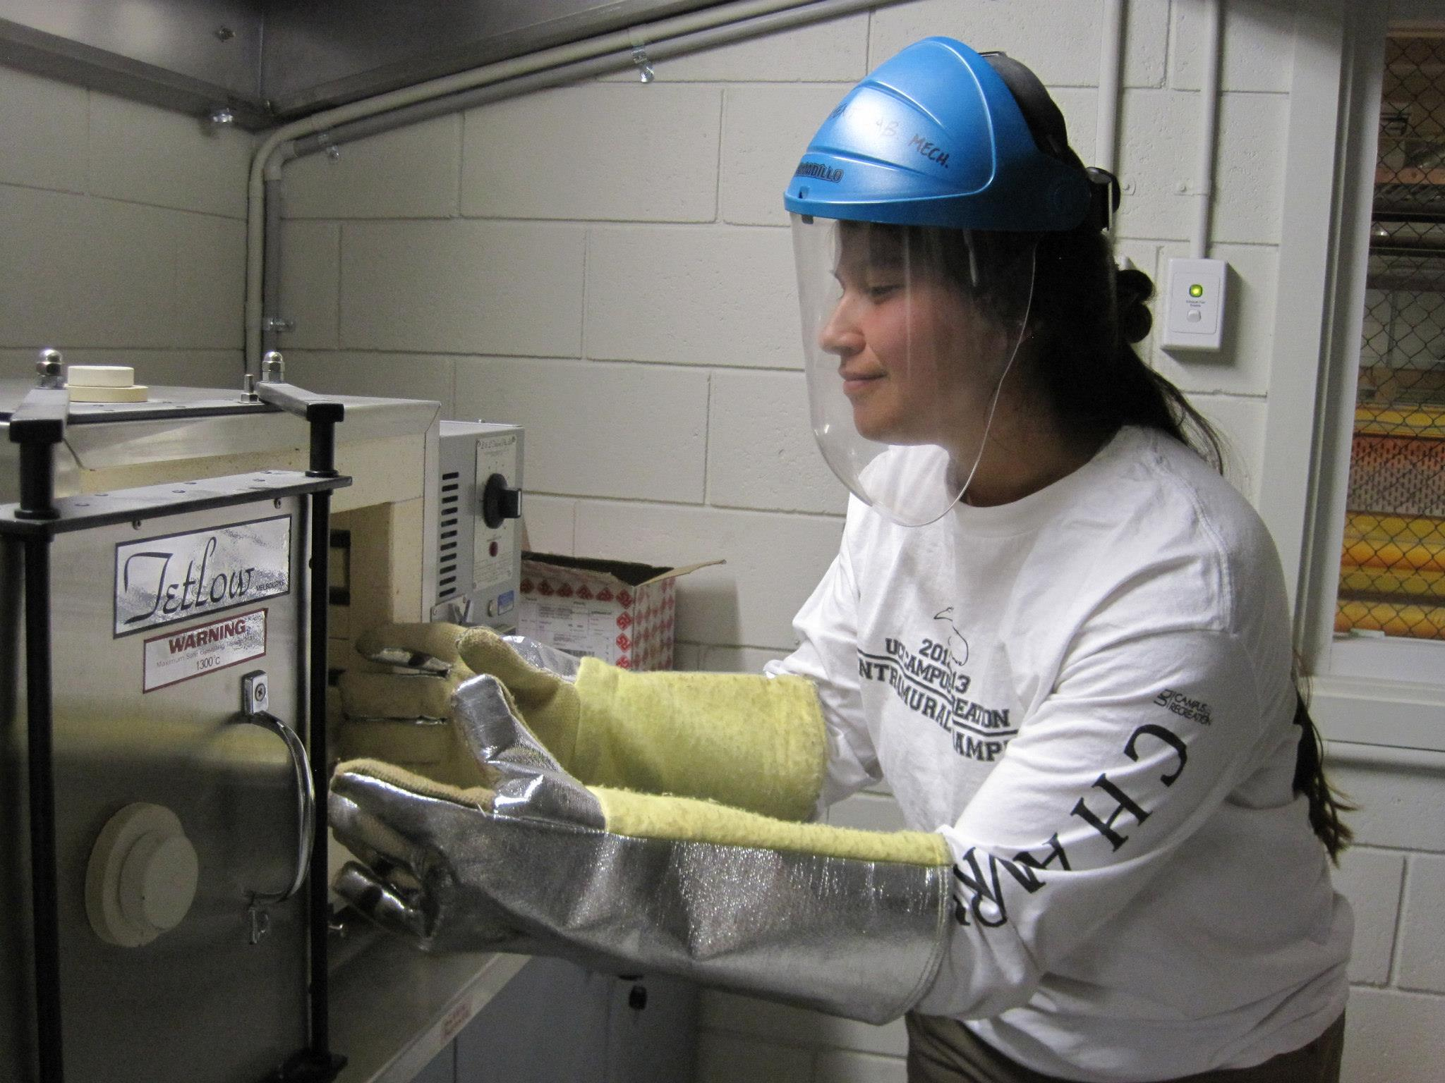
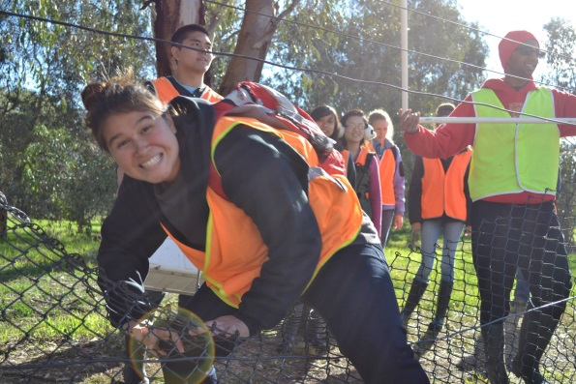
Outline
Objectives
Background
Methods
Results
References
Notes:
AMANDA

Slide 4
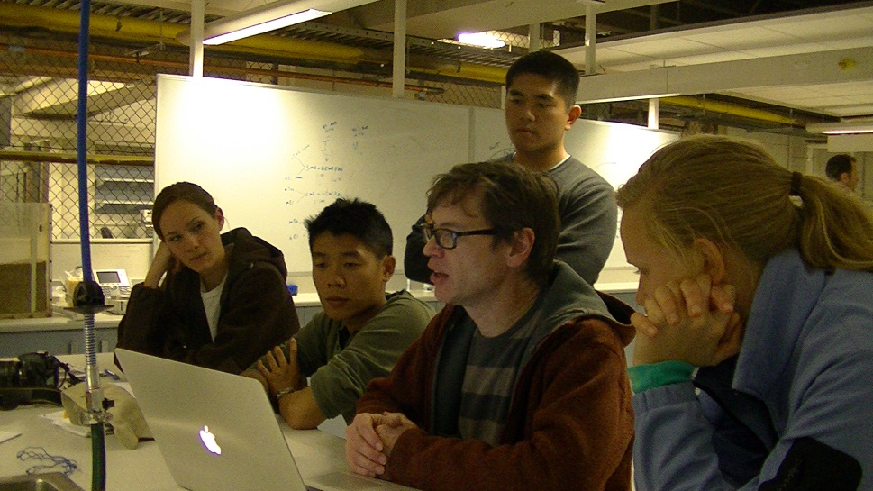
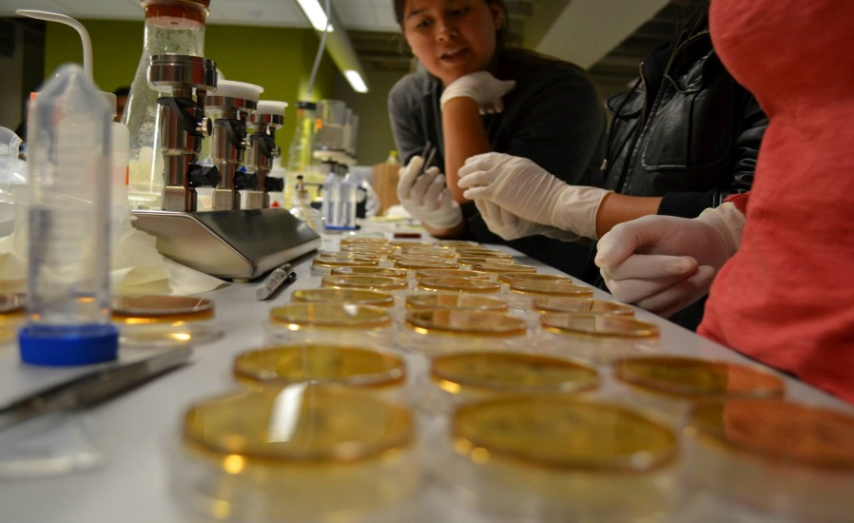
Objectives
To better understand the effectiveness of biofilters and wetlands in filtering storm water by analyzing various water quality parameters.
Compare wetland and biofilter results with the Melbourne Water Class C Standards.
Propose possible explanations to observed trends
Notes:
AMANDA
Define Biofilters and Wetlands – Talk about water flow paths in each system (compare similarities and differences between the systems).
To better understand the effectiveness of biofilters and wetlands in filtering storm water by analyzing various parameters.
Compare the results with Class C standards set by Melbourne Water.

Slide 5
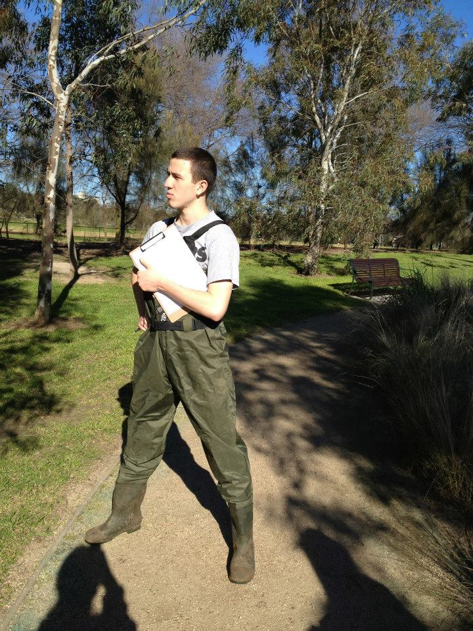
Outline
Objectives
Biofilters VS Wetlands
Methods
Results
References
Notes:
KEVIN

Slide 6
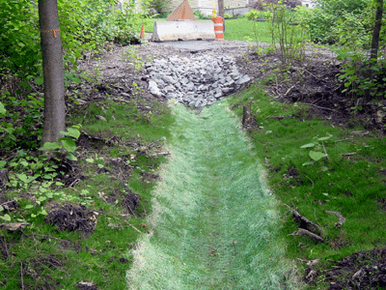
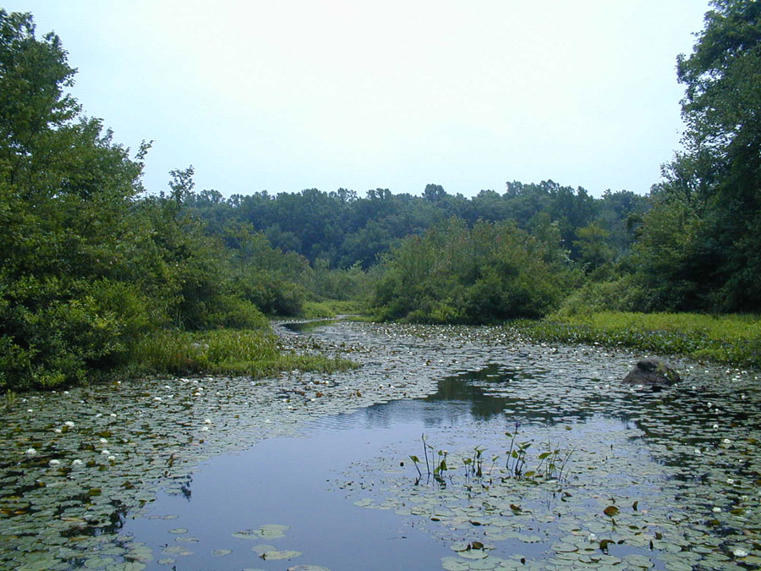
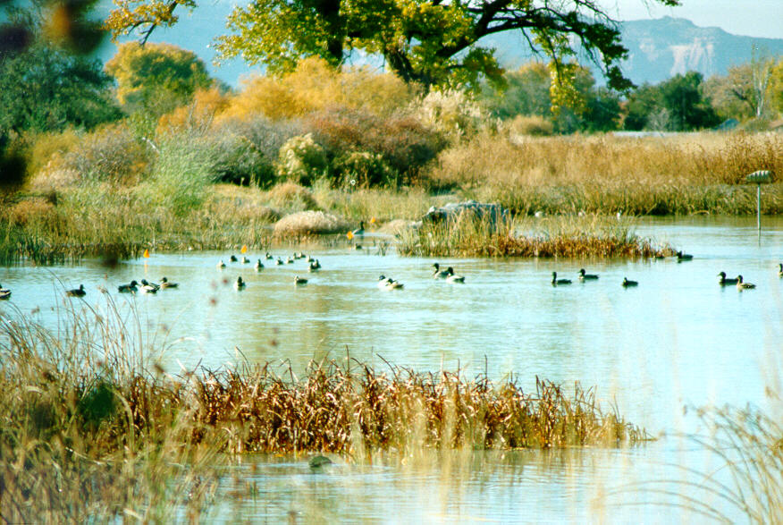
Biofilters VS Wetlands
Design
Flow Paths
Application
Effectiveness
Notes:
KEVIN
Should we include a part about why Australia is a good place to conduct this research?
Due to the Millennium drought, drastic infrastructural changes needed to made to use water more efficiency. One way was to implement biofilters and wetlands that filter incoming stormwater as a initial treatment before it is diverted to storage or further treatment. Ideally, these constructed wetlands and biofilters will filter water to within Class C standards. Class C standards, set by Melbourne Water, are a set of parameters to define water quality. Water defined as Class C can be used for urban non-potable public access purposes, and agriculture for foods that must first be cooked or processed before consumed.

Slide 7
Wetlands
Constructed wetlands mimic the function of natural wetlands
Riparian species
Buffer Between Upland and aquatic
High level of biodiversity
Fig.1: Diagram showing horizontal flow
Notes:
KEVIN
Wetlands occur naturally and serve as a buffer between upland environments and aquatic environments. Wetlands are typically inhabited by riparian species and are important in protecting aquatic environments from sedimentation.
Water flows through a constructed wetland or treatment wetland horizontally. As a result they are large and expansive but not very deep.
Wetlands have a greater biodiversity but lower vegetation density.

Slide 8
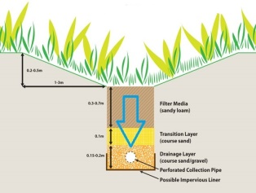
Biofilters
Vertical flow Path
Layered Media designed to filter stormwater
Compact and space efficient.
Effluent is treated further or stored
Fig. 2: Diagram of Verical Flow
Notes:
KEVIN
Biofilters filter water vertically through specifically designed layered media.
The water typically gets filtered into a perforated pipe where it is then transported for further treatment or storage.
Because water is filtered vertically, biofilters can be made in more compact spaces.
Biofilters start with only a few species but have high vegetation density to further slow down the flow of stormwater.

Slide 9
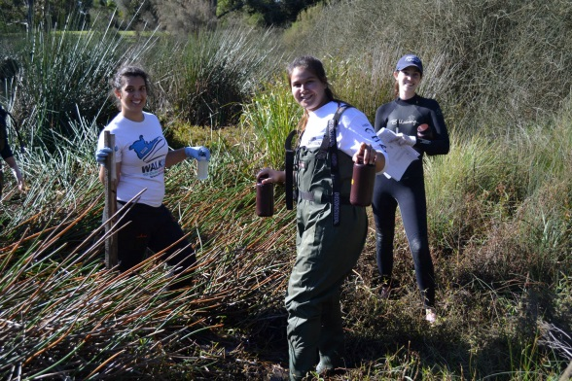
Outline
Objectives
Biofilters VS Wetlands
Methods
Results
References
Notes:
SAM

Slide 10
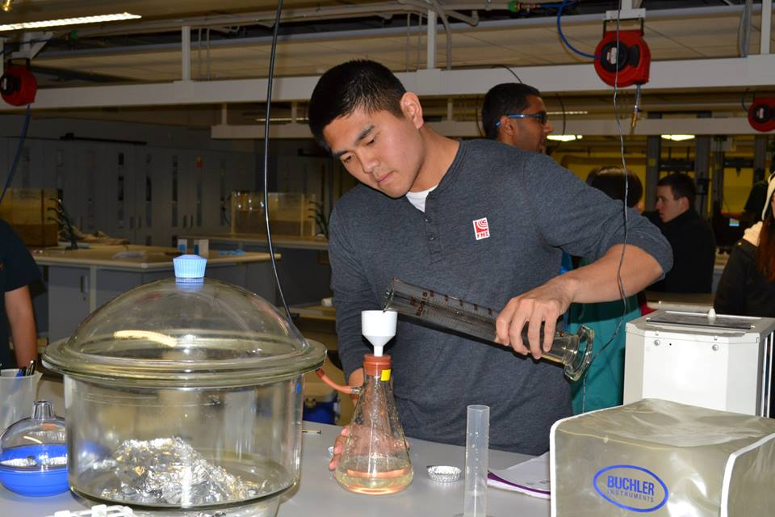
Methods
5 sites visited
2 biofilters (Wikes, Hereford Road)
3 wetlands (Hampton, Royal, Lynbrook)
• Measured 4 parameters
Total Suspended Solids
Escherichia Coli
Chlorophyll
Dissolved Oxygen
Notes:
SAM
5 sites- bio and wet
Took water samples and in lab measured TSS EC Chloro
Sensor sampled DO

Slide 11
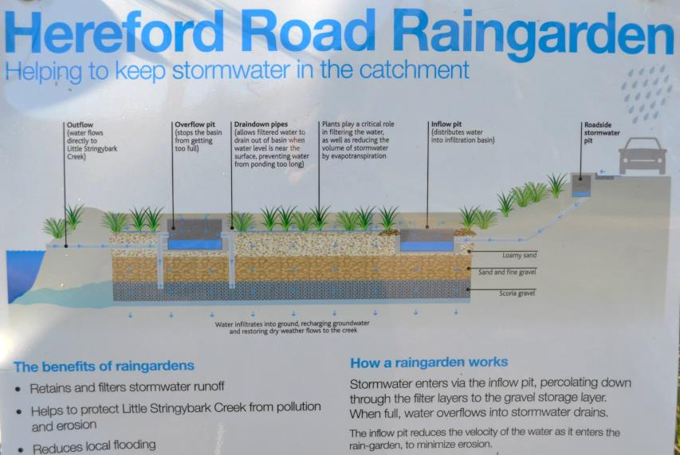
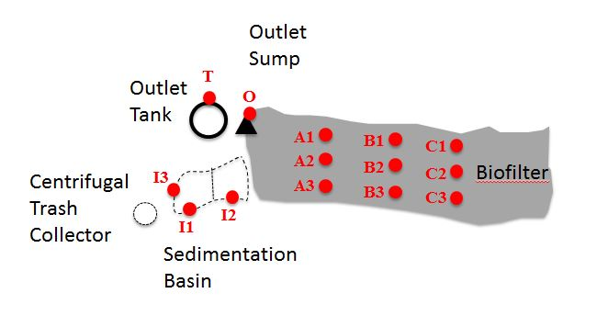
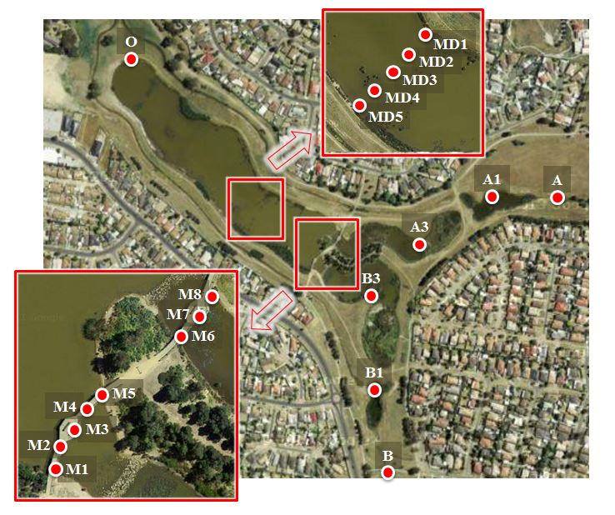
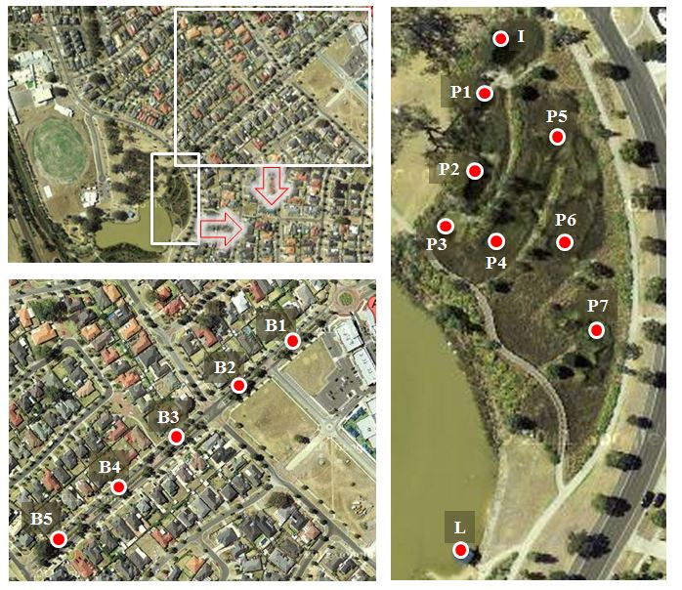
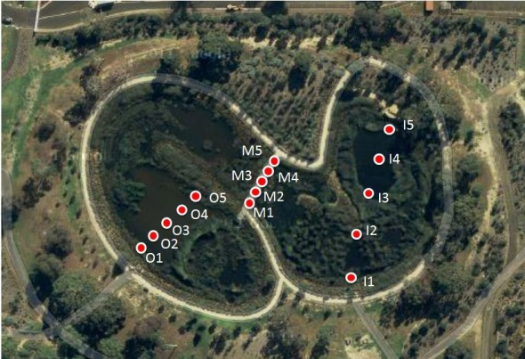
Hereford Road Biofilter
Wikes Biofilter
Royal Gardens Wetlands
Hampton Park Wetlands
Lynbrook Estates Biofilter/Wetlands
Notes:
Sam
Here are maps of sites visited
For our sampling, we divided sites into sections of inlet, outlet, and some middle cross sections which are transects.
For the purpose of our data, we averaged the values at the inlet and outlet and compared them in order to see how certain parameters changed

Slide 12
Hereford Road Biofilter
Wikes Biofilter
Royal Gardens Wetlands
Hampton Park Wetlands
Lynbrook Estates Biofilter/Wetlands

Slide 13
Class C Standards
Standards created and used by Melbourne Water
Parameters to help define the quality of water
Used for non-potable purposes and irrigation
Notes:
SAM
We wanted to compare our measured paramets with Melbourne’s class c standards of water quality. These water quality standards are for non potable puposes such as irrigation of crops and agriculture. The two parameters we analyzed that we compared to class c standards are TSS and E coli
Class C standards of Melbourne for certain parameters to access water quality for non-potable purposes
Class C water is used for non-potable purposes as well as irrigation of crops where the food must first be processed or cooked before consumed.

Slide 14
Class C Standards
Standards created and used by Melbourne Water
Parameters to help define the quality of water
Used for non-potable purposes and irrigation
Notes:
SAM
We wanted to compare our measured paramets with Melbourne’s class c standards of water quality. These water quality standards are for non potable puposes such as irrigation of crops and agriculture.
The two parameters we analyzed that we compared to class c standards are TSS and E coli. E coli specifically is a good indicator of fecal bacteria in water
Class C standards of Melbourne for certain parameters to access water quality for non-potable purposes
Class C water is used for non-potable purposes as well as irrigation of crops where the food must first be processed or cooked before consumed.

Slide 15
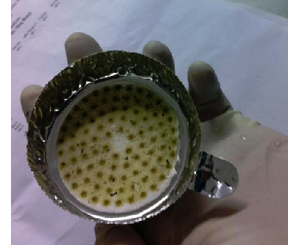
Results – Total Suspended Solids
TSS
Standards
Biofilters VS Wetlands
Fig. 3: Combusted TSS Sample
Notes:
AMANDA
~Total Suspended Solids are a combination of silt, decaying matter, and even industrial waste and sewage.
~The Clean Water Act classifies total suspended solids as pollutants.
~Constructed wetlands and biofilters are designed to reduce TSS, clear turbidity, and allow dissolved oxygen to increase.
~ As you can see here, both biofilters were successful in significantly reducing total suspended solids and met the class c standard which is to be less than 30 mg/.
~The wetland LYNBROOK showed a decrease in TSS, but did not meet class c standard.
~Royal Gardens had no significant difference, but met the standard
~Hampton Park demonstrated more decaying matter in the outlet even though it initially had low levels in both inlets.

Slide 16
Results – Total Suspended Solids
TSS
Standards
Biofilters VS Wetlands
Fig. 3: Combusted TSS Sample
Notes:
AMANDA
~Total Suspended Solids are a combination of silt, decaying matter, and even industrial waste and sewage.
~The Clean Water Act classifies total suspended solids as pollutants.
~Constructed wetlands and biofilters are designed to reduce TSS, clear turbidity, and allow dissolved oxygen to increase.
~ As you can see here, both biofilters were successful in significantly reducing total suspended solids and met the class c standard which is to be less than 30 mg/.
~The wetland LYNBROOK showed a decrease in TSS, but did not meet class c standard.
~Royal Gardens had no significant difference, but met the standard
~Hampton Park demonstrated more decaying matter in the outlet even though it initially had low levels in both inlets.

Slide 17
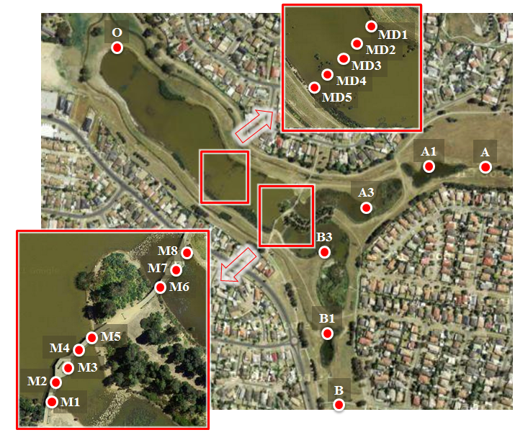
HAMPTON PARK

Slide 18
Results – Total Suspended Solids
TSS
Standards
Biofilters VS Wetlands
Fig. 3: Combusted TSS Sample
Notes:
AMANDA
~Total Suspended Solids are a combination of silt, decaying matter, and even industrial waste and sewage.
~The Clean Water Act classifies total suspended solids as pollutants.
~Constructed wetlands and biofilters are designed to reduce TSS, clear turbidity, and allow dissolved oxygen to increase.
~ As you can see here, both biofilters were successful in significantly reducing total suspended solids and met the class c standard which is to be less than 30 mg/.
~The wetland LYNBROOK showed a decrease in TSS, but did not meet class c standard.
~Royal Gardens had no significant difference, but met the standard
~Hampton Park demonstrated more decaying matter in the outlet even though it initially had low levels in both inlets.

Slide 19
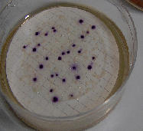
Results - Escherichia Coli (E. Coli)
Fecal Indicator Bacteria
Removal Effeciency
Standards
Fig 4: E. Coli cultures
Notes:
AMANDA
~Microbial contamination in water sources is typically caused by fecal matter. They are a high risk for public health and require monitoring to abide by regulation.
~Constructed wetlands can effectively remove bacteria like Escherichia Coli by up to 90% and even higher removal rates are reported in vegetated systems.
~Royal Gardens showed a remarkable decrease in E. Coli, ultimately meeting the class c standard.
~Although Hampton Park ends up below the regulation limit it actually increases from beginning to end, this could be a result of the excess wildlife inhabitants.

Slide 20
Results - Escherichia Coli (E. Coli)
Fecal Indicator Bacteria
Removal Effeciency
Standards
Fig 4: E. Coli cultures
Notes:
AMANDA
~Microbial contamination in water sources is typically caused by fecal matter. They are a high risk for public health and require monitoring to abide by regulation.
~Constructed wetlands can effectively remove bacteria like Escherichia Coli by up to 90% and even higher removal rates are reported in vegetated systems.
~Royal Gardens showed a remarkable decrease in E. Coli, ultimately meeting the class c standard.
~Although Hampton Park ends up below the regulation limit it actually increases from beginning to end, this could be a result of the excess wildlife inhabitants.

Slide 21
Results - Escherichia Coli (E. Coli)
Fecal Indicator Bacteria
Removal Effeciency
Standards
Fig 4: E. Coli cultures
Notes:
AMANDA
~Microbial contamination in water sources is typically caused by fecal matter. They are a high risk for public health and require monitoring to abide by regulation.
~Constructed wetlands can effectively remove bacteria like Escherichia Coli by up to 90% and even higher removal rates are reported in vegetated systems.
~Royal Gardens showed a remarkable decrease in E. Coli, ultimately meeting the class c standard.
~Although Hampton Park ends up below the regulation limit it actually increases from beginning to end, this could be a result of the excess wildlife inhabitants.

Slide 22
Results - Escherichia Coli (E. Coli)
Fecal Indicator Bacteria
Removal Effeciency
Standards
Fig 4: E. Coli cultures
Notes:
AMANDA
~Microbial contamination in water sources is typically caused by fecal matter. They are a high risk for public health and require monitoring to abide by regulation.
~Constructed wetlands can effectively remove bacteria like Escherichia Coli by up to 90% and even higher removal rates are reported in vegetated systems.
~Royal Gardens showed a remarkable decrease in E. Coli, ultimately meeting the class c standard.
~Although Hampton Park ends up below the regulation limit it actually increases from beginning to end, this could be a result of the excess wildlife inhabitants.

Slide 23
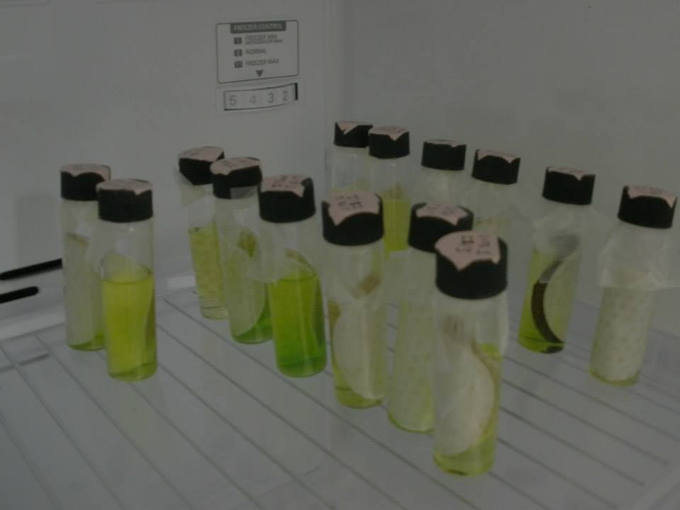
Results - Chlorophyll
Trends
Water pathways
Exposure to sunlight
Biofilters should be used instead of
wetlands in areas where algal blooms is a concern
Fig 5: Processed Chlorophyll samples
Notes:
KEVIN
In general, wetlands show a significant increase in chlorophyll from the inlet to the outlet whereas biofilters show a general decrease. The data for hereford road shows no discernible difference in chlorophyll levels between the inlet and the outlet.
Chlorophyll levels can be used as an indication of algal abundance.
A possible explanation for these trends is the physical size of each system and the filtration method
Wetlands are much larger because they are designed to filter water horizontally.
As a result the water receives more sunlight exposure compared to biofilters
The sunlight drives photosynthetic activity and could explain the higher levels of chlorophyll in wetlands.
Biofilters are better at maintaining low chlorophyll levels and preventing algal growth.

Slide 24
Results - Chlorophyll
Trends
Water pathways
Exposure to sunlight
Biofilters should be used instead of
wetlands in areas where algal blooms is a concern
Fig 5: Processed Chlorophyll samples
Notes:
KEVIN
In general, wetlands show a significant increase in chlorophyll from the inlet to the outlet whereas biofilters show a general decrease. The data for hereford road shows no discernible difference in chlorophyll levels between the inlet and the outlet.
Chlorophyll levels can be used as an indication of algal abundance.
A possible explanation for these trends is the physical size of each system and the filtration method
Wetlands are much larger because they are designed to filter water horizontally.
As a result the water receives more sunlight exposure compared to biofilters
The sunlight drives photosynthetic activity and could explain the higher levels of chlorophyll in wetlands.
Biofilters are better at maintaining low chlorophyll levels and preventing algal growth.

Slide 25
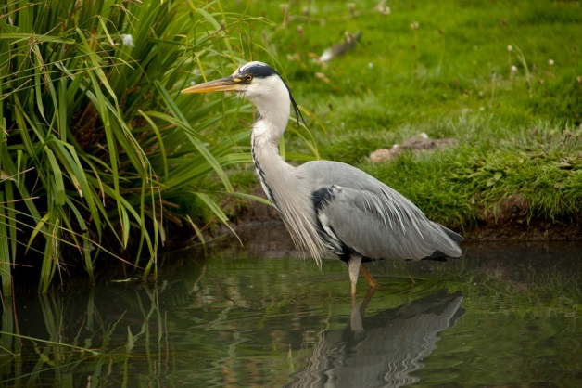
Results – Dissolved Oxygen
Wetlands
DO higher in outlets compared to inlets
High DO levels allow ecology to thrive
Biofilers
Wicks Reserve DO level low in outlet (subterranean sump)
Hereford Road Do level high in outlet (little Stringy Bark Creek)
Subterranean biofilter outlets may promote lower DO concentrations
Notes:
SAM
DO good indicator of water quality
Wetlands DO was high and increased
Normally wetlands organisms would consume DO, and we would expect it to decrease
However DO levels went up, which is great and allows ecosystems to thrive and adds aesthetic purposes to these wetlands (pretty birds eat fish)
Biofilters, wikes decreased subterranean sump outlet
Hereford road increase creek outlet
Subterranean outlets lower DO, less wildlife
In all wetlands, DO was higher in outlets compared to inlets
At Wicks Reserve Biofilter, DO was low in the outlet (a subterranean sump)
At Hereford Road Biofilter, DO was high in the outlet (little Stringy Bark Creek)
Subterranean biofilter outlets may promote lower DO concentrations
DO and CHL appear correlated across all sites, perhaps suggesting production of oxygen by photosynthesis
Dissolved Oxygen (DO) is a good indicator of water quality..
Wetlands support large ecosystems so high dissolved oxygen levels are especially important, hence the large increase of DO.
Biofilters reduce DO levels significantly because the filtration media is underground.
What is interesting is in Lynbrook the Chlorophyll levels indicate a Eutrophic environment while dissolved oxygen data seems to suggest the opposite.

Slide 26
Chlorophyll
Dissolved Oxygen

Slide 27
Chlorophyll
Dissolved Oxygen
Notes:
KEVIN
The data represents a snapshot of the wetlands in a specific point in time.
Based on the data we can confidently say that these wetlands are not Eutrophic because these high chlorophyll levels are accompanied by high levels of dissolved oxygen.
This suggests that there is a high level of phytoplankton accumulating in the outlet.
What’s interesting is that this trend is consistent throughout all the wetlands we saw which may suggest that either all the wetlands sampled happened to be undergoing a algal bloom or perhaps this is a more permanent phenomenon.

Slide 28
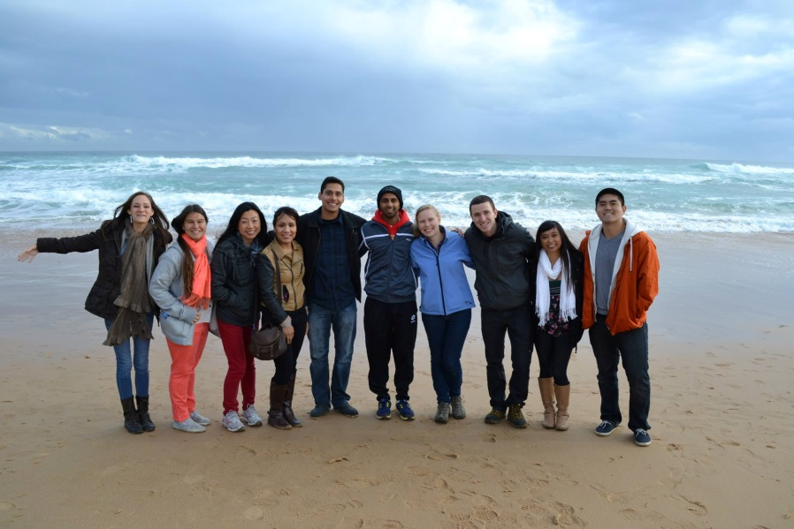
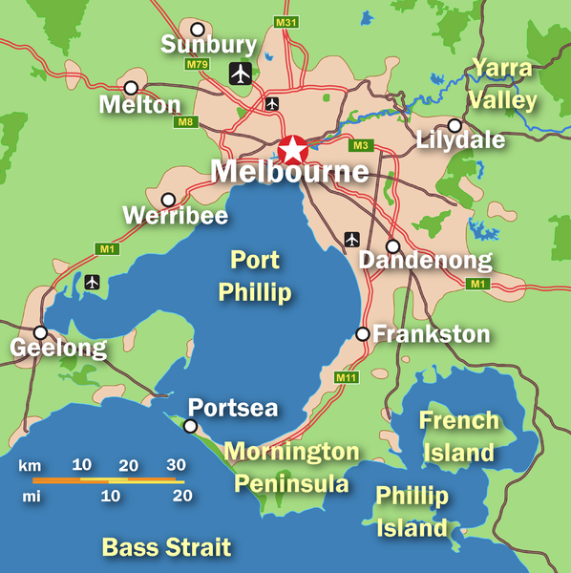
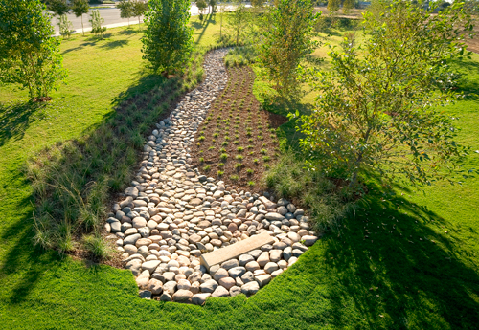
Learning from Australia
Notes:
SAM
We hope that by visiting Australia and studying their water filtration systems and how they have adapted to the Millenium Drought, that we can take what they’ve done right and struggled with and apply it to Southern California where we mostly steal our water from Northern California. Hopefully it doesn’t take a severe drought to change our perception on recycled water. And on that note we would just like to thank you
We hope that by learning how these established systems work we can learn from what was done correctly and avoid potential mistakes that were made.
Additionally, based on this information we can ascertain what systems are better at filtering different pollutants and apply them to regions where inputs of a specific pollutant may be especially high.

Slide 29
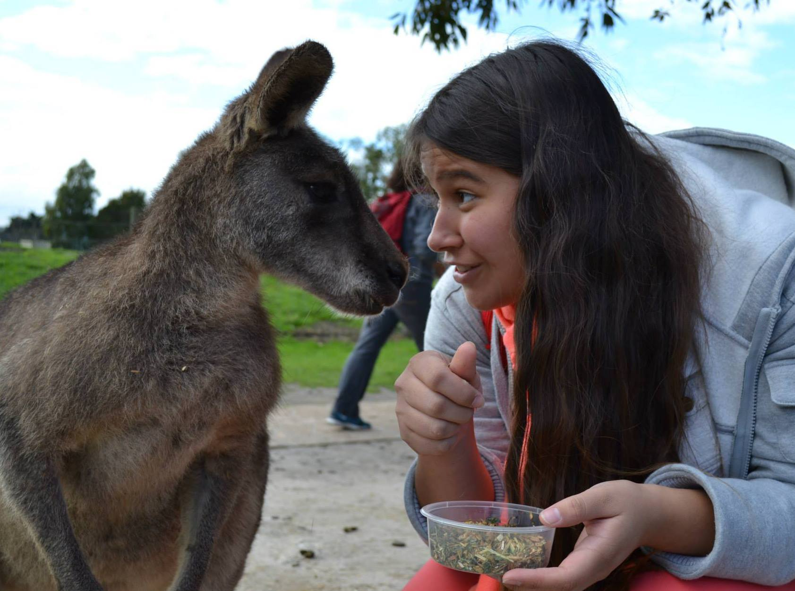
References
Eastern Treatment Plant Inputs and Discharges. (n.d.). Retrieved July 29, 2013, from Melbourne Water
Murphy, S. (n.d.). general Information on Solids.
Martin, R. M. (2012, February 28). Bacterial Source Tracking of E. coli in a Constructed Wetland.
File:Horizontal subsurface flow consructed wetland.png. (n.d.).
Example section of bioretention system. (n.d.). Retrieved from
Rossouw, N. (Ed.). (2003, September 9). Chlorophyll a as indicator of Algal Abundance.
Boyer, J. N. (2009, November). Ecological Indicators.
Shifflett, S. D. (n.d.). Water Quality Indicators: Dissolved Oxygen.
Constructed Treated Wetlands. (2004, August).
Chaudhary, D. S. (n.d.). Biofilter in Water and Wastewater Treatment.

Slide 30
THANK YOU

