Slide 1
Low Energy Options for Making Water from Wastewater
Stanley B. Grant
CEE @ UCI
UCI CEE Affiliates
November 9, 2013

Slide 2
UCI Water PIRE

Slide 3

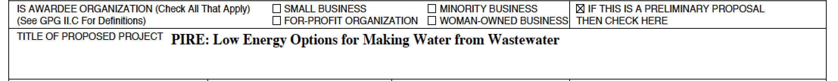
UCI Water PIRE

Slide 4
UCI Water PIRE
?
“Wastewater”
“Fecal”

Slide 5
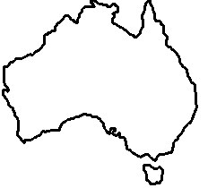
Goulburn River
Key
North-South
Pipeline
Melbourne Central Business District
N
Metropolitan Area
Yarra River
Catchment Areas
Streams
Major Harvesting
Reservoirs
Other Reservoirs
Port Phillip
Bay
Thomson River
Wonthaggi
Desalination Plant
Tarago River
Wonthaggi-
Cardinia Pipeline
km
Bass Strait
0
10
20
Inter-Basin
Transfers
Grant et al. (in press) Environmental Science and Technology

Slide 6
The Millennium Drought: Inflow to Melbourne Reservoirs (1915 to 2012)
Post-drought
average inflow 2010-2012
(617 GL/yr)
Pre-drought
Long term average inflow 1913-1996
(615 GL/yr)
Drought 1997-2009 average inflow
(376 GL/yr)
GL/year
Source: www.melbournewater.com.au

Slide 7

UCI Water PIRE: “Low Energy Options for Making Water from Wastewater”
http://water-pire.uci.edu/

Slide 8
UCI Water PIRE
PIRE=Partnerships for International Research and Education
Funded October 1 2012
~$4.8M over 5 years
  Undergraduate boot camp in urban water sustainability (2 weeks at UCI; 2 weeks in Melbourne; 3 weeks at UCI)
  PhD scholarships for research on urban water sustainability at Monash and Melbourne University (7 to 10)
  Post-doctoral research positions (3 total, two ecologists and one physical scientist)
  Outreach to water community (e.g., UCI Water PIRE session at CASQA annual conference, UCI Water PIRE session at upcoming CASQA workshop on stormwater)
  Development of K-12 curriculum on water sustainability

Slide 9
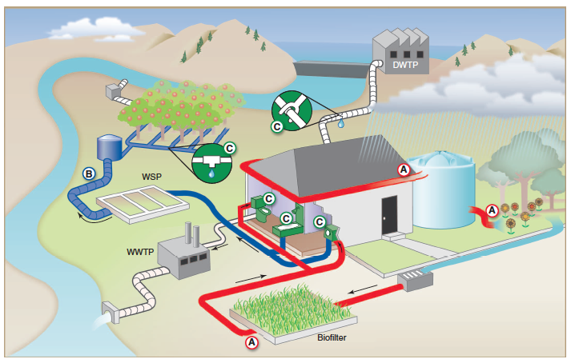
Focus: Stormwater Capture/Retention/Reuse
Grant et al (2012) “Taking the waste out of wastewater” Science 337, 681-686

Slide 10
Research Layers
Layer 1: Pollutant removal and treatment
Layer 2: Public health risks, energy savings and GHG emissions
Layer 3: Regulations, Economic Instruments, Equity, and Policy
Layer 4: Watershed scale processes

Slide 11







Slide 12
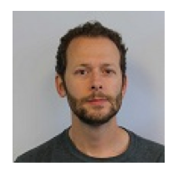
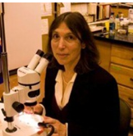
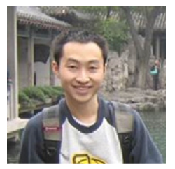
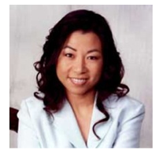
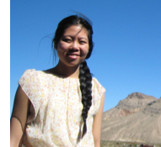
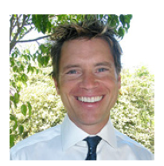
Highlight a couple projects
Greenhouse gas emissions from treatment wetlands
Andrew Mehring
Lisa Levin
Virus removal from stormwater biofilters
Eric Huang
Sunny Jiang
Modeling Drought Response at the City Scale
Kathleen Low
Stanley Grant

Slide 13
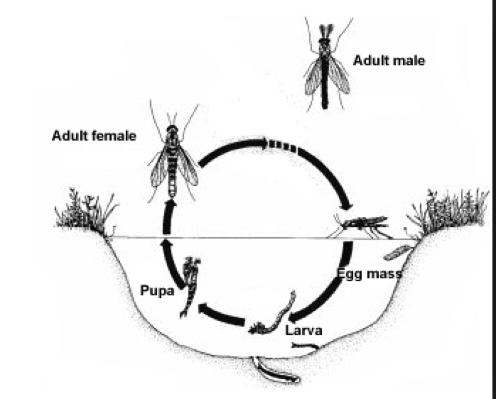
Highlight a couple projects
Greenhouse gas emissions from treatment wetlands
Andrew Mehring
Lisa Levin

Slide 14
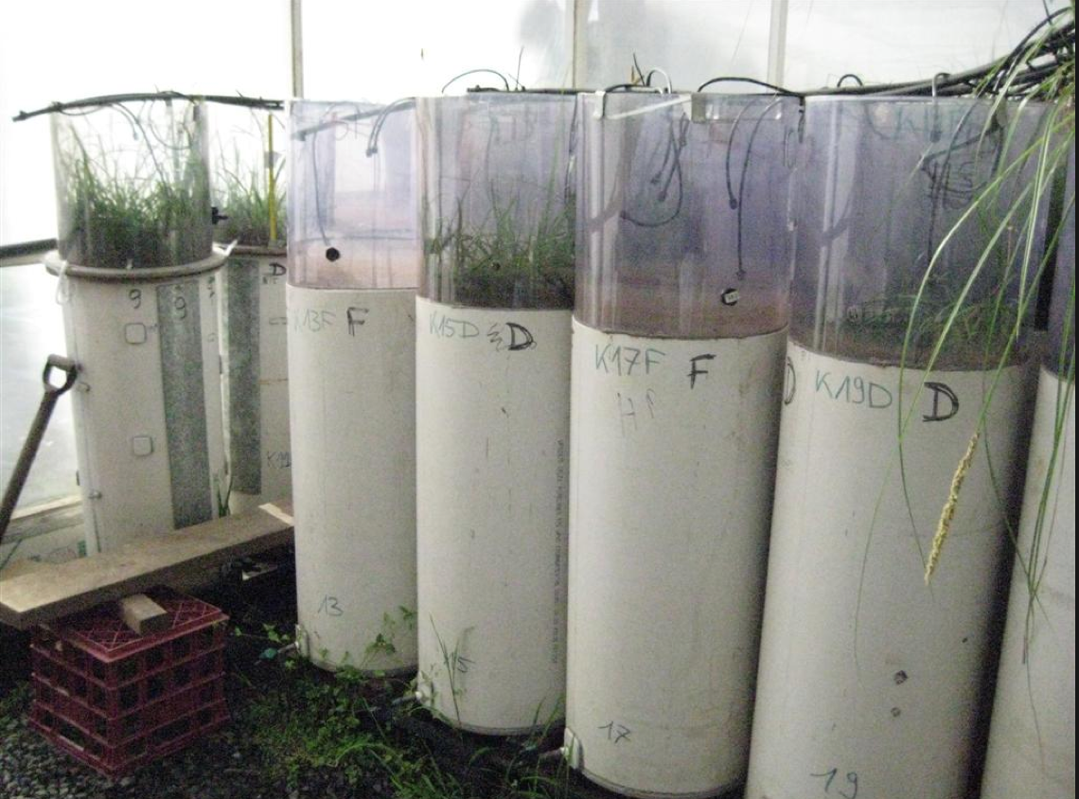
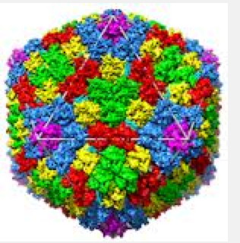
Highlight a couple projects
Virus removal from stormwater biofilters
Eric Huang
Sunny Jiang

Slide 15
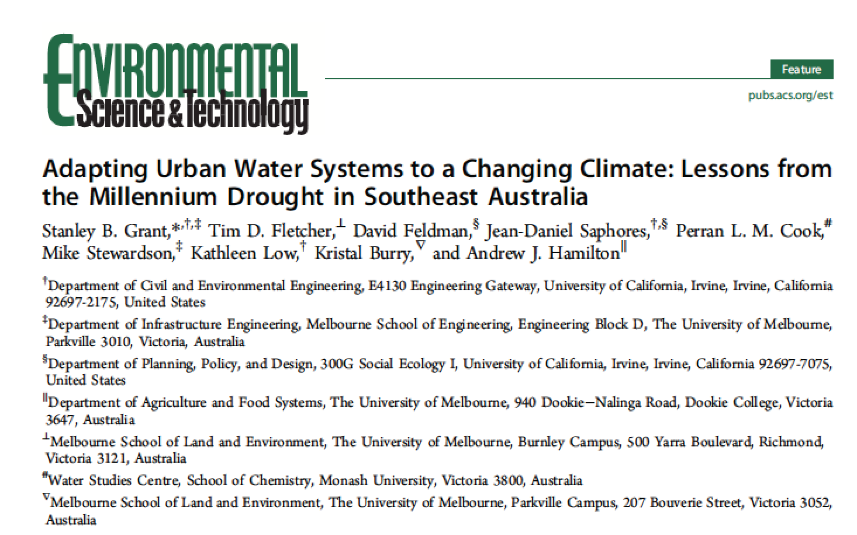
Modeling Drought Response at the City Scale
Kathleen Low
Stanley Grant

Slide 16
Melbourne per capita water consumption

Slide 17
  Melbourne decreased its per capita potable water consumption by a whopping 46% over 12 years (458 to 247 L/person-day)

Slide 18
  Melbourne decreased its per capita potable water consumption by a whopping 46% over 12 years (458 to 247 L/person-day)
  =300 GL of water saved in 2012
  >3X maximum annual capacity of OC GWRS (88 GL)
  >water supplied by LA Aqueduct in 2010/11 (228 GL)

Slide 19
  Melbourne decreased its per capita potable water consumption by a whopping 46% over 12 years (458 to 247 L/person-day)!
  =300 GL of water saved in 2012
  >3X maximum annual capacity of OC GWRS (88 GL)
  >water supplied by LA Aqueduct in 2010/11 (228 GL)
  How did Melbourne do it?

Slide 20
The answer to that question could have implications…
Los Angeles Water Use (2012 annual average)

Slide 21
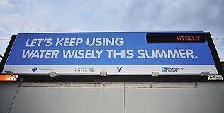
Public Education
Daily updates of reservoir storage levels on TV, radio, newsprints, and billboards
Pic source: www.theage.com.au

Slide 22
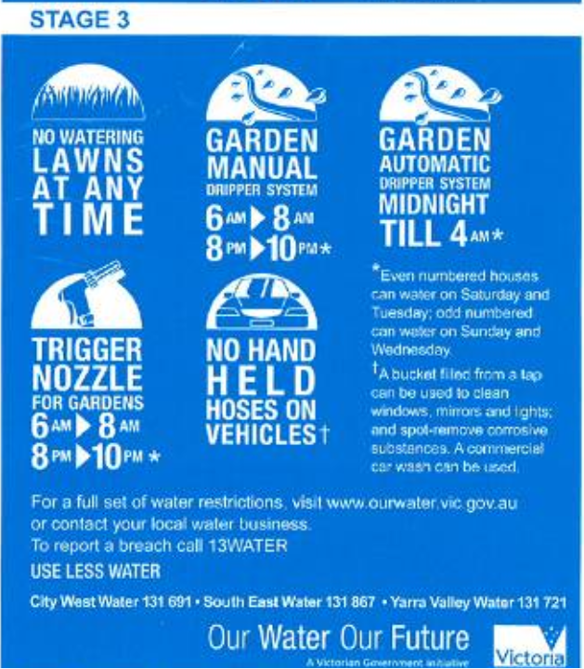
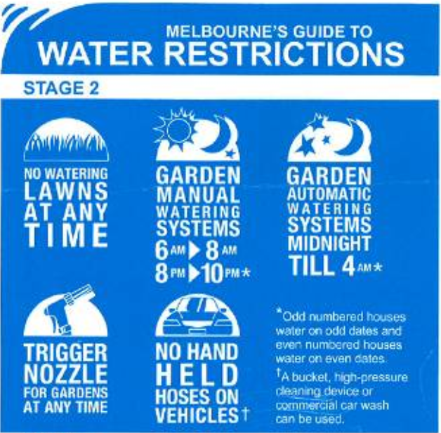
Water Use Restrictions
  Ranged from Stage 1 to Stage 4 restrictions based on water levels in reservoirs
Pic. Source: Melbourne Water, Managing Water Supplies for Climate Change and Variability—Melbourne, Aus.

Slide 23
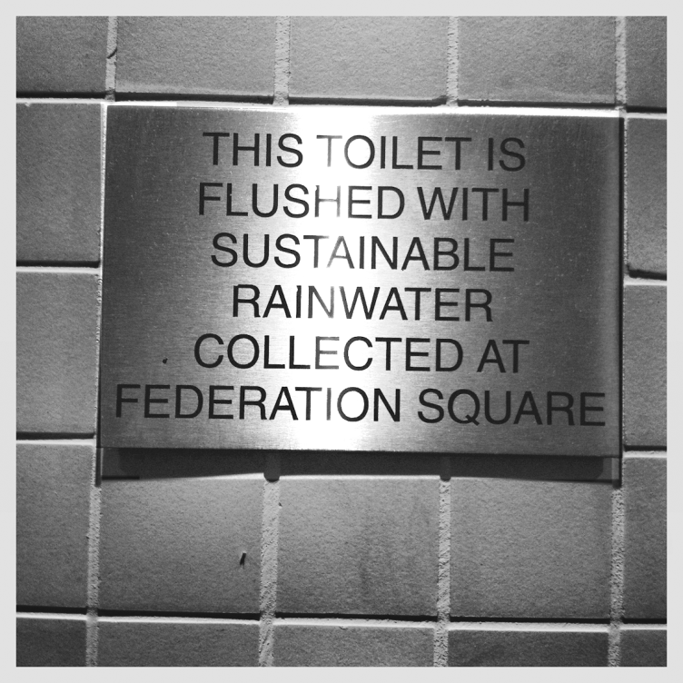
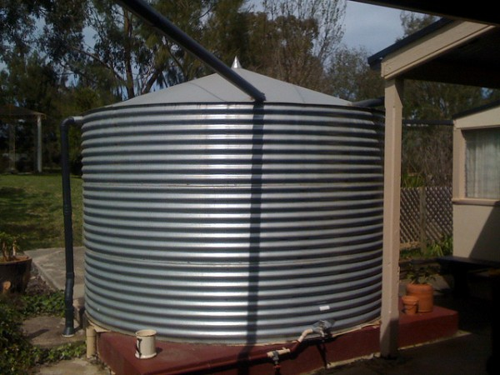
Substitution targets
  Recycled 22.8% of wastewater inflows by 2009/2010
  Stormwater and rainwater harvesting (3% of annual municipal demand)
Rainwater collection water tank. Pic. Source: http://www.sustainablemelbourne.com/tag/rainwater-harvesting/
Grant et al. (in press)

Slide 24
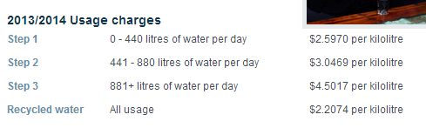

Water Pricing
  Imposed 5% environmental levy
  Introduced 3-tier block tariff pricing (from 2-tier system)
2013/2014 Residential Usage Charges
Source: Yarra Valley Water, www.yvw.com.au
Notes:
Residential charges, businesses have price per annum

Slide 25
Modeling per capita potable water consumption
Pre-drought annual average
Seasonal fluctuation (amplitude reduced by potable substitution)
Climate (precipitation)
Policy interventions:
  Pre-restriction activities (education, pricing)
  Water restrictions (I through VI)

Slide 26
Progress so far…
R²=0.9507

Slide 27
Preliminary Findings
Observed water demand can be modeled using climate and the timing of specific policy interventions
Water savings can be attributed to specific policy interventions (e.g., pre-restriction education campaigns)
Retrospective assessment of what worked and what didn’t in Melbourne
Prospective assessment of what might work in other areas of the world, including southern California

Slide 28
Engineering
Prof. Stanley Grant
Climate
Economics
Prof. Amir AghaKouchak
Prof. Jean-Daniel Saphores
Demand Modeling
Governance
Hydrology
Prof. David Feldman
Prof. Rebekah Brown
Prof. Murray Peel
Dr. Ashmita Sengupta
Ecosystem Services
Prof. Michael Stewardson
Legend
University of California, Irvine
University of Melbourne
Monash University
Southern California Coastal Water Research Project

Slide 29
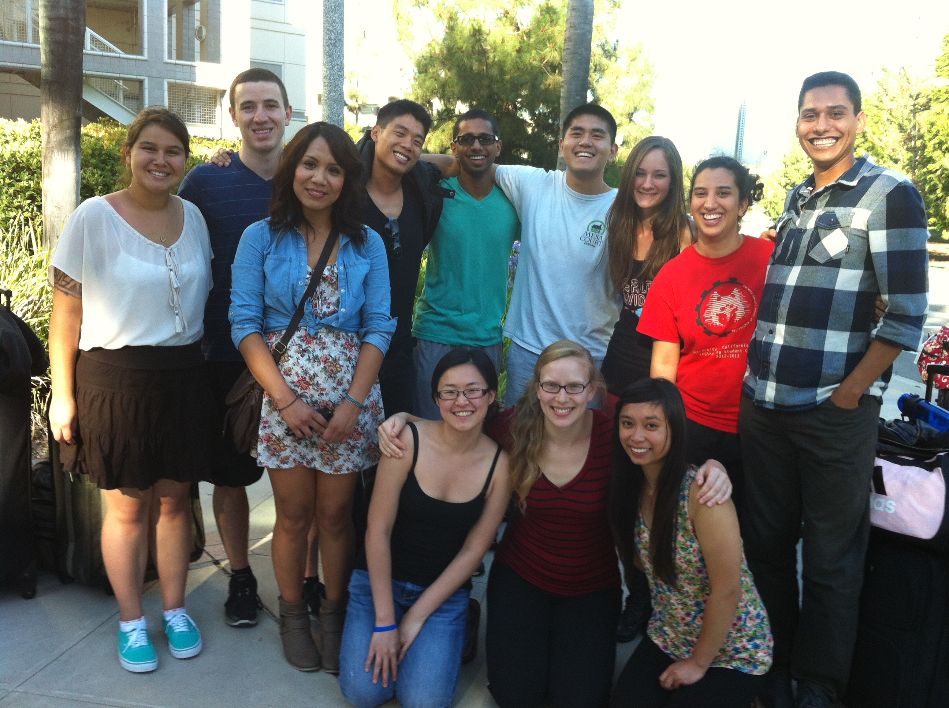
Undergraduate PIRE Program

Slide 30
Undergraduate Field Program
6 field sites in six work days
At each site characterize:
  Dissolved Oxygen, pH, conductivity, temperature
  Fecal Indicator Bacteria (E. coli and Enterococcus) by MF (EPA 1600 and 1603)
  Human pathogens by QPCR
  Chlorophyll, TSS, PAR, nutrients (phosphate, sulphate, and nitrogen species)
  Invertebrate and plant communities

Slide 31
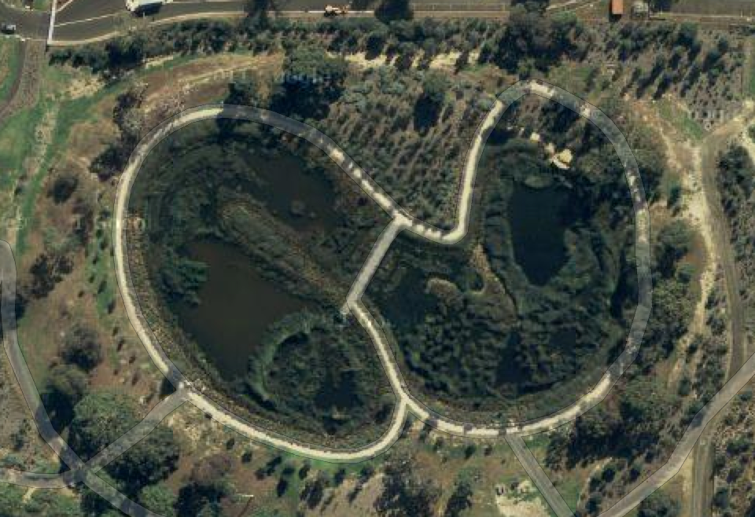
Site #1: Royal Park Constructed Treatment Wetland (B) (July 3, 2013)
I5
M5
I4
M3
M4
O5
M2
I3
O4
M1
O3
I2
O2
O1
I1

Slide 32
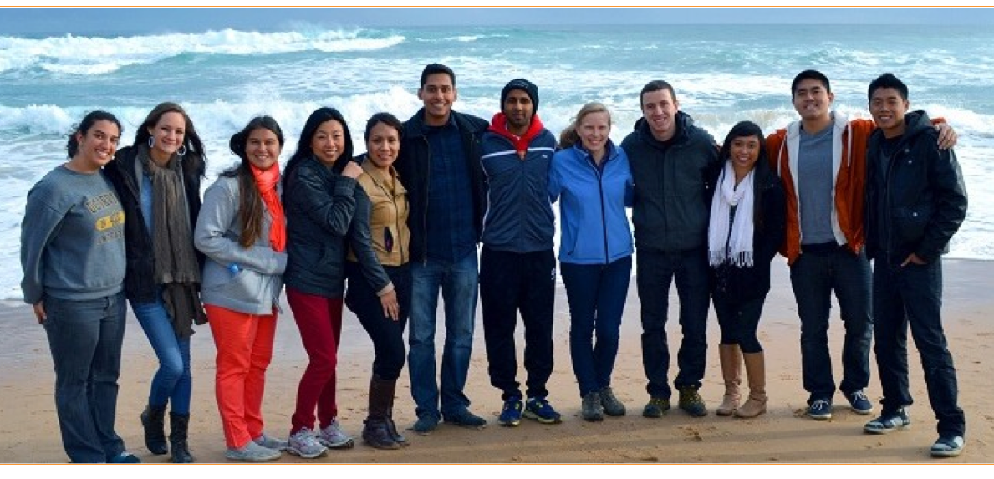
See you Down Under!
http://water-pire.uci.edu/

