Slide 1
Plant communities in wetlands and biofilters
Richard F. Ambrose University of California, Los Angeles

Slide 2
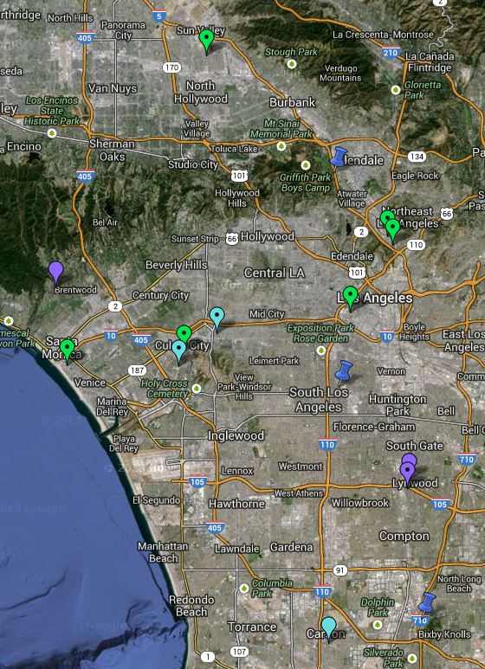
Los Angeles area biofilters
Green Streets
Elmer Avenue
Hope Street
Oros Street
Riverdale Avenue
Bicknell Avenue
Baldwin Avenue
Rain Gardens
Culver City
Carson
Westside Park
Other
Lynwood
Green Street
Rain Garden
Other

Slide 3
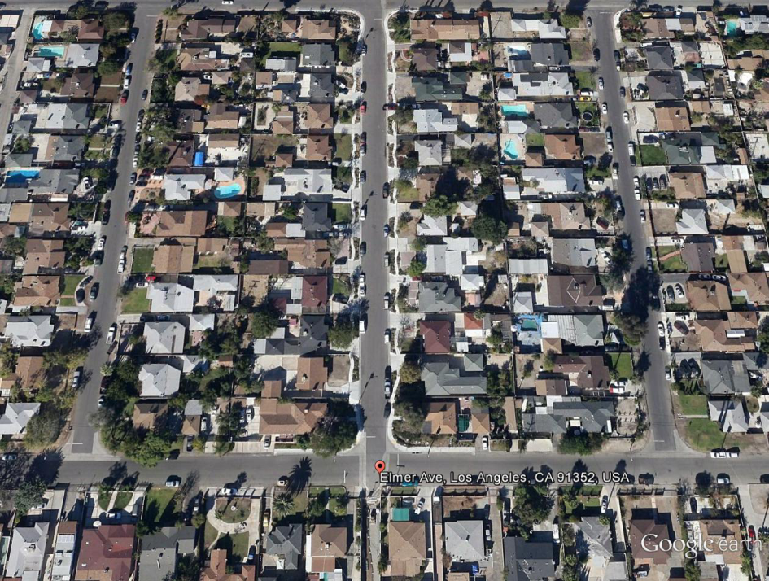
Elmer Avenue

Slide 4
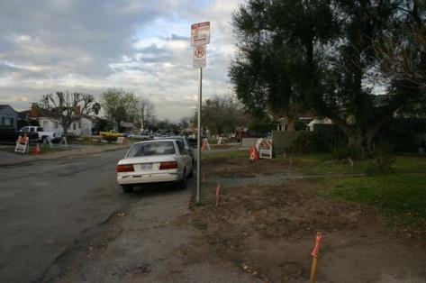
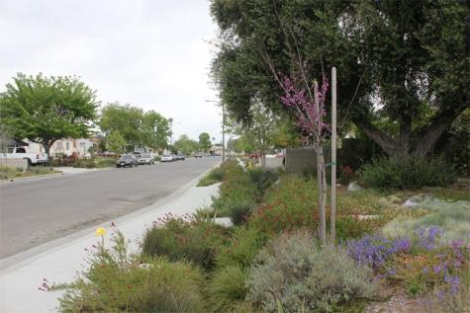
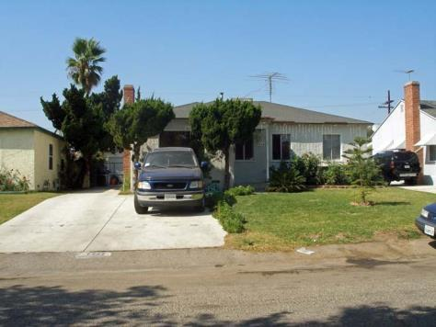
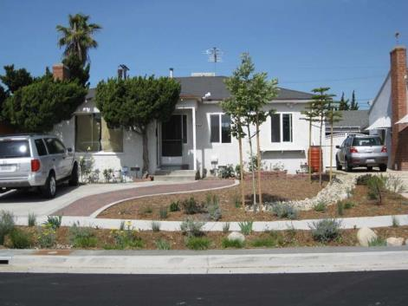
Before Construction
After Construction
Watershedhealth.org

Slide 5
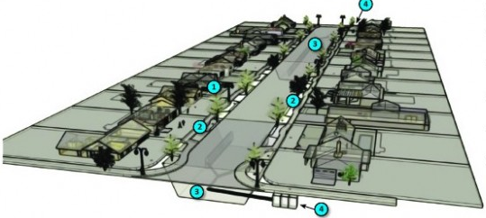
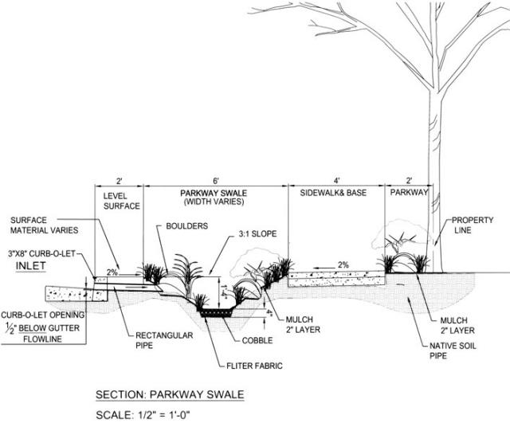
Elmer Avenue Design Elements
Parkway bioswales
Infiltration gallery
Catch basin
www.lafoundation.org

Slide 6
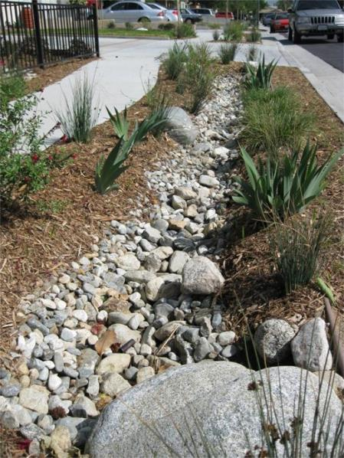
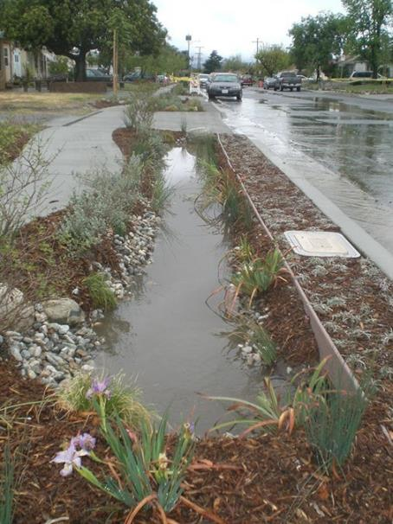
Before and After Rain
www.lafoundation.org

Slide 7
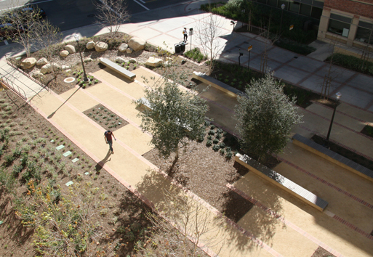
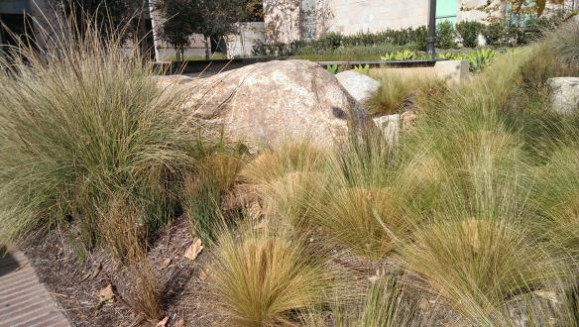
UCLA Biofilters

Slide 8
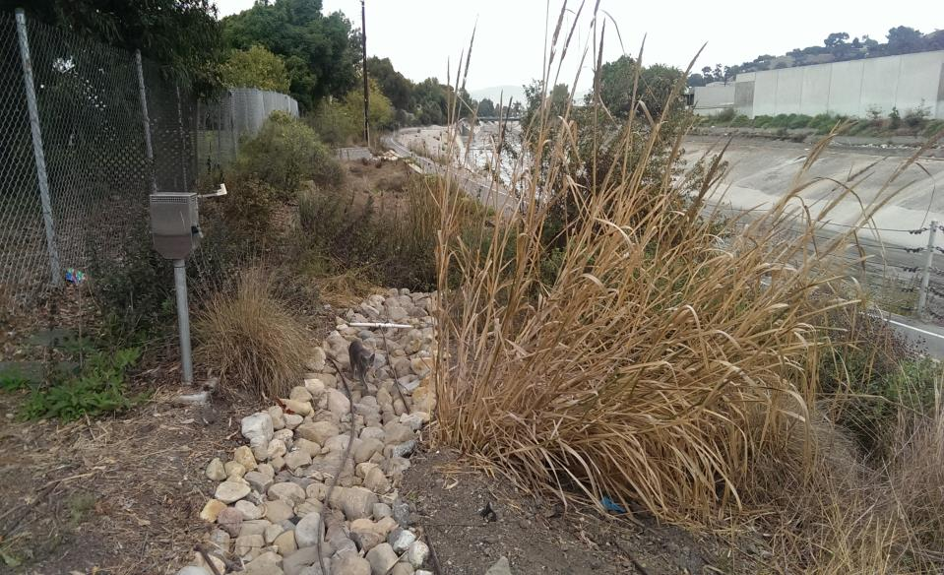
Issues
VEGETATION
Maintenance
Monitoring
Jackson Ave rain garden Photo: B. Winfrey

Slide 9
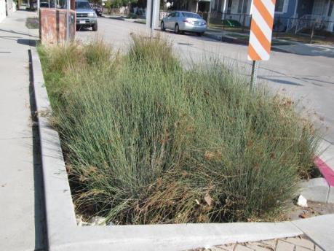
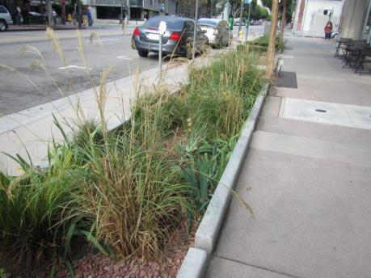
Vegetation
Native species
Maximize ecological value
Tolerate seasonal rainfall
Aesthetics
Effectiveness
Improving water quality, hydrology
Low maintenance

Slide 10
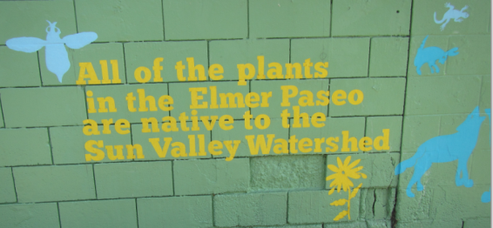
Vegetation Selection in Los Angeles
Generally native species or “climate-appropriate”
Irrigation often used, but ideally would tolerate dry season without irrigation
Criteria for selection of particular species not generally stated
No data on effectiveness of different species or groups of species for improving water quality (in contrast to Australia)
No data on effects on biodiversity (including soil organisms) or other ecosystem services (e.g., carbon sequestration)

Slide 11
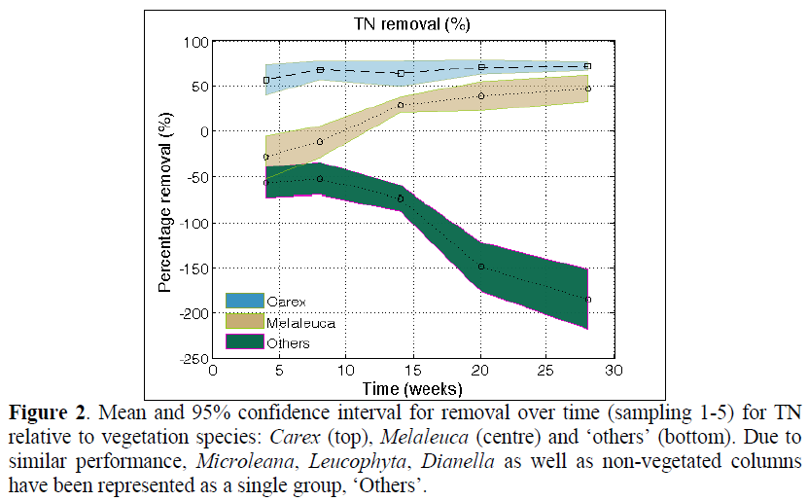
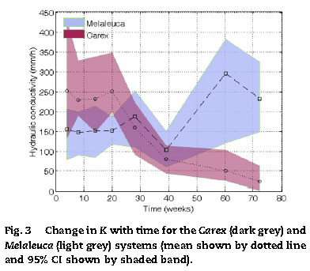
Role of Plants in Biofilters

Slide 12
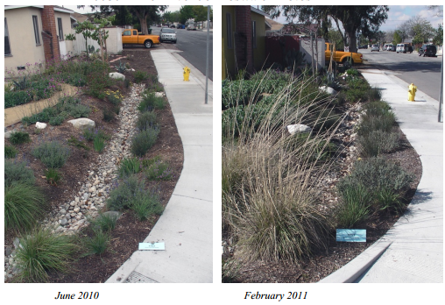
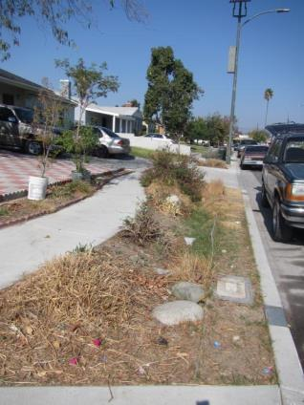
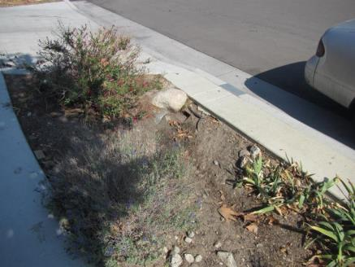
Maintenance
Beldon and Morris 2011
Elmer Ave 2011 report:
Plant survival high
Sediments in east side
Some bare spots
2013 observations
November 2013
November 2013

Slide 13
Maintenance
Biofilter design should minimize maintenance requirements
Selection of plant species could reduce maintenance
Roots can influence hydraulic conductivity
There may be a trade-off with pollutant removal
Some species can survive without supplemental water (and maintain attractive appearance)

Slide 14
Monitoring
Need consistent monitoring of biofilter performance
Need better availability of monitoring results
Need well designed experiments to evaluate different factors influencing biofilter effectiveness

Slide 15
Future Plans
Vegetation
Influence of plant species and plant functional traits on biofilter performance
Mesocosms and field trials
Collaboration with Los Angeles agencies/UCLA
Comparison of Australian biofilter design and effectiveness with southern California biofilters
Collaborative studies in Australia
Vegetation management

