Slide 1
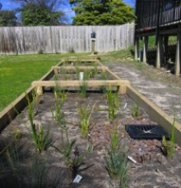
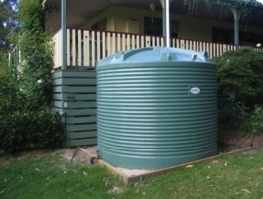
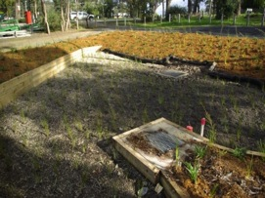
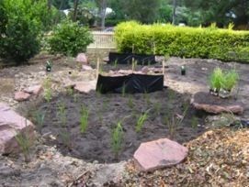
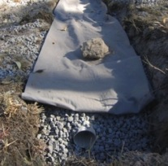
Impacts of catchment-scale flow regime management on channel flooding and geomorphic stability
Brett Sanders (PI UCI)
Jochen Schubert (post-doc UCI)
Tim Fletcher (PI UoM)
Matt Burns (post-doc UoM)
Geoff Vietz (research fellow UoM)
Jasper Kunapo (research fellow UoM)

Slide 2
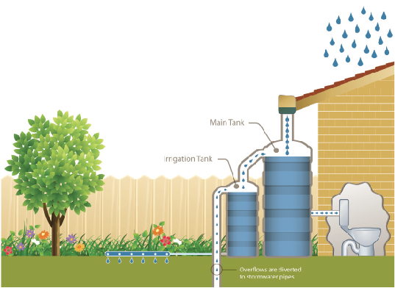
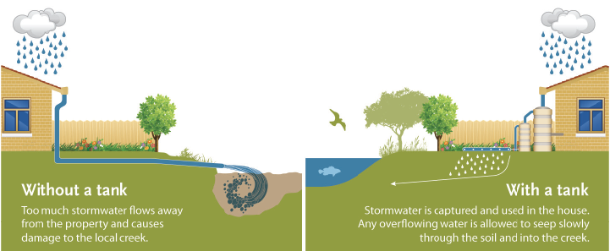
Motivation and Research Objectives
Impervious surfaces in urban areas produce excessive runoff which is directly channeled to streams. To address channel stability and for hydraulic efficiency streams are often hard-lined.
Result is flashy hydrology, loss of water quality, and ecological degradation.
Stormwater control measures (SCMs) are being implemented in the Little Stringybark Creek watershed to disconnect impervious surfaces and deliver appropriate quality and quantity of flows to receiving waters, reducing peak stream flows during heavy rainfall.
Study the effects of implementing a flow-regime management approach on channel flooding and geomorphic stability.

Slide 3
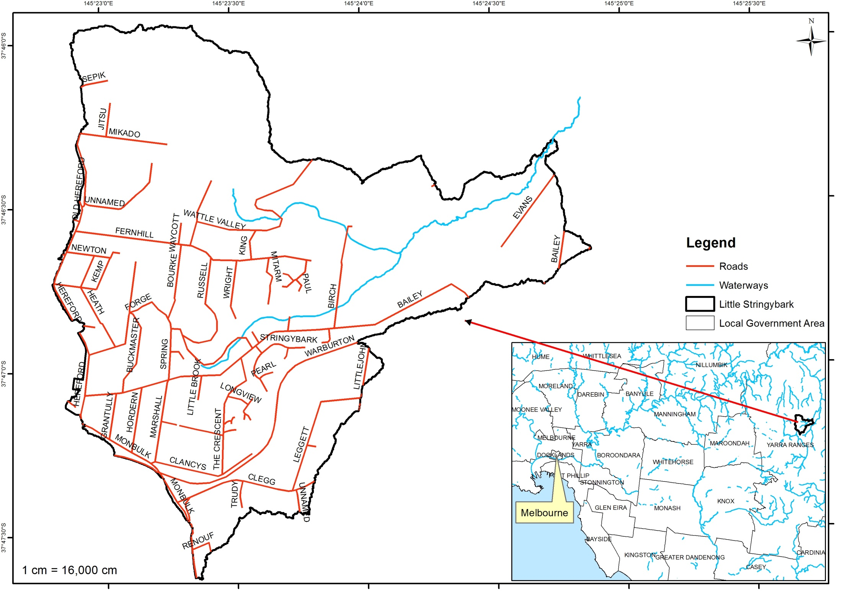
Approach
Four research questions:
What is the impact of SCMs on channel flow velocities and shear stress acting on channels during storm events, and how does the impact vary with the exceedance probability of the storm event?
How does channel and floodplain storage affect peak flow hydrology? What channel and floodplain morphologies are most effective in attenuating downstream hydrologic impacts? Can channels and floodplains be reconfigured to reduce the peak flows experienced by downstream reaches?
How will SCMs affect the occurrence and extent of overbank flows, particularly those flows that represent a hazard to development ("flooding")? Which SCMs appear most promising relative to flood hazard reduction?
Given a hydrologic/hydraulic modeling framework such as MUSIC+BreZo, does it become possible to link specific SCMs to specific flood risk reduction benefits (e.g., shallower flooding at a factory)? Could this information help with the development of more effective SCM incentive programs?
Little Stringybark Creek—a peri-urban catchment, with most development in the headwaters
Model the hydrology of the catchment under different development scenarios
(e.g. current, intensive application of stormwater source control measures, etc)
Hydrologic outputs become input to a hydraulic model which is used to understand local flood impacts

Slide 4
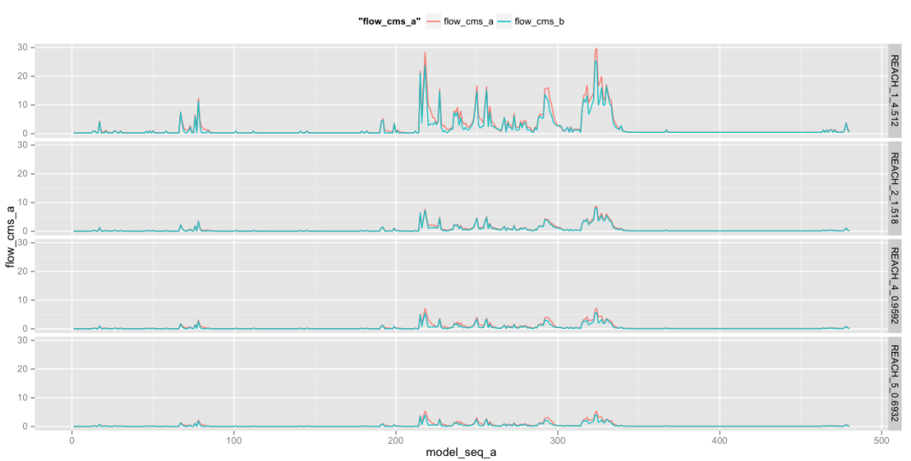
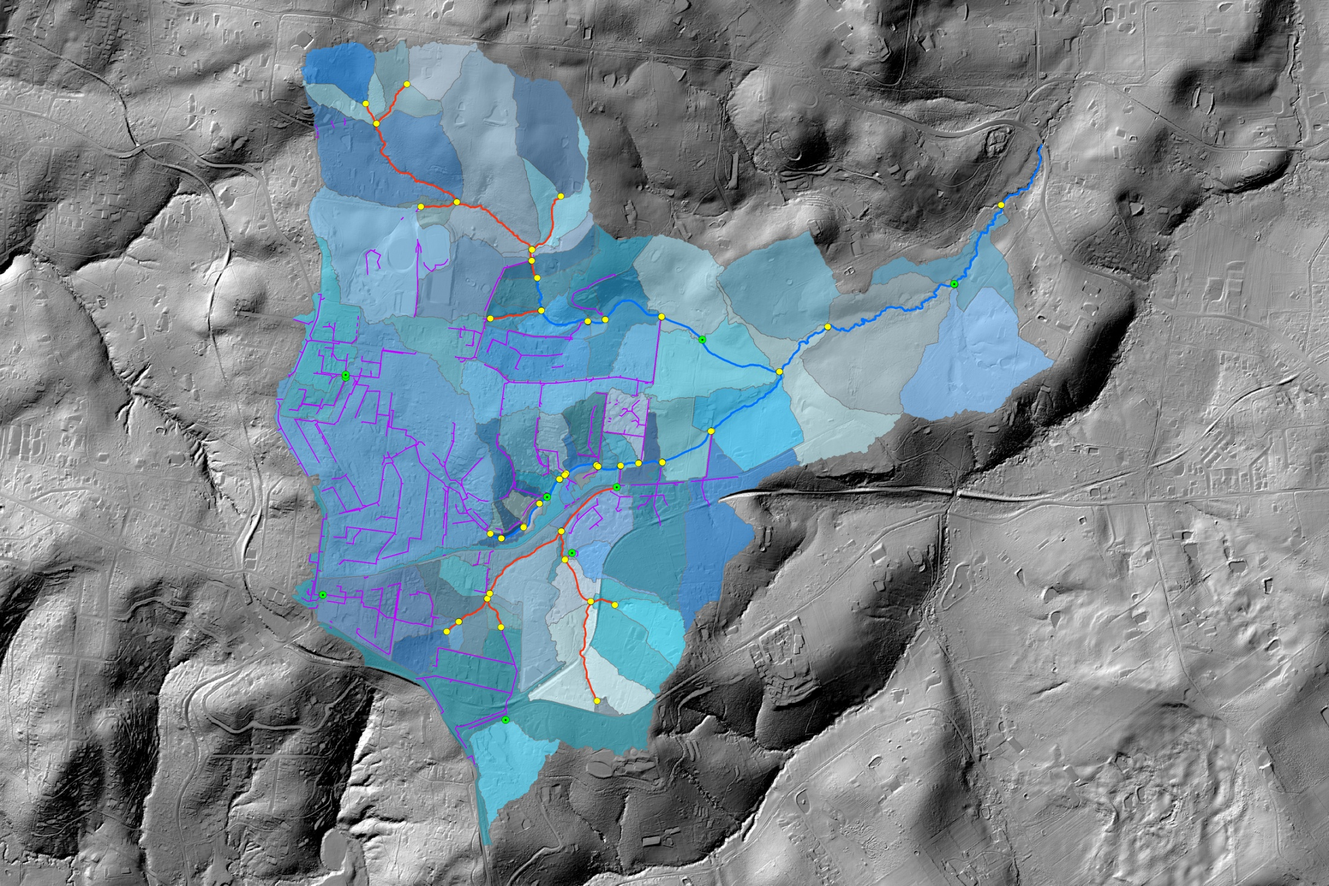
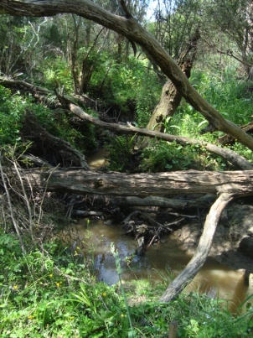
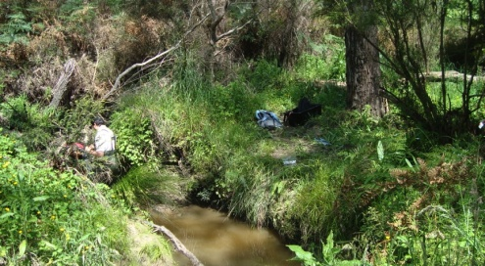
Results to Date (work in progress)
Hydrologic model calibration (UoM)
Stream Conditioning (UCI)
1
2
5
4

Slide 5
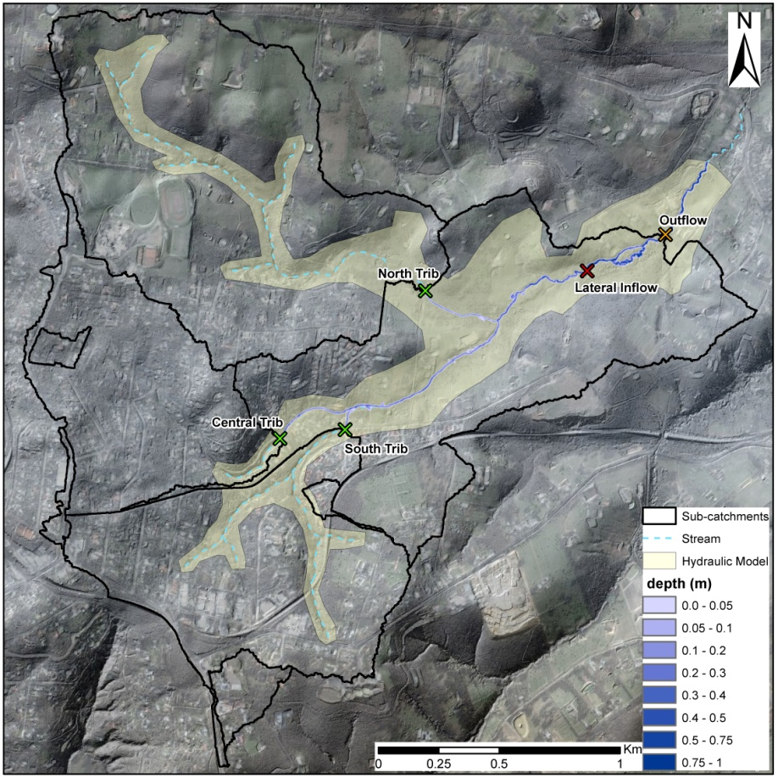
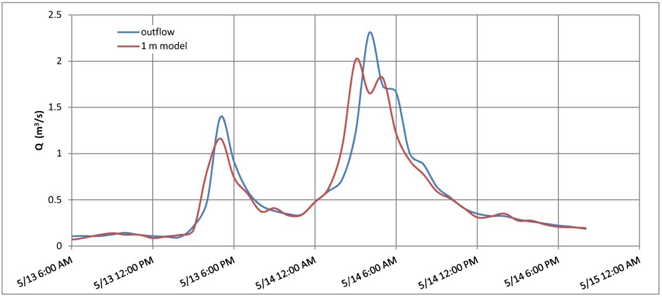
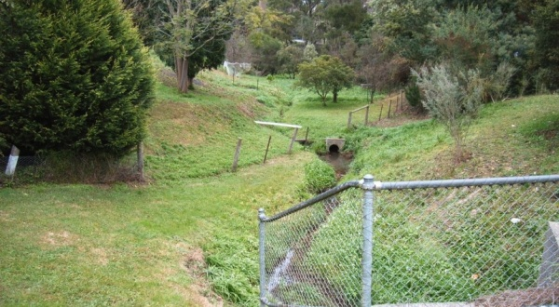
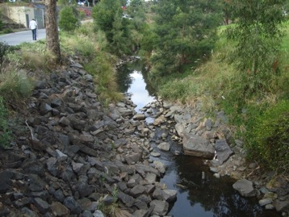
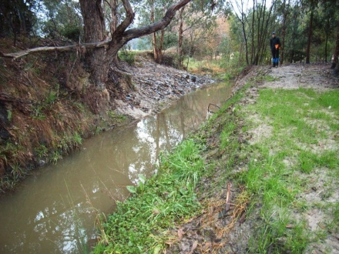
Results to Date (work in progress)
Hydraulic Modeling (UCI)
Still to do:
Complete hydrologic model calibration and provide inflows for various scenarios.
Extend hydraulic model to encompass urban areas.
Validate stream conditioning by measuring distributed channel bottom elevations.
Collect data to parameterize distributed channel surfaces and vegetation and in hydraulic model.
Validate hydraulic model over extended area which includes culvers.
Model event able to produce flood stage.

