Slide 1
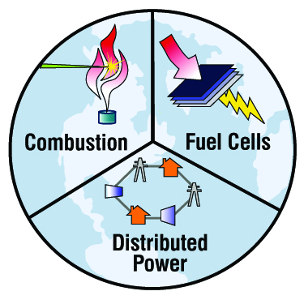
“Energy Opportunities” related to PIRE
Advanced Power and Energy Program
University of California, Irvine
PIRE Workshop
January 25, 2014

Slide 2
Outline
Digester Gas Utilization
Microbial Fuel Cell
Distributed Power
Energy – Water Nexus

Slide 3
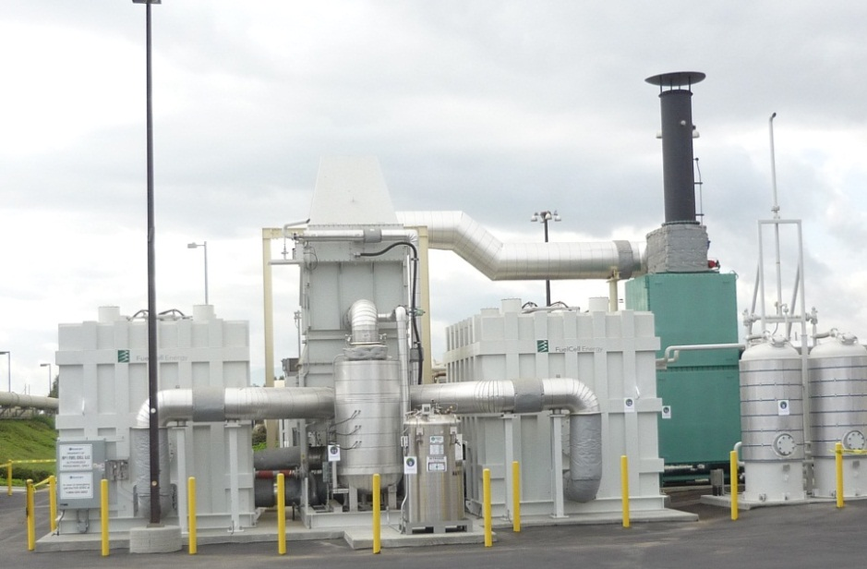
Digester Gas Utilization
DIGESTER
STORAGE
TANK
HEAT
EXCHANGER
ANAEROBIC
DIGESTION
GAS HOLDER
SLUDGE
ADG
HOT
WATER
HIGH-T
FUEL CELL
FUEL
TREATMENT
BOILER
AC
POWER
RENEWABLE

Slide 4
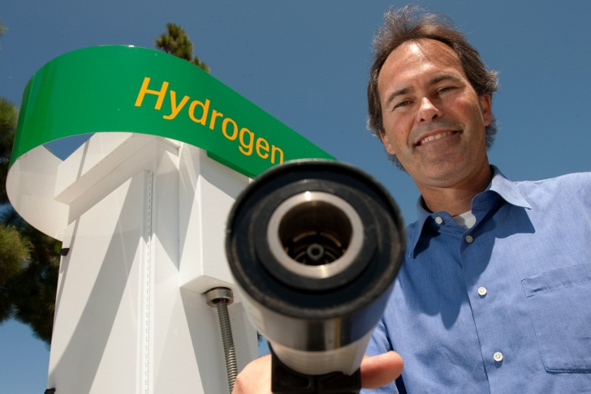
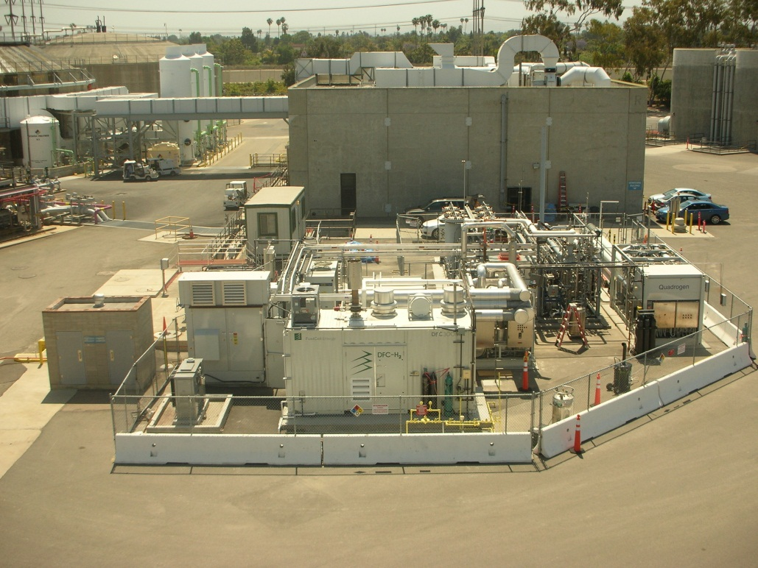
Digester Gas Utilization
DIGESTER
STORAGE
TANK
HEAT
EXCHANGER
ANAEROBIC
DIGESTION
GAS HOLDER
ADG
HOT
WATER
TRI-GENERATION
DEMONSTRATION
HIGH-T
FUEL CELL
FUEL
TREATMENT
BOILER
AC
POWER
  DEMONSTRATION
  Orange County Sanitation District
  Euclid Exit, I405, Fountain Valley
  Support: DOE, ARB, AQMD
  August 16, 2011
BIO
HYDROGEN
Notes:
First of a kind demonstration
Example of strategic alliance fostered by the NFCRC

Slide 5
Outline
Digester Gas Utilization
Microbial Fuel Cell
Distributed Power
Energy – Water Nexus

Slide 6
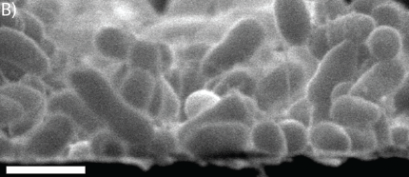
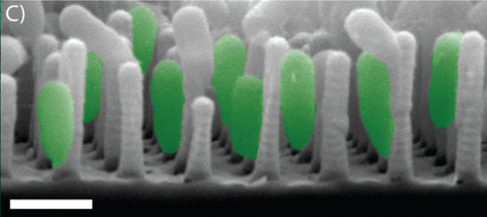
Microbial Fuel Cell
Sensors, Small Power Devices, Clean-up
Nanostructured Electrodes
Charge and nutrient transport are coupled in natural biofilms.
Nanostructured electrodes induce self-assembled biofilm morphologies that decouple these transport length scales.
Feedback between model predictions and engineered biofilm structures minimize internal losses.
Dual modeling-experiment approach will generate biofilm design principles to maximize bioelectrochemical productivity.
Nutrients
Charge
Charge
Nutrients

Slide 7
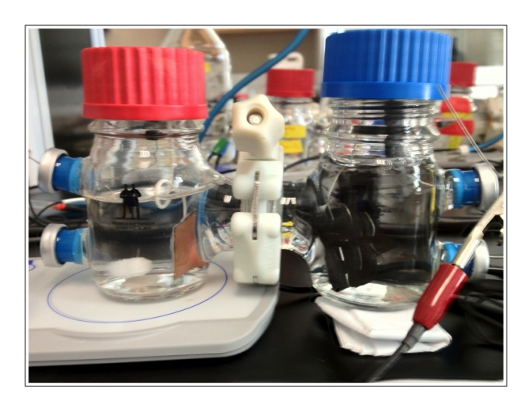
Microbial Fuel Cell
MFC with Nano-Structured Anode
Representative 3-d and cross sectional images of a mature Geobacter Sulfurreducens biofilm. Bacteria were stained with FITC and imaged using a 2-photon excitation wavelength of 820nm

Slide 8
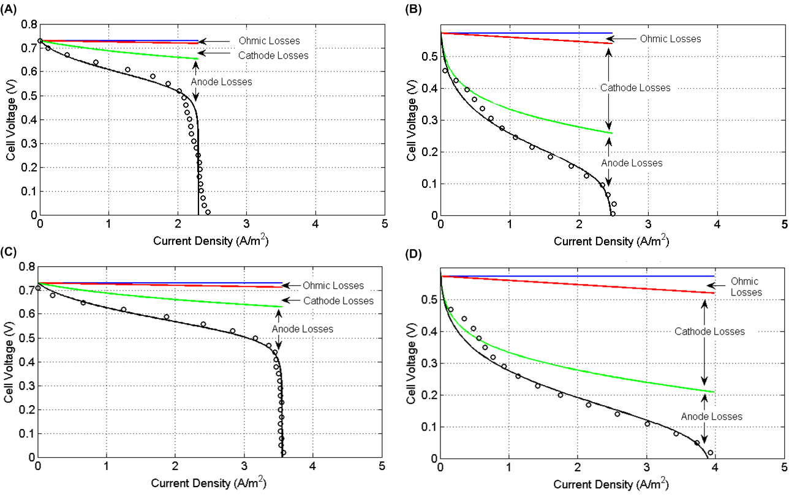
Microbial Fuel Cell
Losses Contributions-MFC with Air & FeCN Cathode
Air cathode at 110 (top) and
160.5 hours (bottom) of growth
FeCN cathode at 110 (top) and
160.5 hours (bottom) of growth

Slide 9
Outline
Digester Gas Utilization
Microbial Fuel Cell
Distributed Power
Energy – Water Nexus

Slide 10
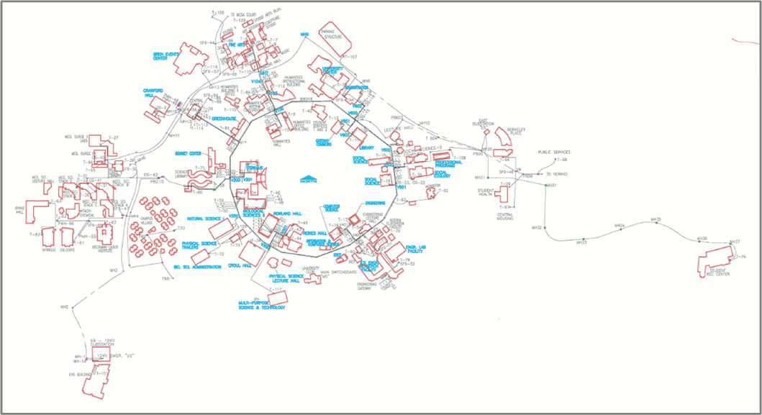
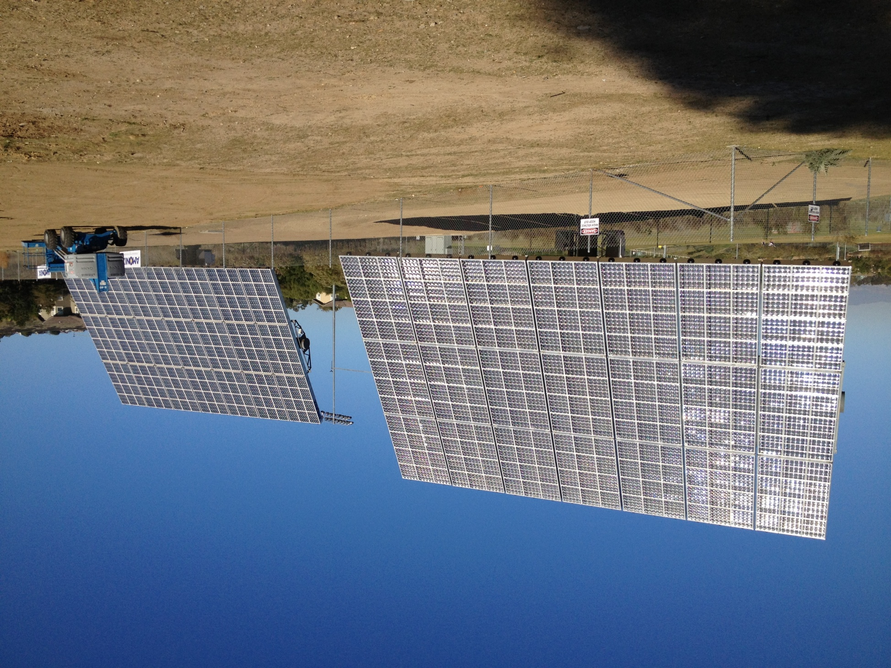



Distributed Power
Central Plant
East Substation
Univ. Substation 1
UC 1A/1B
UC 2
UC 3
UC 4
UC 5
Univ. Substation 2
UC 6A/6B
(UC 7)
UC 8
UC 9A/9B
UC 10
University Substation

Slide 11
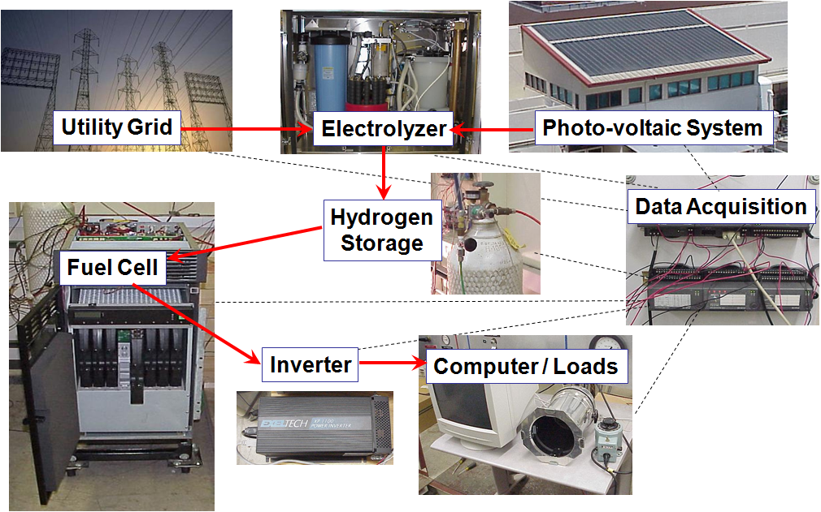

Distributed Power (with Storage)

Slide 12
Distributed Power (with Storage)
4.2 kW RFC Supply & Demand Power Flow:
System Cost | $ 42,000.00
H2 Produced | 50.9 kWh
kW Peak RFC | 8.1 kW
RFC Round Trip Eff. | 57%
System Eff. | 71%
18-mile weekday commute

Slide 13
Outline
Digester Gas Utilization
Microbial Fuel Cell
Distributed Power
Energy – Water Nexus

Slide 14
UCI-STREET Modeling Platform
Grid Inputs
Electricity demand forecasts
Generator parameters
Weather data
Model of California Electric Grid
Global Inputs
Emission factors
Resource potential
Geographic data
Economic information
Existing energy infrastructure
Model of California Transportation
Outputs
Spatially and temporally resolved:
Criteria pollutant emissions
GHG emissions
Energy use
Resource consumption
Water impacts
Cost
Infrastructure placement
Air quality prediction
Transportation Inputs
Travel demand forecasts
Fuel supply chains parameters
Vehicle parameters
Demographic data
J. Eichman, F. Mueller, B. Tarroja, L. Schell, and G.S. Samuelsen, “Exploration of the Integration of Renewable Resources Into California’s Electric System Using the Holistic Grid Resource Integration and Deployment (HiGRID) Tool,” Energy, 2013.
S. Stephens-Romero, M. C. Sospedra, J. Brouwer, D. Dabdub, G. S. Samuelsen, “Determining Air Quality and Greenhouse Gas Impacts of Hydrogen Infrastructure and Fuel Cell Vehicles,” Environmental Science & Technology, 2009, Vol. 43, No. 23, pp. 9022–9029.

Slide 15
UCI-STREET Water Balance Module
Water Measure-Related Energy Consumption and Emissions Models / Calculations
Electric Load
Direct Fuel Consumption
Direct GHG Emissions
To Main Energy Infrastructure Model (STREET)
Legend
Input
Output
Modify Reservoir Demand
Profiles
Reservoir Network Fill Simulation
Select Water Stabilization Measures Portfolio
Reservoir Fill Levels
Hydropower Inlet Modification
Modified Hydropower Inlet Vector
Determine Reservoir Inflow Profiles
Select Hydrologic Condition
Approach
  Identify the potential for different options to stabilize reservoir levels
  Evaluate energy / emissions /grid impacts of deploying technologies to required scale
  Advise the rollout of options / technologies to stabilize reservoir levels with minimum energy and emissions impacts

Slide 16
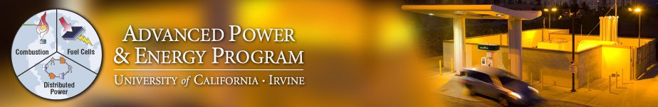
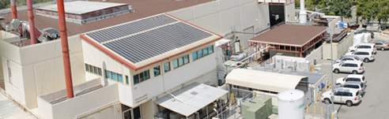
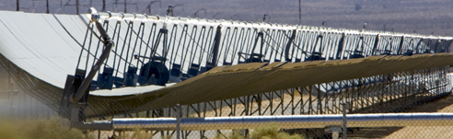
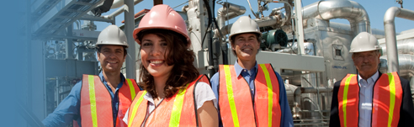
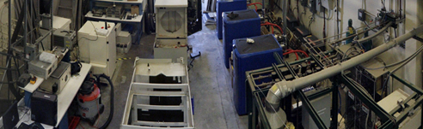
Questions
Thank you!

