Slide 1
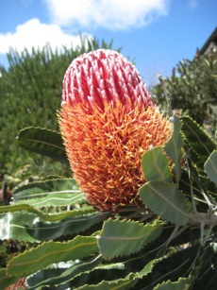
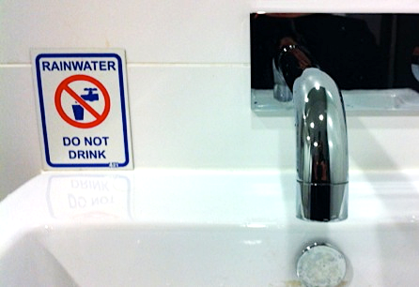
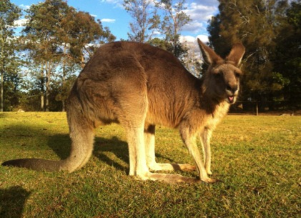
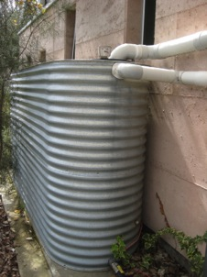
TreePeople and Australia: Program Summary
Presented at UCI-PIRE Retreat
January 25, 2014
Project partly funded by

Slide 2
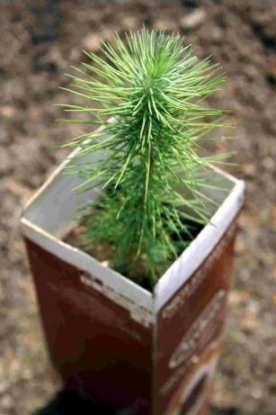
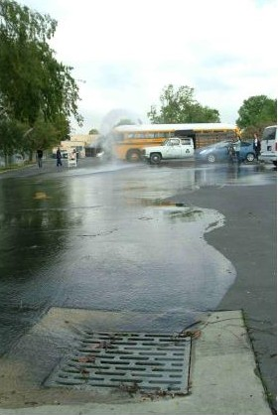
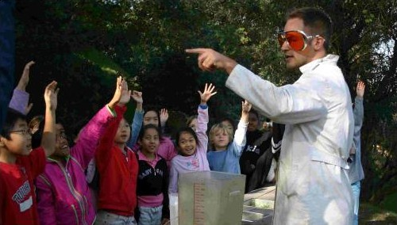
About TreePeople
Policy and Research
Education
Forestry

Slide 3
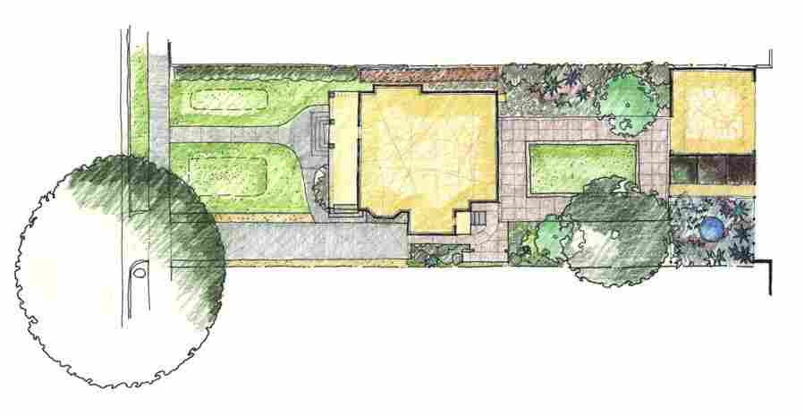
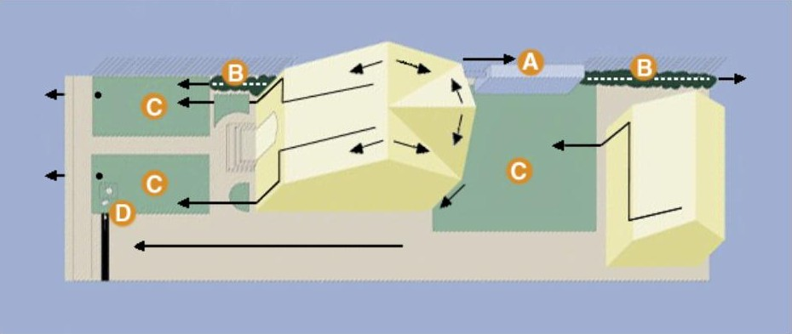
Single-family home: South LA (1998)
Objectives:
Capture all rainwater from majority of storms
Store some water in cistern for irrigation use
Infiltrate remaining water
Minimize waste stream
Project Features:
A
Cistern
B
Mulched swales
C
Retention grading
D
Driveway drywell

Slide 4
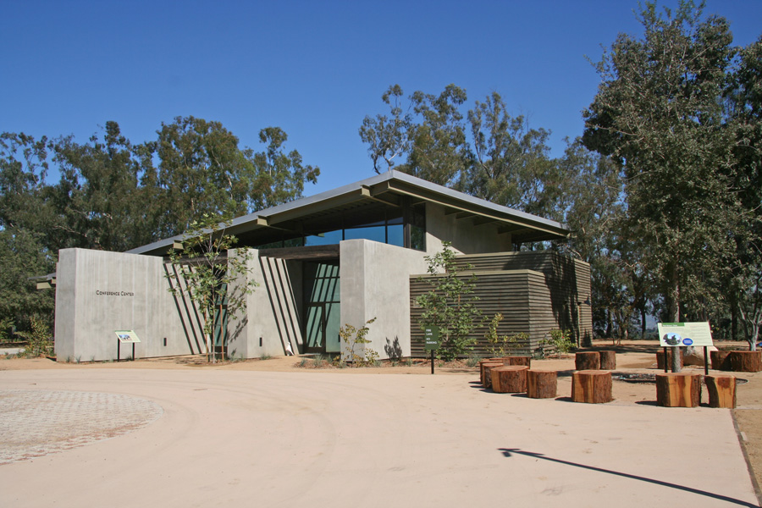
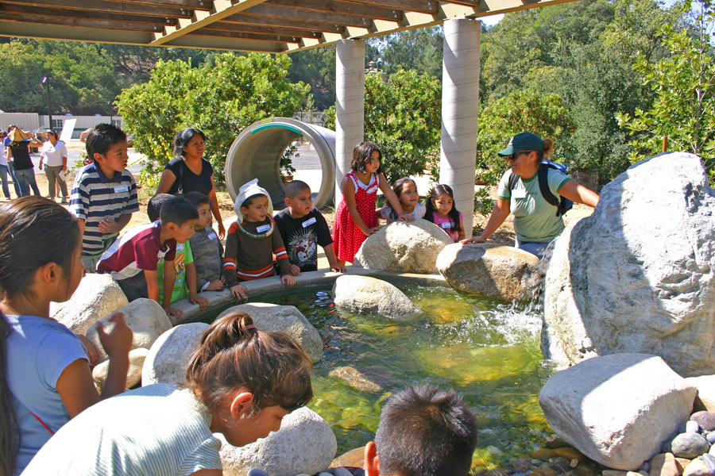
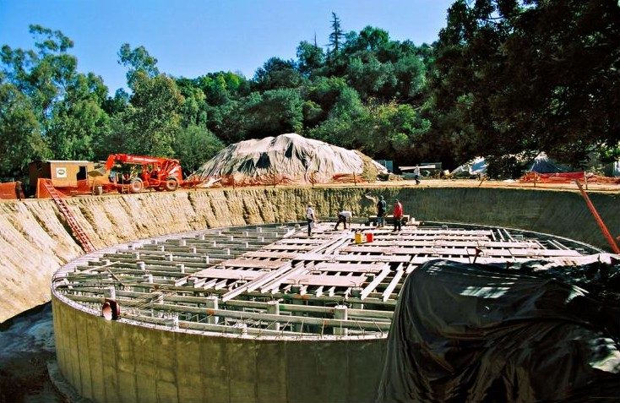
TreePeople Center for Community Forestry (2008)

Slide 5
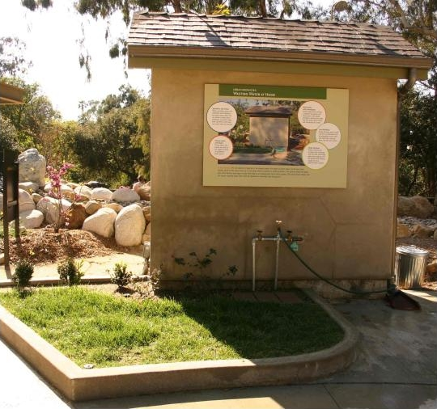
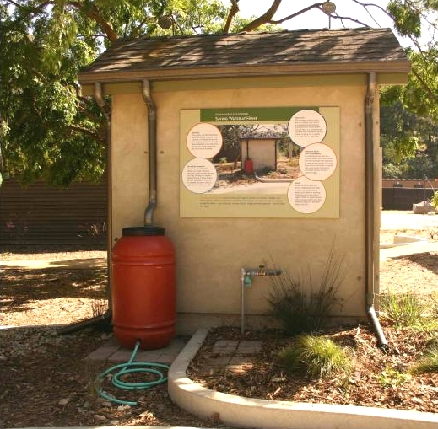
TreePeople Center for Community Forestry
X

Slide 6
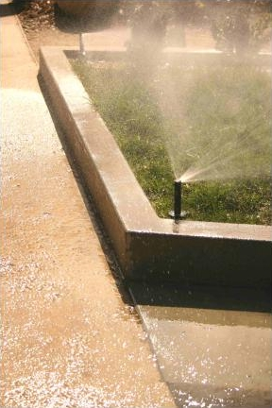
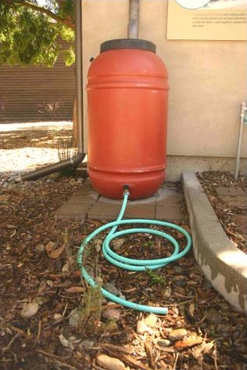
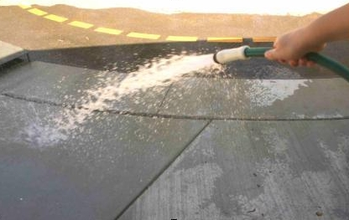
TreePeople Center for Community Forestry
X

Slide 7
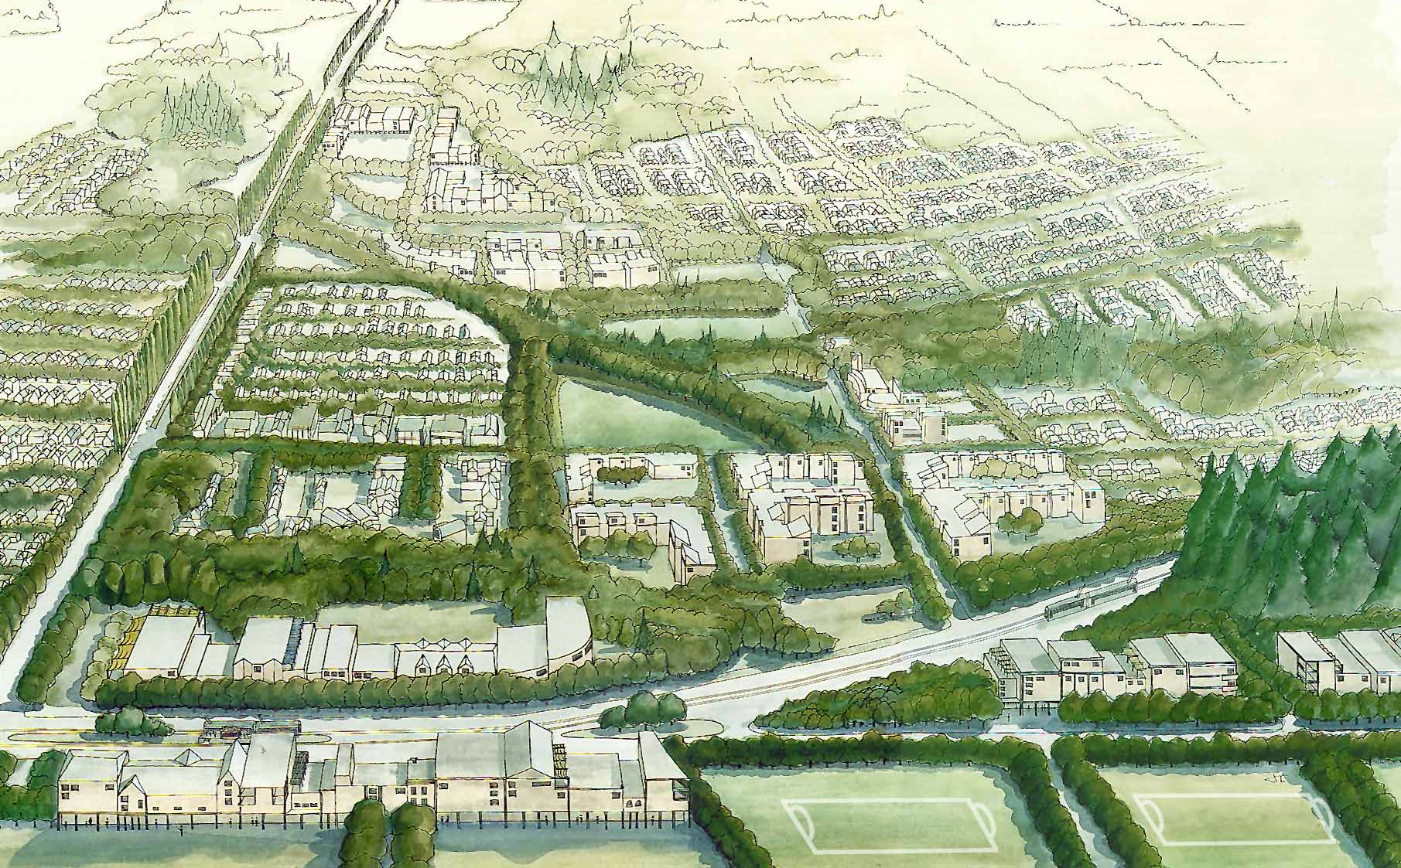
Watershed-scale project: Sun Valley (2004-present)
Porous pavement
Industrial cisterns & drywells
Mulching
Retention basins/parks
Strategic tree planting
Residential cisterns & drywells
Infiltration/sports fields

Slide 8
Making the investment case: Cost-benefit model

Slide 9
Why Australia
Similarities with US – transferability of solutions
Size, climate, lifestyle
A land of extremes – early climate change impacts
The Millennium Drought (and its abrupt end)
Innovative policies
Investment in people

Slide 10
The project: goals & objectives
Goal:
To link innovative drought and climate change responses in the US and Australia by engaging government, academia, investors and communities in rainwater harvesting, advanced water conservation and heat mitigation best practices

Slide 11
The project: goals & objectives
Objectives:
Provide on-the-ground research
Educate professionals, thought leaders, community leaders and policy makers
Focus on policies that support implementation and institutionalization
Use grassroots programs to build support
Identify innovative technologies for multi-purpose urban rainwater capture and advanced conservation practices

Slide 12
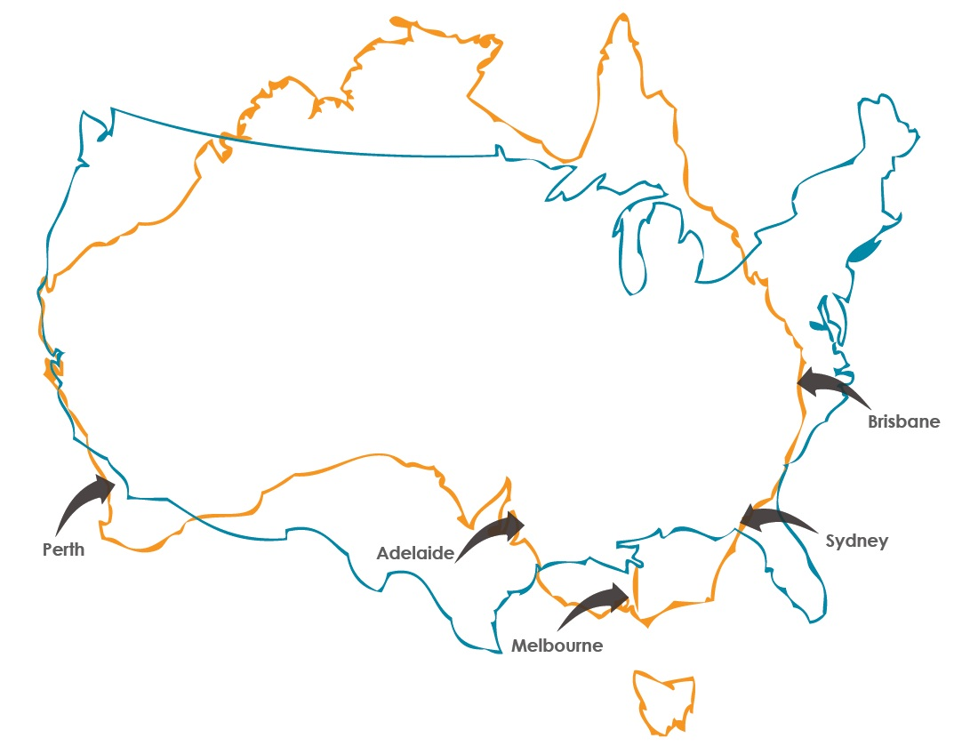
Research trips – May and Aug 2012

Slide 13
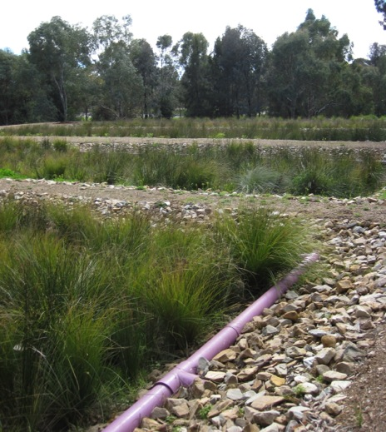
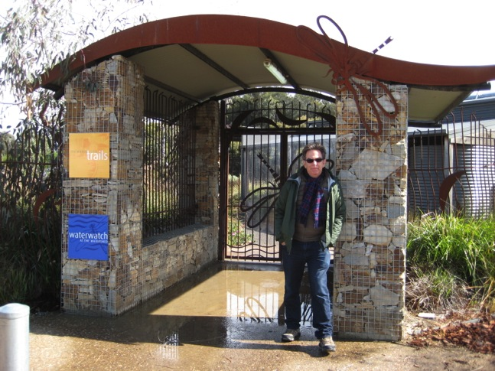
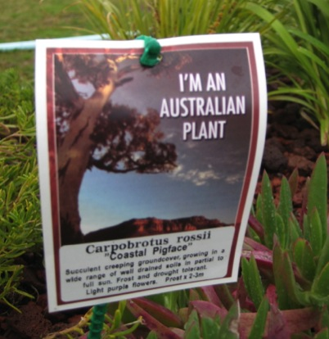
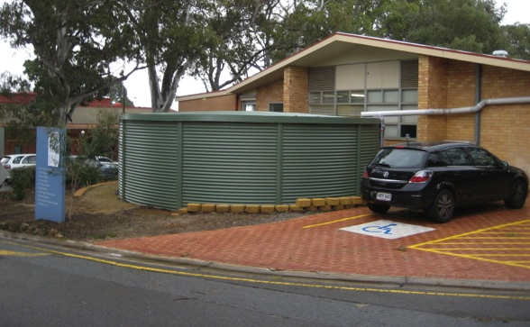
Adelaide, South Australia

Slide 14
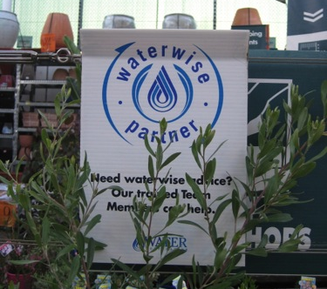
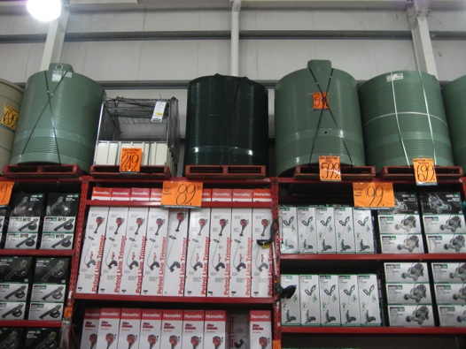
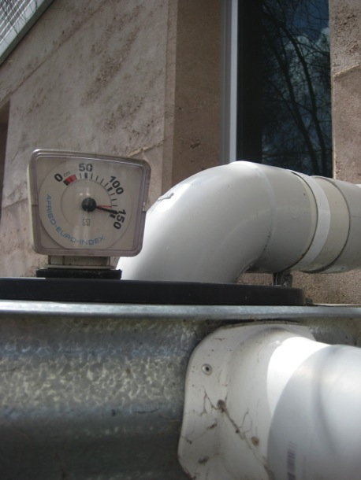
Perth, Western Australia

Slide 15
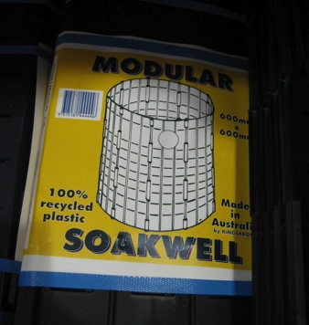
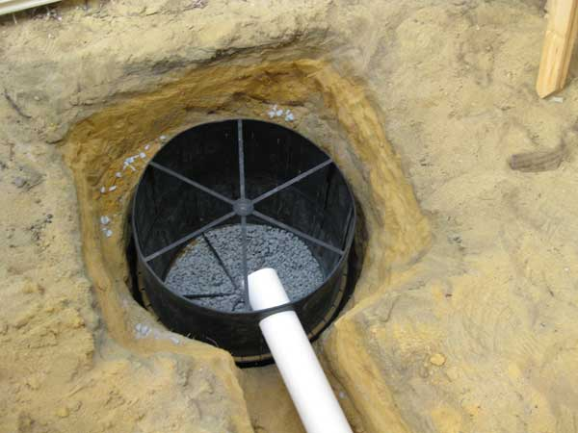
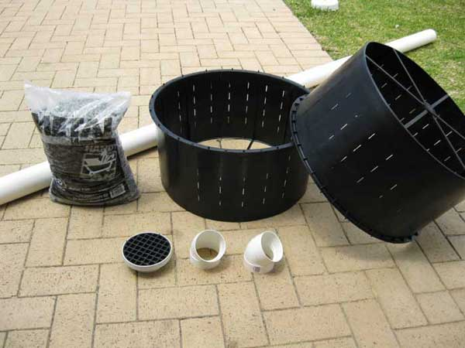
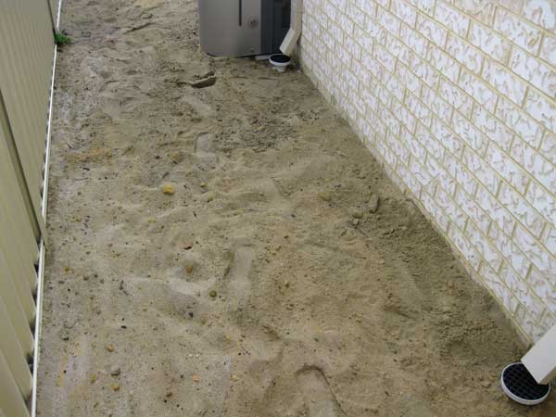
Perth, Western Australia
http://www.eyeonaustralia.com/diy/soakwells/

Slide 16
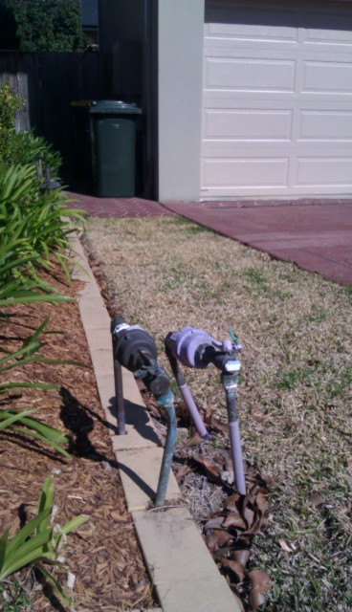
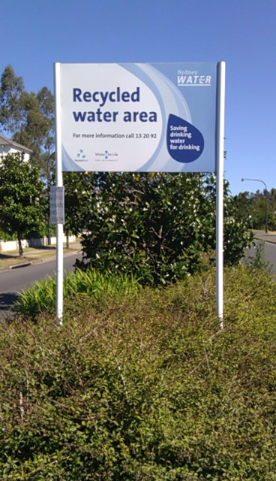
Sydney, New South Wales

Slide 17
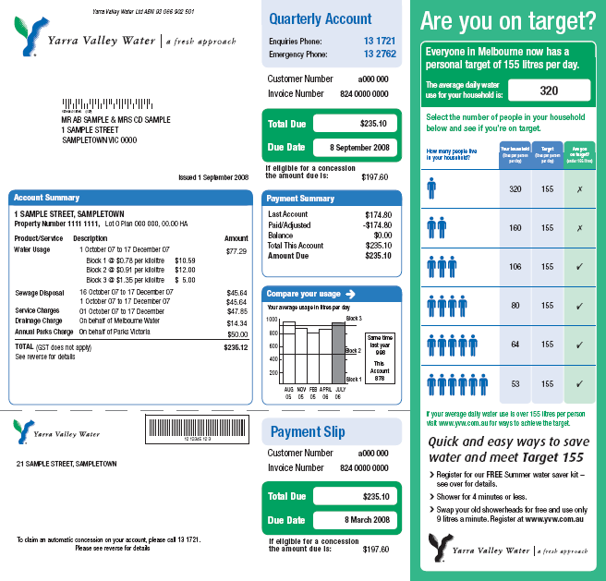

Slide 18
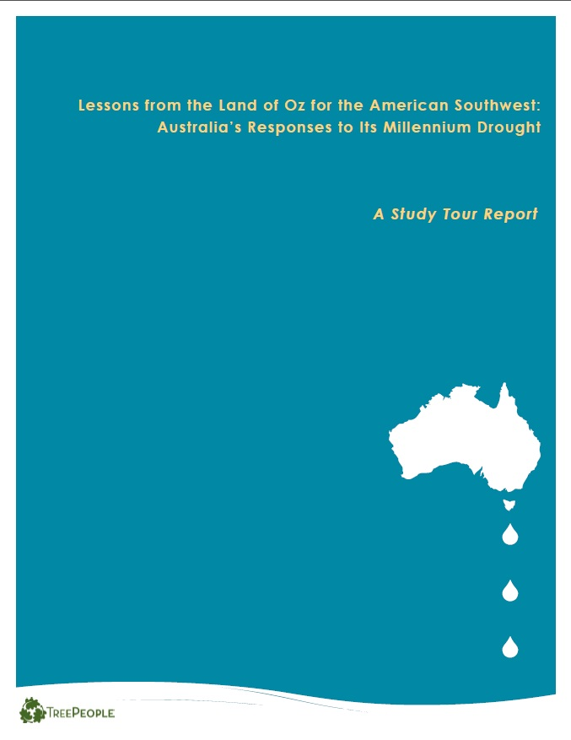
Current and next steps
Engaging local policymakers to coordinate drought response
G’Day USA Water Day
Briefing from Dr. Tony Wong, Monash University
Policy delegation trip
Local and int’l collaborations around research and policy

Slide 19
Thank you!
Edith de Guzman
Director of Research
edeguzman@treepeople.org
(818) 623-4889
www.treepeople.org

