Slide 1
Evaluation of the UC Irvine Water-PIRE project
Evaluator:
Lisa Kohne, Ed.D,
SmartStart Educational Consulting Services, Inc.
lkohne@smartstartecs.com
714.296.3440

Slide 2
Strengths
Challenges
Notes:
Difference between a researcher and evaluator.
Spend time pondering strengths and weaknesses of programs – Formative evaluation

Slide 3
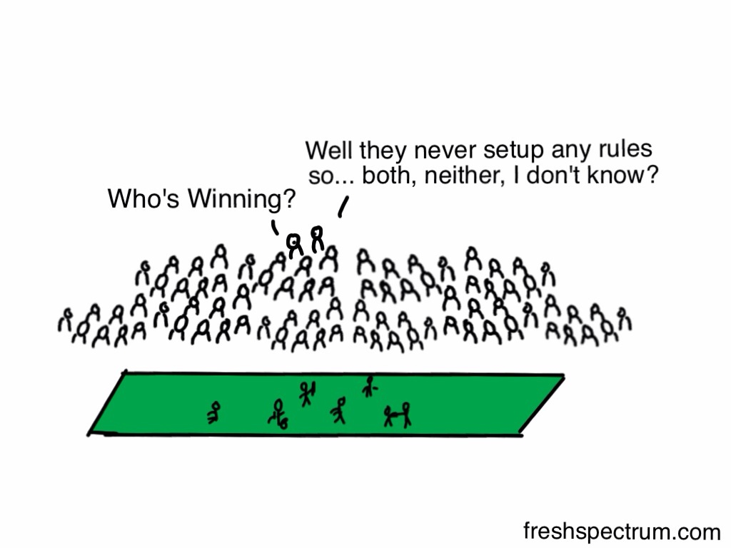
Who’s Winning?
freshspectrum.com
Notes:
Here’s another aspect of evaluation.
Rules are equal to goals, Activity outputs, milestones

Slide 4
UPP Down Under Activities
Lectures on climate change, ecnomics, governance, drought, wastewater, stormwater, statistics, communication, data analysis
Genome DNA extraction demo
VERY TO EXTREMELY USEFUL !
Fieldtrips to the pond, treatment wetlands, reserve biofilters, Scripps
Symposiums in Australia and US
Notes:
5 males, 7 female
5 Asian, 4 Caucasian, 3 Hispanic - so a quarter urm+

Slide 5
UPP Down Under Logistics
Notes:
Advertising for this program (Interesting, clear explanations, sufficient distribution/notification time)
Application process and pre-program information (clear communication, information, forms)
Program management (focused, well-prepared, coordinated, sessions started/ended on time)
Atmosphere (friendly, supportive, promoted teamwork)
Leadership (fostered working relationships, encouraged involvement)
Student involvement (presentations at appropriate level, collaboration, networking)
Technology (availability/quality of equipment and internet)
Accommodations (physical comforts, facilities, safety, location)
Food (quality, dietary needs, preferences, freshness)

Slide 6
Students’ Requests for Topics
Teach about statistical tools, sampling, types of data students will collect, and how to conduct data analyses
Develop hypotheses before collecting data
The difference between Australian & US water conservation methods
Industry presenters show how systems are applied in the US
Potable reuse
Water chemistry
Ecology
Notes:
Additional topics suggested by students
Students noted other concepts or topics they would have liked to see covered during the UPP Down Under program. Common themes include focusing on hypothesis development prior to data collection and knowing the differences between Australian and U.S. water conservation methods. There were a variety of recommendations for learning about specific concepts, in addition to suggestions for bringing in industry professionals for talks and increasing the amount of group collaboration opportunities.
Hypothesis development prior to data collection
The most frustrating part was not having a hypothesis before we started data collection. We collected a lot of data, but then we had no idea what we were supposed to be analyzing it for. In many cases we didn't have large enough datasets for analysis. There should have been a large focus on our group projects prior to Australia so that we would have a better idea of what we were trying to find. Just being told to come up with some statistics about the data was challenging and we need much more guidance about how we were supposed to do that.
The hypothesis development should have occurred before we began sampling in the field.
Comparisons of Australian/US methods of water conservation
Another thing I noticed was that while in Australia we emphasized recycled water use and its public acceptance but did not address it when back in the US.
Some Australian household examples of water conservation. Some comparisons to the U.S methods of conservation.
Specific content knowledge
I would have liked to learn more about potable reuse, but that may just be a personal preference.
I would like to have seen some more water chemistry related concepts.
More ecology.
Other
I think it would be interesting to get industry involved in this project directly. I currently work for an environmental consulting company that has implemented constructed wetland projects like the ones we saw in Australia. To have some of those companies come in and talk to the students would be useful to show them how these systems are applied in our own backyard.
If anything less broad and more group collaboration time as early as possible. I would have also liked to have been able to participate in more lab work especially back in the US.
Students’ suggestions for improvement
Students provided suggestions to improve this UPP Down Under program next year. Two common themes were increased preparation for field work days and increased organization.
Preparation for field work days
In the morning before heading to the field, undergraduates can help with whatever needs to be prepared so that the group arrive to field sites on time. We liked being involved and would really have liked to help out. Trinity College cafeteria food was fine, but their prepared lunches declined in quality as time passed. Guest internet was also very unreliable for the right wing of the dorms. Students should also be told what they'll be doing throughout the program.
Start earlier for field work days.
A lot more preparation work for each field day. We wasted practically the entire morning waiting for the professors to decide the logistics of the plans. We were expected to show up in the lab around 8 or 9am but sometimes did not arrive at the field site until after noon because we waited around in lab for them to decide their plans and then drive out to the field site. Even the previous night, they did not know where we would be going the following morning.
I would recommend that professors go look at the biofilters or wetlands in person or on Google maps prior to taking the group to the location. This preparation could help prevent confusion between professors.
More planning ahead of time would be helpful in getting daily activities started on time! :)
Have some more interactive activities prior to the trip so the team could bond beforehand. Also we could have brought our own lunch to the week one orientation, to cut back on some costs.
Improved organization
YES! Please have the next set of students prepare their research project before going on the trip. I realize this will be very tricky because this means the leadership team will need to have everything planned out and explained beforehand, but it will really help them understand what they are looking for. This way they could take pictures of what they are going to present and take extensive notes on their topics.
See my response to question 12. Having the undergrads more evenly balanced between UCLA, UCI, and UCSD would have been nice. Overall, just more organization would have been nice, especially on our projects.
More organization in the beginning.
Other
Perhaps a video for the entire project is a bit much for one person to handle. Maybe you can cut that person some slack by having a team handle a video and the other three teams do posters / presentations? Also from what I saw, perhaps you should hire a full-time photographer instead of depending on students? This way, you will definitely have necessary photos for projects and presentations.
Perhaps have a panel of us to answer questions that next year's students may have
It was the first year, so the faults of the program are understandable. The cafeteria food was okay.

Slide 7
Students’ Suggestions
Increase advertising /visibility
Organize application process
Students prepare research projects in CA
More thoroughly plan and organize activities
Make orientation useful and productive
More lab work in US before and after
Let students help with preparations
Provide more information and preparation time before activities – especially field work days
Notes:
Increase advertising and visibility of the program
• Increase organization /planning application process
• Students prepare research projects in CA
• More thoroughly plan and organize program activities.
• Make the orientation more useful and productive
• Provide more information and preparation time before activities to maximize time engaging in activities – especially field work days
• More lab work in US before and after
• Let students help with preparations
Additional topics suggested by students
Students noted other concepts or topics they would have liked to see covered during the UPP Down Under program. Common themes include focusing on hypothesis development prior to data collection and knowing the differences between Australian and U.S. water conservation methods. There were a variety of recommendations for learning about specific concepts, in addition to suggestions for bringing in industry professionals for talks and increasing the amount of group collaboration opportunities.
Hypothesis development prior to data collection
The most frustrating part was not having a hypothesis before we started data collection. We collected a lot of data, but then we had no idea what we were supposed to be analyzing it for. In many cases we didn't have large enough datasets for analysis. There should have been a large focus on our group projects prior to Australia so that we would have a better idea of what we were trying to find. Just being told to come up with some statistics about the data was challenging and we need much more guidance about how we were supposed to do that.
The hypothesis development should have occurred before we began sampling in the field.
Comparisons of Australian/US methods of water conservation
Another thing I noticed was that while in Australia we emphasized recycled water use and its public acceptance but did not address it when back in the US.
Some Australian household examples of water conservation. Some comparisons to the U.S methods of conservation.
Specific content knowledge
I would have liked to learn more about potable reuse, but that may just be a personal preference.
I would like to have seen some more water chemistry related concepts.
More ecology.
Other
I think it would be interesting to get industry involved in this project directly. I currently work for an environmental consulting company that has implemented constructed wetland projects like the ones we saw in Australia. To have some of those companies come in and talk to the students would be useful to show them how these systems are applied in our own backyard.
If anything less broad and more group collaboration time as early as possible. I would have also liked to have been able to participate in more lab work especially back in the US.
Students’ suggestions for improvement
Students provided suggestions to improve this UPP Down Under program next year. Two common themes were increased preparation for field work days and increased organization.
Preparation for field work days
In the morning before heading to the field, undergraduates can help with whatever needs to be prepared so that the group arrive to field sites on time. We liked being involved and would really have liked to help out. Trinity College cafeteria food was fine, but their prepared lunches declined in quality as time passed. Guest internet was also very unreliable for the right wing of the dorms. Students should also be told what they'll be doing throughout the program.
Start earlier for field work days.
A lot more preparation work for each field day. We wasted practically the entire morning waiting for the professors to decide the logistics of the plans. We were expected to show up in the lab around 8 or 9am but sometimes did not arrive at the field site until after noon because we waited around in lab for them to decide their plans and then drive out to the field site. Even the previous night, they did not know where we would be going the following morning.
I would recommend that professors go look at the biofilters or wetlands in person or on Google maps prior to taking the group to the location. This preparation could help prevent confusion between professors.
More planning ahead of time would be helpful in getting daily activities started on time! :)
Have some more interactive activities prior to the trip so the team could bond beforehand. Also we could have brought our own lunch to the week one orientation, to cut back on some costs.
Improved organization
YES! Please have the next set of students prepare their research project before going on the trip. I realize this will be very tricky because this means the leadership team will need to have everything planned out and explained beforehand, but it will really help them understand what they are looking for. This way they could take pictures of what they are going to present and take extensive notes on their topics.
See my response to question 12. Having the undergrads more evenly balanced between UCLA, UCI, and UCSD would have been nice. Overall, just more organization would have been nice, especially on our projects.
More organization in the beginning.
Other
Perhaps a video for the entire project is a bit much for one person to handle. Maybe you can cut that person some slack by having a team handle a video and the other three teams do posters / presentations? Also from what I saw, perhaps you should hire a full-time photographer instead of depending on students? This way, you will definitely have necessary photos for projects and presentations.
Perhaps have a panel of us to answer questions that next year's students may have
It was the first year, so the faults of the program are understandable. The cafeteria food was okay.

Slide 8
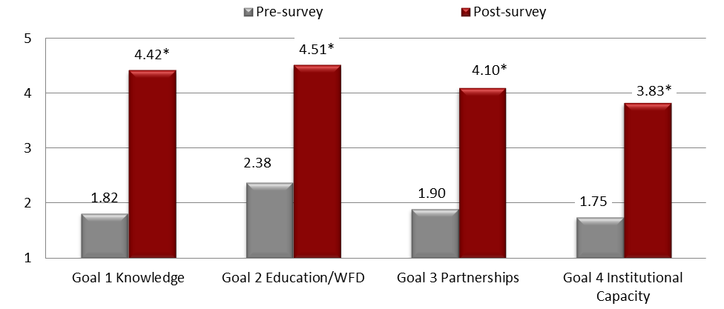
*Statistically significant
Notes:
So what the NSF and therefore the project leaders really want to know is… Is the project having any IMPACT?
Four project goals, pre/post survey.
My understanding of with low-energy approaches for removing pollutants from water
My understanding of the benefits and risks associated with adoption of low-energy treatment technology
My understanding of acceptance factors that hinder the adoption of low energy treatment options
My understanding of the impacts of distributed approaches for capturing and reusing runoff
My understanding of urban water supply and demand challenges and solutions
My understanding of why an interdisciplinary approach to urban water sustainability is necessary
My understanding of why a cross-cultural approach to urban water sustainability is necessary
My understanding of the challenges associated with conducting scientific research in an international setting
My interest in majoring in a field related to urban water sustainability science
My knowledge of careers that are available in urban water sustainability
My interest in pursuing a career in an urban water sustainability-related area
My collaborations and interactions with university (UCI, UCSD, UCLA) researchers
My collaborations and interactions with SCCWRP and governmental researchers
My collaborations and interactions with Australian researchers
My desire to develop and maintain scientific partnerships and collaborations
My knowledge of how to work with my university to participate in a research abroad visit

Slide 9
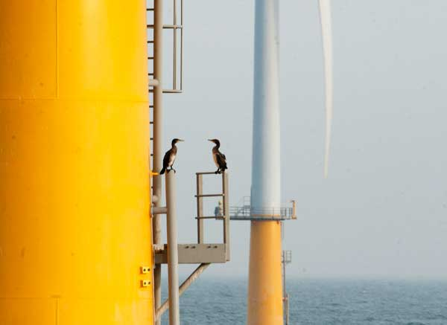
Collaboration
Interactions
Culture
Reflection
Careers
Time
Notes:
Provide additional training and experience in areas that were rated the lowest on the post survey:
Collaborations and interactions SCCWRP and governmental researchers
Collaborations and interactions with Australian researchers
Incorporate information about Australian culture in the UPP Down Under materials and lessons. Encourage students to do cultural research about Australia prior to leaving for Australia. Encourage them to complete the Intercultural Developmental Inventory administrator’s recommendations while in Australia. During their RAE, provide students with opportunities to interact with Australian scientists and students and engage in local cultural activities. Encourage all students to complete evaluation forms to ensure accurate reporting of project components. Incorporate questions about reflecting on cultural experiences in students’ projects and presentations.
Knowledge of careers in urban water sustainability
Knowledge of how to work with the university to participate in research abroad
Increase length of research abroad visits to Australia to increase impacts.

Slide 10
CASQA Meeting
RBF Consulting
County of Orange
Downey Brand Law
Municipal Maintenance Equipment
Old Castle Precast
OC Public Works
TreePeople
Weston Solutions, Inc.
Black & Veatch
CASQA
CDM Smith
City of Anaheim
City of Huntington Beach
City of Irvine

Slide 11
Activity | Comments
SoCal and Australia: UC-Irvine Water-PIRE | A wealth of knowledge was shared, and the context provided for how the two regions might learn from one another was excellent. Ana did a great job presenting information that will be immediately useful to CASQA members. The topics that shared results were more helpful. Topics about on-going research were interesting, but not very applicable until results are in. Content was good, A/V was a disaster and made it hard to keep focus. It was interesting to hear about efforts at integrated water management, and the webconferencing might have worked well except that 1) the sound wasn't great, 2) the hotel line kept intruding, and 3) the technician kept flipping back to presenters' faces during their presentations
Very useful
Somewhat
useful
PIRE Panel Discussion | There just wasn't enough time for the discussion. It really didn't add much at all. I did not stay for this portion of the meeting (2)

Slide 12
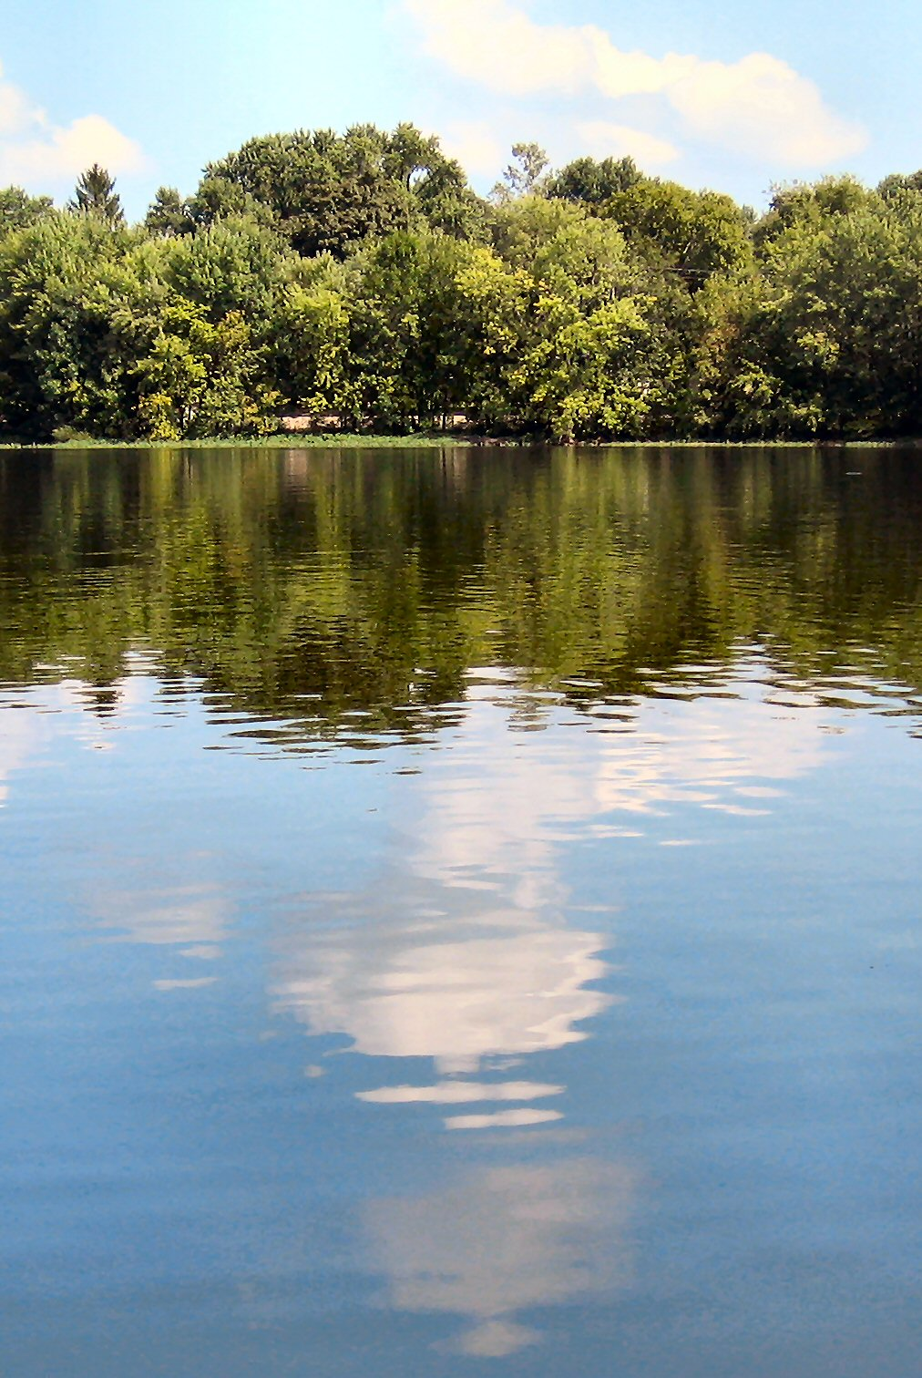
Additional topics suggested by attendees
Australia vs California Regulatory differences
Low impact development in Australia
Action at policy level -> shifts at resident level.
WERF study on pollutant removal
Reused stormwater & BMP monitoring, maintenance.
Research results → implementation standards.
Notes:
Regulatory and other gov't level differences between Australia and California -- and how CA can begin to address these issues.
A broader overview of Low impact development and stormwater/water quality implementation in Australia
Discussion of action needed both at the policy/ governmental level AND of the shifts that have to happen at the resident/business level.
Water Environment Research Foundation study on pollutant removal for different media in biofilters. WERF Study Quantifying Nutrient Removal Technology Performance
Reused stormwater & BMP monitoring, maintenance.
More about taking the research results and turning them into implementation guidance or standards.

Slide 13
Attendees’ suggestions for improvement
Workshop materials and activities
Meeting organization and technical difficulties
New workshops and discussions
Focus more on outcomes
Collaboration opportunities
Need for funding
Notes:
Attendees’ suggestions for improvement
Attendees provided suggestions to improve the logistical aspects of this meeting, including distributing handouts with a description of the PIRE program, providing opportunities for Q&A, having more time for collaboration, improving technology, and increasing the level of organization.
Workshop materials and activities
Perhaps include in the agenda the more specific titles for each presenter's talk. Provide a hard copy description of the PIRE program and this project as a whole, with the investigator names we saw in powerpoint but did not have in a handy form. Electronic is good for trees, but some things are good on paper...
It's a shame that the panel discussion was cut short and that there was no opportunity for Q&A. As the CASQA meeting was labeled a "workshop" -- it would have been great to have a more time for discussion, collaboration and setting next steps.
Meeting organization and technical difficulties
The presentations seemed to be very disorganized and the logistics of the presentations were terrible.
Need to improve the sound if webconferencing and it is more useful to stay on the slides than switching back to presenters' faces.
Fixing the glitch with the phone line to the speakers that interrupted every 5 minutes.
New workshops and discussions
Would love for a practical workshop to be hosted in the future, perhaps about hands-on problem solving on specific projects, an example of this model is the US Studies Centre (Univ. of Sydney) carbon reduction project which brought mayors of 6 mayors from New South Wales to American cities this past summer ("Mayors' institute" model)
Would love future discussion about planning for retrofits of... {portion of text cut off} ...instead of new development regulations.
Focus more on outcomes
More of a focus on actual implementation outcomes rather than academic study would be of more interest for municipal practitioners. Options rather than infiltration is also important since many areas cannot infiltrate.
P.S. It's always better, in my opinion, to focus time in presentations on outcome/conclusions more than process.
Collaboration opportunities
I think the workshop was an excellent first step in collaboration with Australia integrated water resource management. I think this should be used as an impetus to more collaboration on IRUM and stormwater between Australia and California.
Might be good to not only look backward to present information on what has happened, to the future to open up collaborative efforts toward future efforts.
Utilizing information and projects from other countries, with similar climate and challenges as So. Cal., is important when trying to accomplish the same goal and realize other opportunities and knowledge currently being utilized.
Economic and social aspects of the project seem to be ones that cut the most new ground. Thanks to Australian participants (and in person presenters).
Closing with Dr. Feldman's context-setting (convergence/divergence between SoCal and Australia) was excellent! Fascinating observations.
Need for funding
Water reuse has no real success without funding and funding may be provided by getting buy in from end users. This can be accomplished by providing a way to rebate for the effort they produce.
Other
Workshop format was good. CASQA has brought in external speakers for webcast before, and has done well with the format. Keep up the good format and work. The context did not work. Only one speaker discovered anything of value, and that was Bruce P. The others were just talking heads or impractical researchers.
Time management.

Slide 14
WaterPIRE Goals
Notes:
My knowledge and understanding of sustainable urban water systems (Goal 1 - Knowledge/Research/Discovery)
My ability to accelerate education and training in the area of urban water sustainability, and diffuse knowledge about sustainability options to U.S. students, professionals, and practitioners (Goal 2 - Education/Workforce Development)
My ability to establish new partnerships with other water researchers, organizations, and managers (Goal 3 - Partnerships)
My ability to increase the capacity of my organization to lead research and educational programs (Goal 4 - Institutional Capacity)

Slide 15
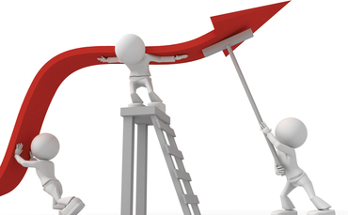
Make info useful
Visible program and leadership
Strategic planning
Partnerships
Institutional capacity
Notes:
Recommendations for program impacts
Consider ways to highlight how to utilize or implement presentation material in future meetings so that the meetings’ content connects to attendees’ studies, research, work, or instruction
My ability to establish new partnerships with other water researchers, organizations, and managers (Goal 3 - Partnerships)
Some individuals and organizations are currently involved in exchanges of information and best practices on the subject of water management with goals that are complementary to the WaterPIRE project. Connect with these organizations to discuss possible opportunities for collaboration.
Provide additional training and experience in areas that were rated the lowest after participation in the CASQA meeting:
My ability to increase the capacity of my organization to lead research and educational programs (Goal 4 - Institutional Capacity)

