Slide 1
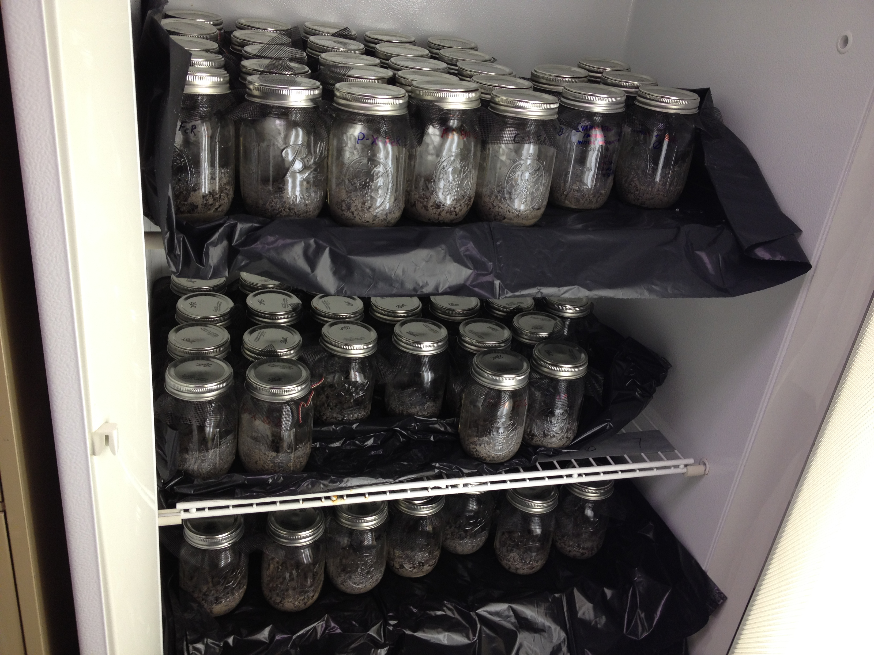

Slide 2


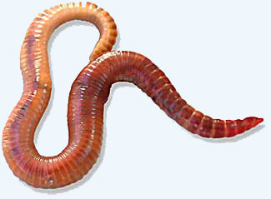
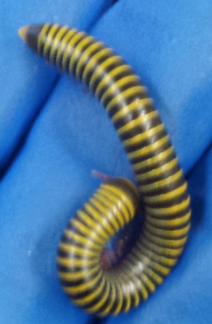
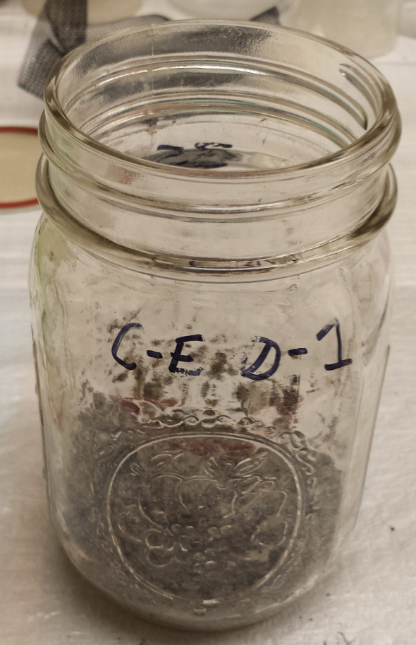
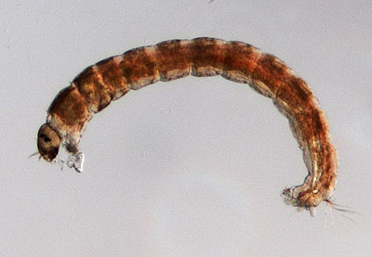
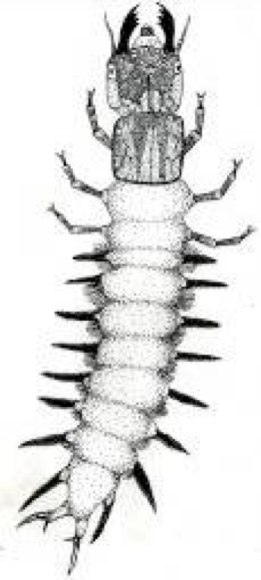
LEVIN LAB PIRE ACTIVITIES
Mehring/Levin/Kraikittikun
UPP Summer 2013 (Animals in Australia Biofilters and Wetlands)
  Summer sorter: Garfield Kwan
  ESYS Senior Thesis - Dianna Kraikittikun
Can animals improve the efficiency of bioretention systems?
(Review Manuscript In Prep: Mehring and Levin, Frontiers in Ecology and the Environment)
Animal mediation of phosphate availability:
Lab Experiment: Dec-Jan2014
Fe + P ;
Earthworms, Millipedes, Earthworms + Millipedes
Fe reducing microbes (Geobacter, Shewanella)
New Field Work: Monash/Melbourne Australia
Biofilter chronosequence: Infaunal Succession
Biofilter harvesting: Infaunal Consequences (Belinda Hatt)
Chironomid release of greenhouse gasses: Treatment Wetlands (P. Cook)

Slide 3
Levin-Lab Biofilter/Wetland Questions
What are the dominant soil taxa and their lifestyles in biofilters? Treatment wetlands?
What factors influence faunal availability?
Age and size? Plant sp. & properties? Soil root and detrital organic matter?
What roles do animals play in water purification?
Vertical drainage: reduce clogging
Contaminant retention –
Direct reduction (or spread of pathogens)
Enhanced denitrification (in guts or via bioirrigation)
Enhance NO3 leaching, P mobilization, metal mobility
Metal accumulation
Indirect effects on plant growth, metal uptake etc.
Nutrient remineralization
Greenhouse gas emissions (CH4, N20) – through effects on soils and guts

Slide 4
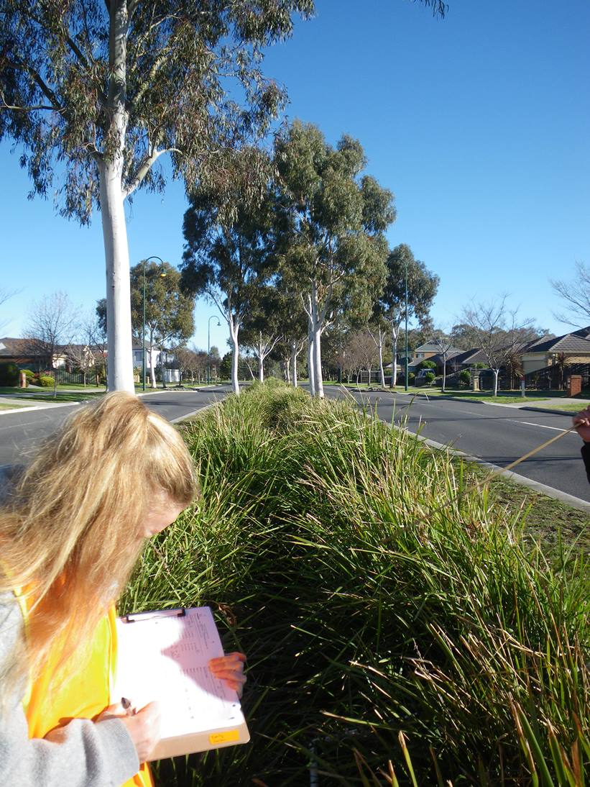
UPP 2013 – Biofilter Fauna
Oligochaetes dominate
Low number of species

Slide 5
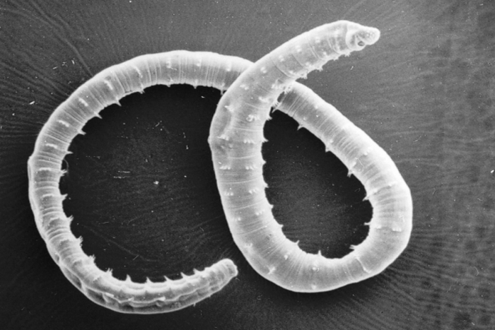
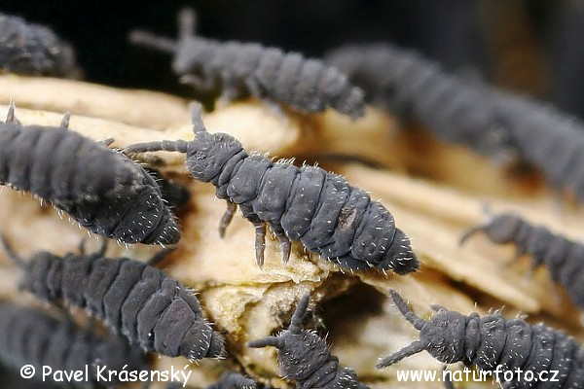
What are the dominant soil taxa and their lifestyles in biofilters?

Slide 6
What are the dominant soil taxa and their lifestyles in biofilters?
Total densities (ind/m²):
Wicks – 33,486
Lynbrook Estate – 5,942
Hereford Road – 9,664

Slide 7
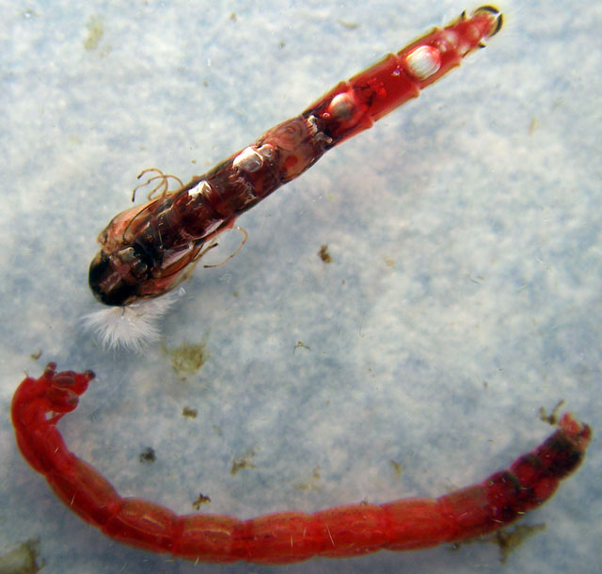
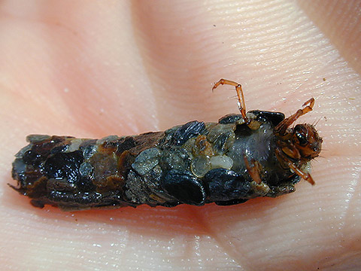
What are the dominant soil taxa and their lifestyles in treatment wetlands?
Macrofauna Individuals m⁻² (cores)
Total macrofaunal densities (ind /m2):
Edithvale – 19,047; Royal Garden 28,011; Hampton Park – 42, 271

Slide 8
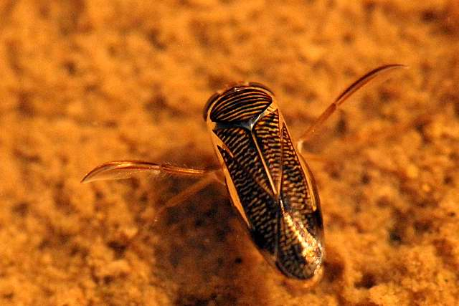
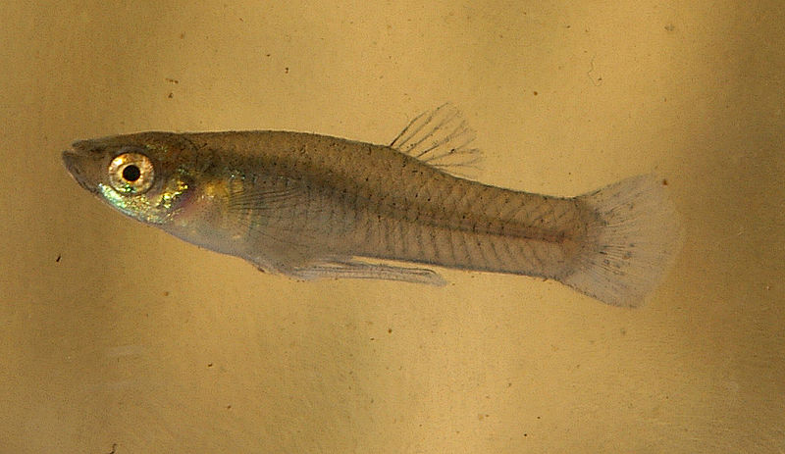
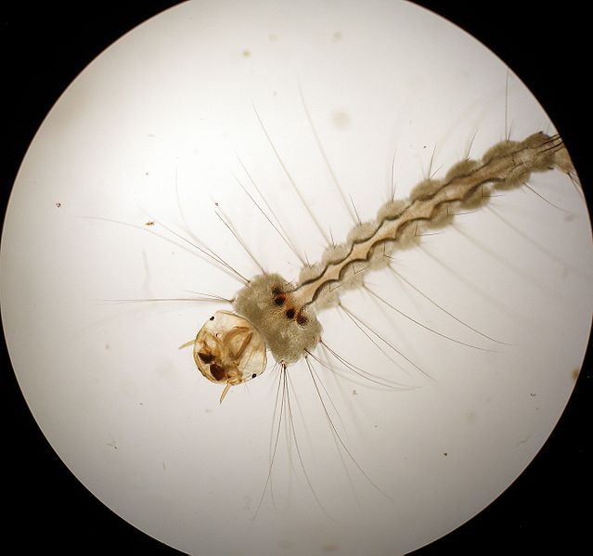
Wetland animals in sweep nets that were not detected in cores
Corixidae (water boatman)
Gambusia sp. (mosquitofish)
mosquito

Slide 9
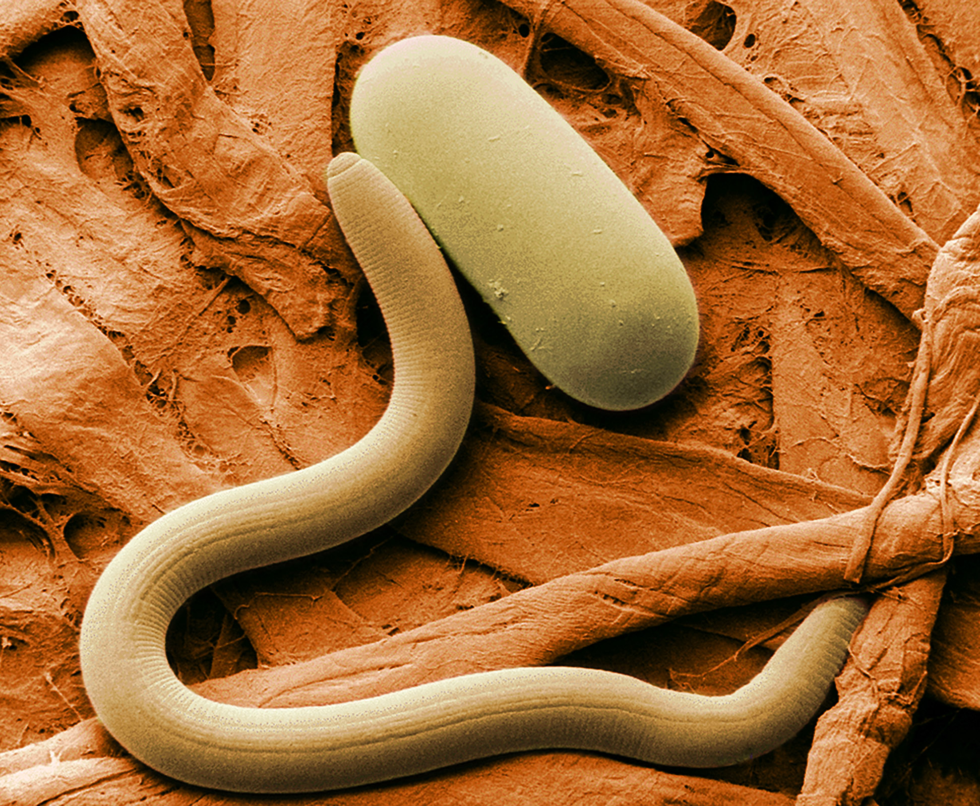
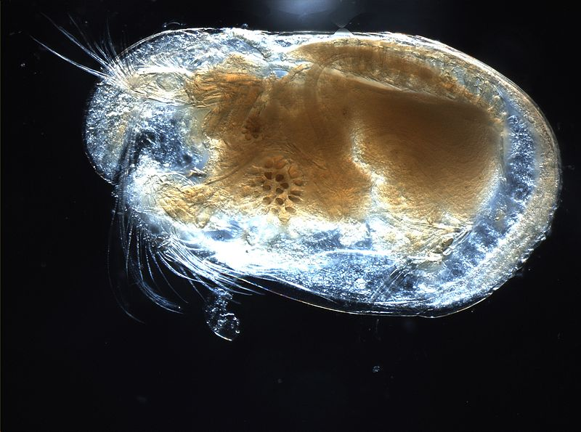
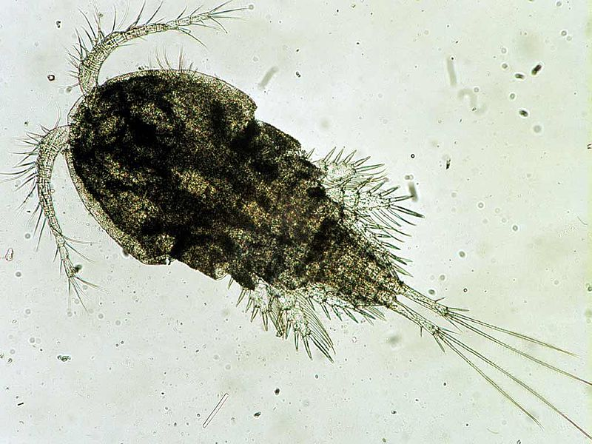
What are the dominant soil taxa and their lifestyles in treatment wetlands?
Meiofauna individuals m⁻² (cores)

Slide 10
Factors influencing faunal abundance in biofilters
(>2mm,0.3-2, 0.045-0.3 mm tested)
Top model R²adjusted = 0.89
1. organic 45-300 µm 2. rush % cover 3. roots
Parameter relative importance weights (range 0-1)
Rush cover | OM. 45-300 um | Roots | Sedge cover | Max core depth
0.95 | 0.88 | 0.59 | 0.26 | 0.16
+ | + | - | + | +

