Slide 1
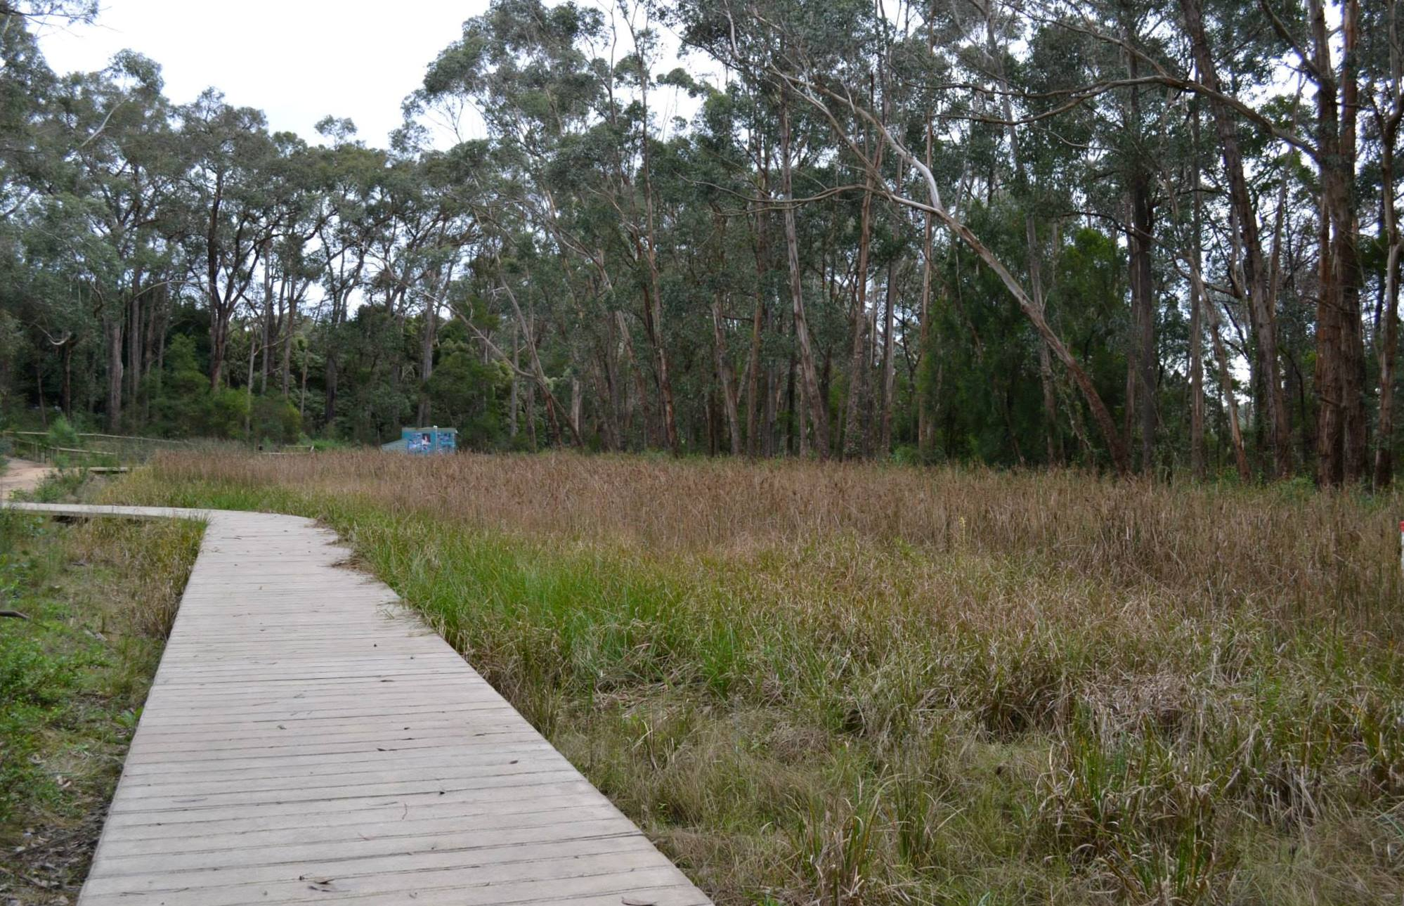
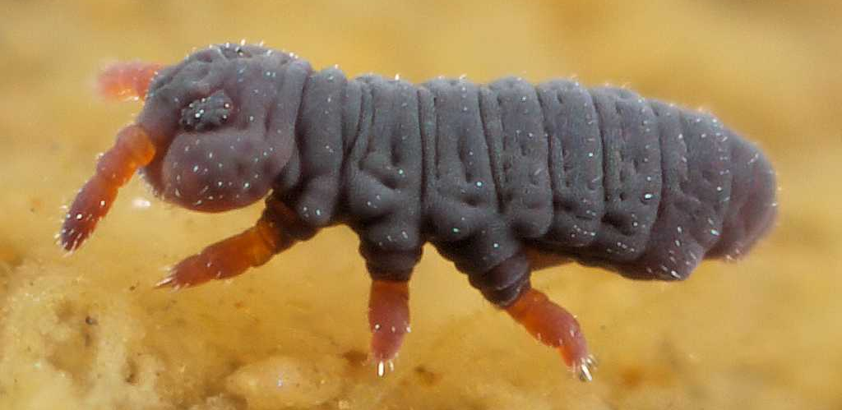
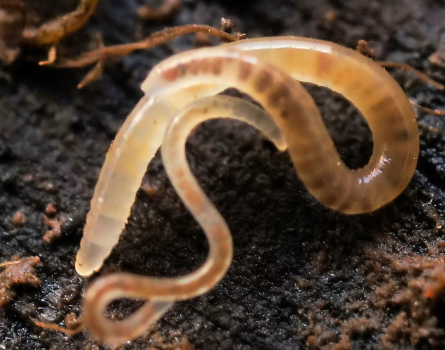
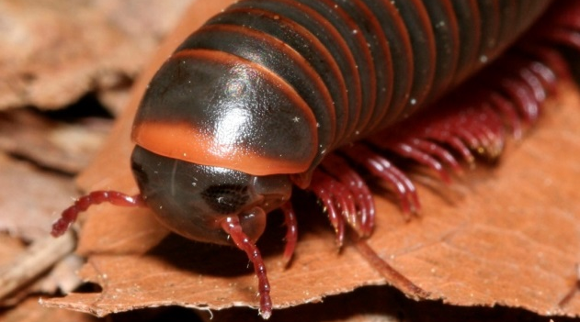
Post-doctoral Research Status Report
Andrew Mehring

Slide 2
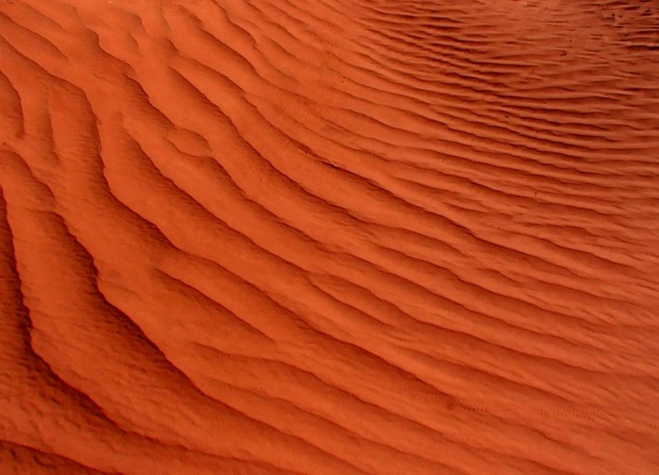
Microcosm study 2013
Phosphate (PO₄³⁻) more mobile in submerged zone?
Anoxia releases PO₄³⁻
Iron (Fe) and aluminum (Al) strongly bind PO₄³⁻
Skye Sand
coated with Fe
binds (PO₄³⁻) in upper layers
Skye sand

Slide 3
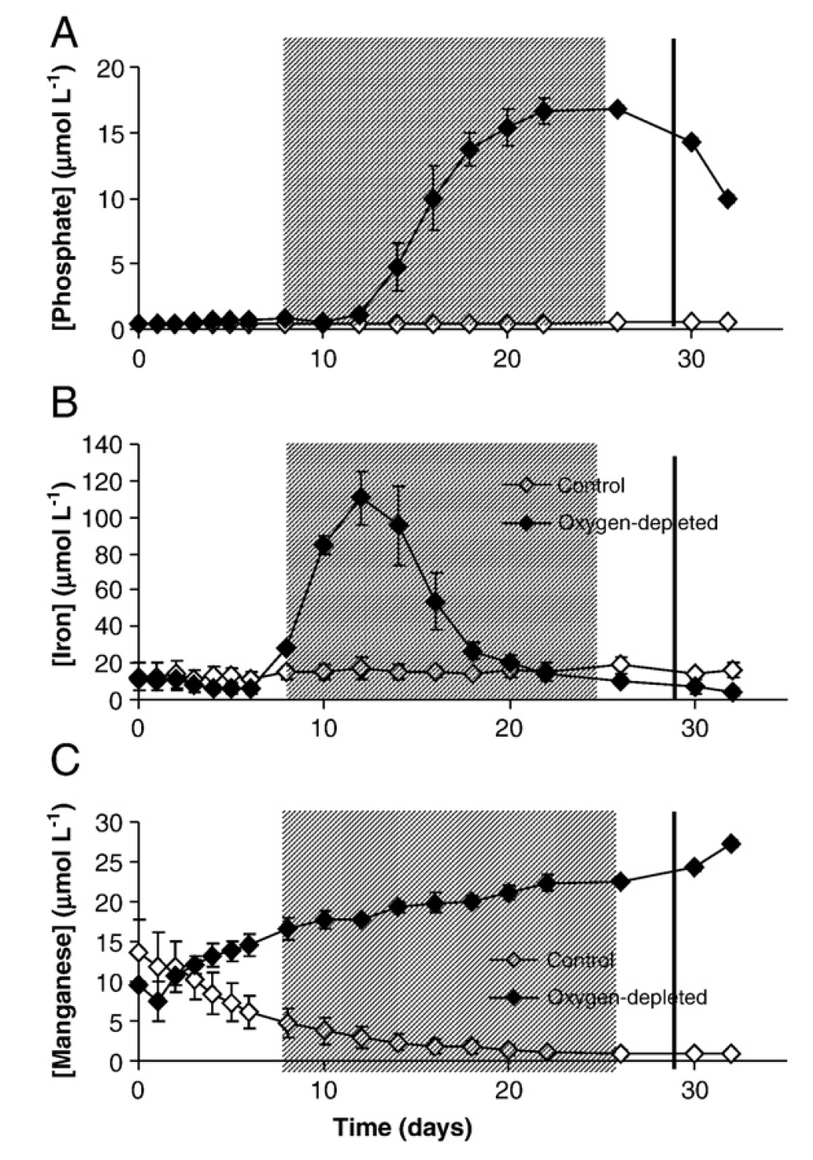
Microcosm study 2013
Anoxia allows Iron reduction
Ferric (Fe³⁺) iron → Ferrous (Fe²⁺) iron
Skoog and Arias-Esquivel 2009 – Sci. Tot. Env.

Slide 4
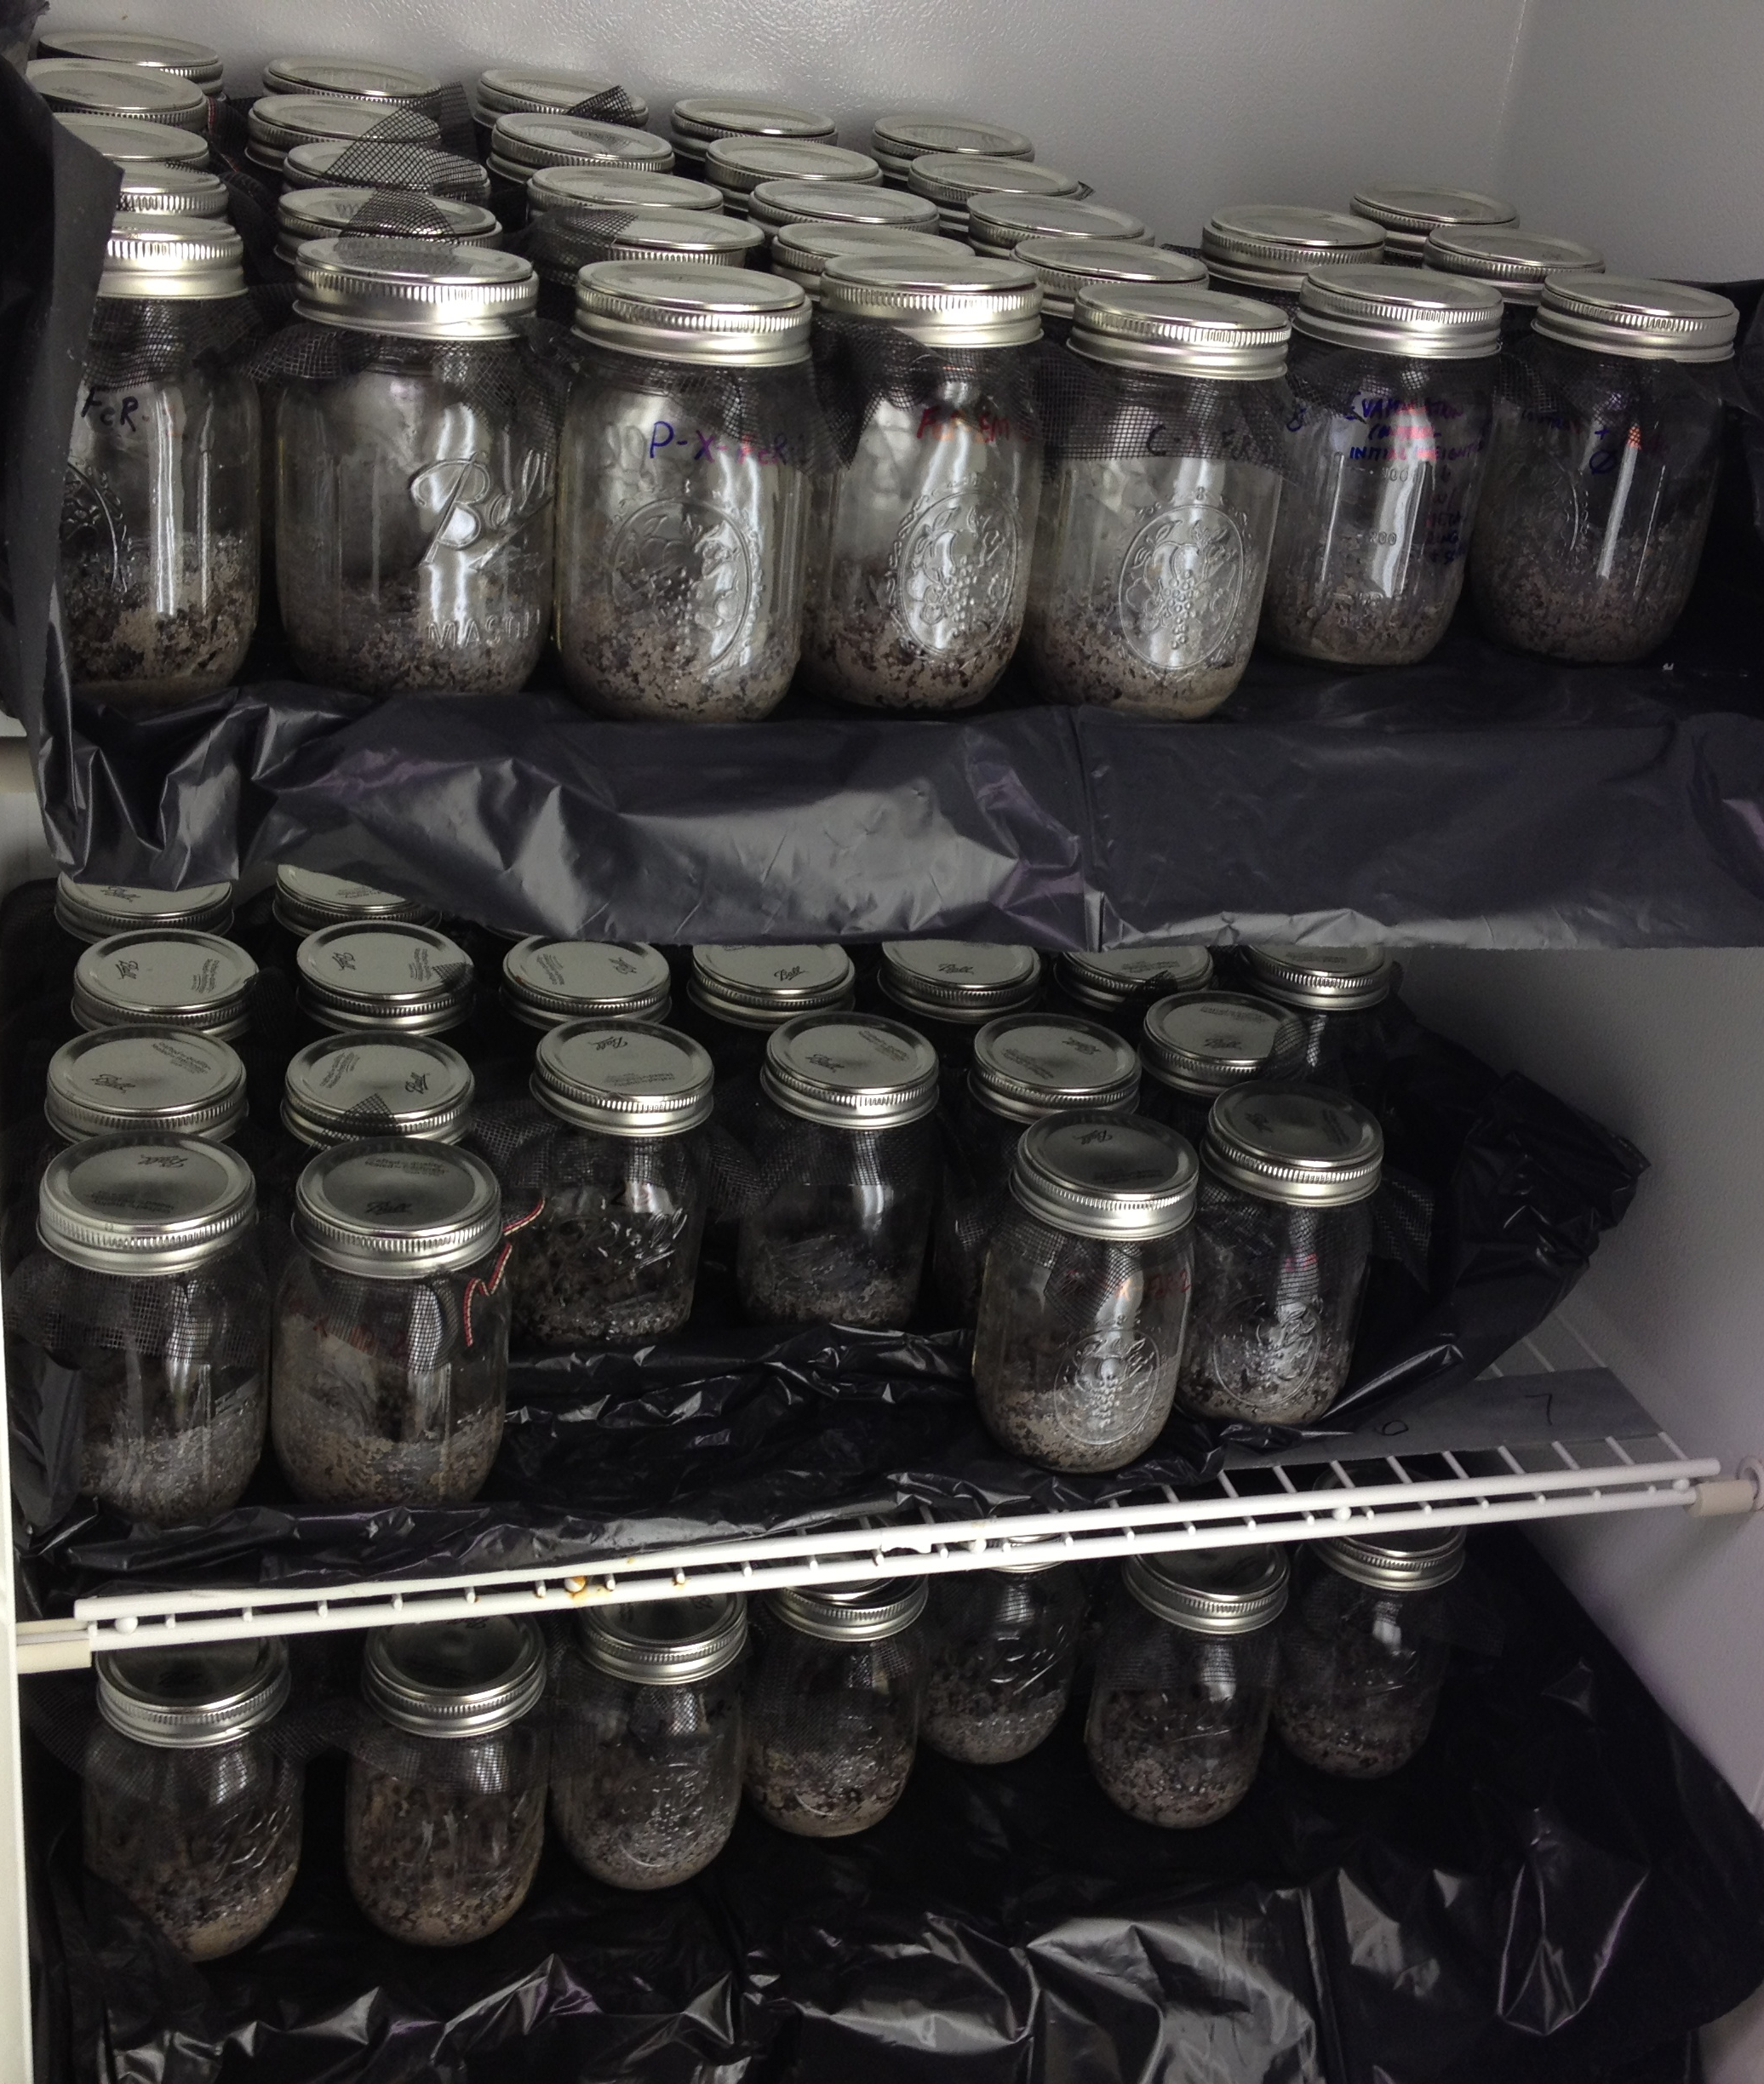
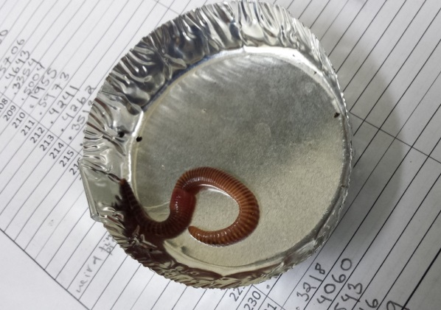
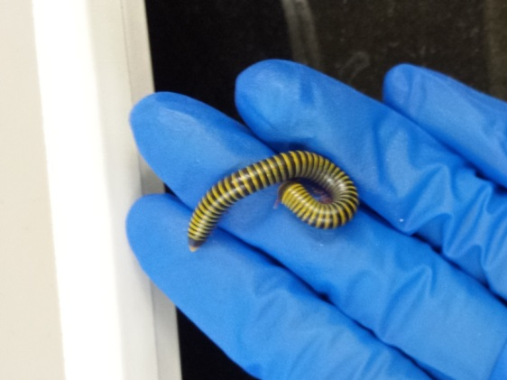
Microcosm study 2013
Soil treatments control P P + Iron oxide
Fe reducers Shewanella oneidensis Geobacter metallireducens
Animals earthworms millipedes both neither

Slide 5
Microcosm study 2013
Incubation period finished and animals weighed
Soils homogenized and ready to ship

Slide 6
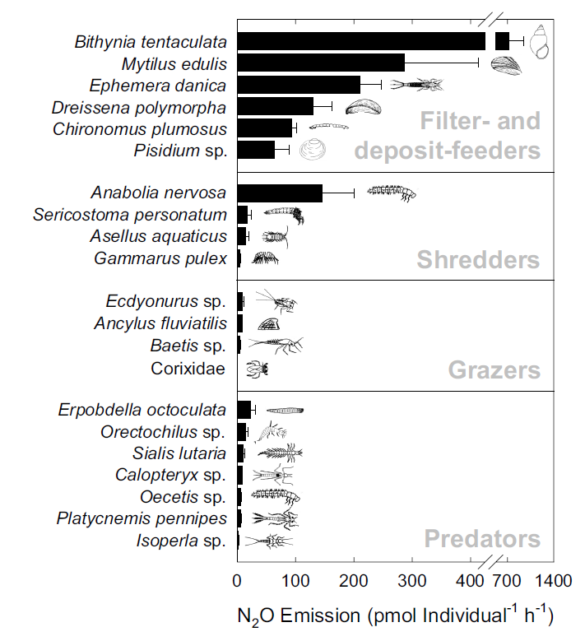
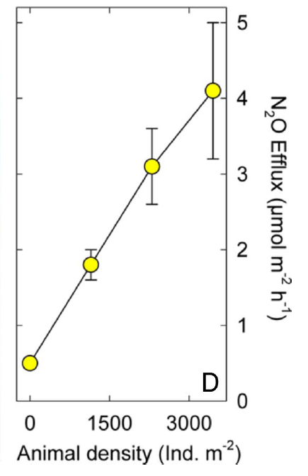
Wetlands – chironomids oligochaetes and GHG emissions
Sediment-feeding invertebrates enhance N₂O emissions (Stief et al 2009 PNAS)

Slide 7
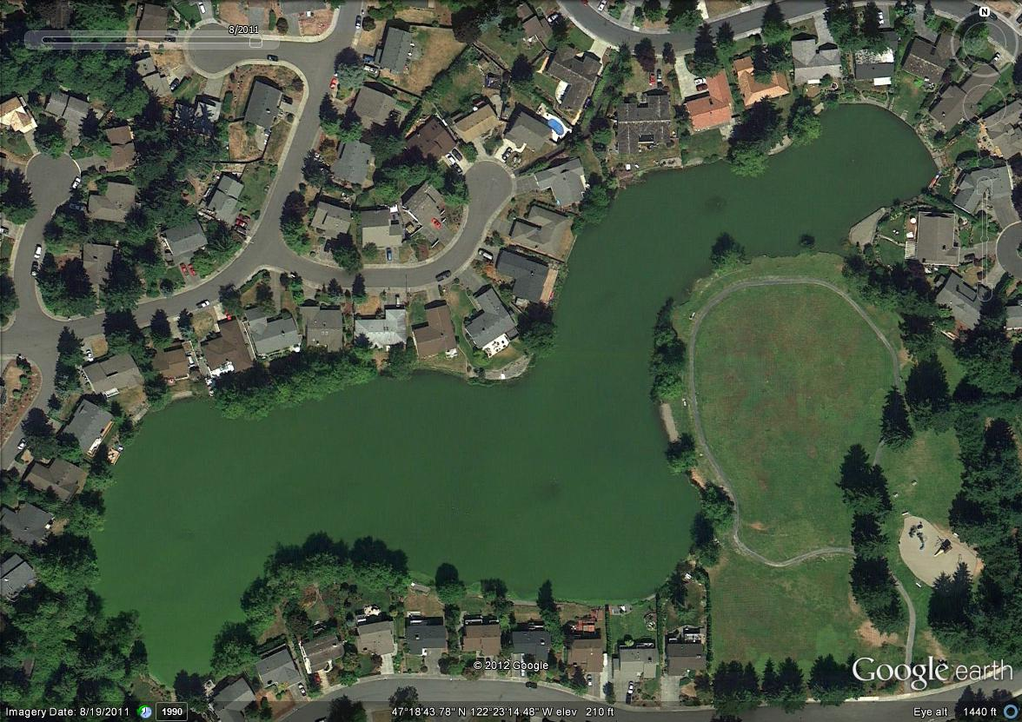
Wetlands – chironomids oligochaetes and GHG emissions
N₂O emissions also enhanced by nutrient loading (NO₃⁻)

Slide 8
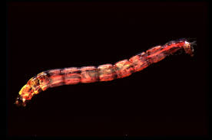
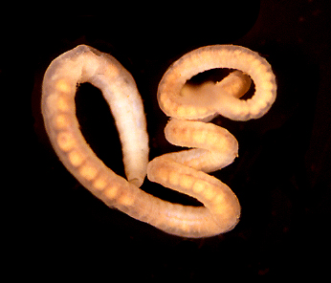
1. Wetlands – Chironomids oligochaetes and GHG emissions
15 wetlands
5 constructed/urban wetland
5 agricultural
5 waste stabilization or golf course
Measurements
N₂O, CH₄ emissions (response)
From each core:
Chironomid, oligochaete, etc. abundance
NO₃⁻
Turbidity, temperature, O₂
chlorophyll a
Stable isotopes ¹³C and ¹⁵N

Slide 9
1. Wetlands – Chironomids oligochaetes and GHG emissions
15 wetlands
5 constructed/urban wetland
5 agricultural
5 waste stabilization or golf course
Measurements
N₂O, CH₄, CO₂ emissions (response)
From each core:
Chironomid, oligochaete abundance
NO₃⁻
[O₂], turbidity, temperature
Stable isotopes ¹³C, ¹⁵N
Ecosystem metabolism

Slide 10
1. Wetlands – Chironomids oligochaetes and GHG emissions
15 wetlands
5 constructed/urban wetland
5 agricultural
5 waste stabilization or golf course
Measurements
Repeated seasonally (4x per year)
Captures seasonal changes in chironomid biomass, temperature, nutrient inputs
.
.
.

Slide 11
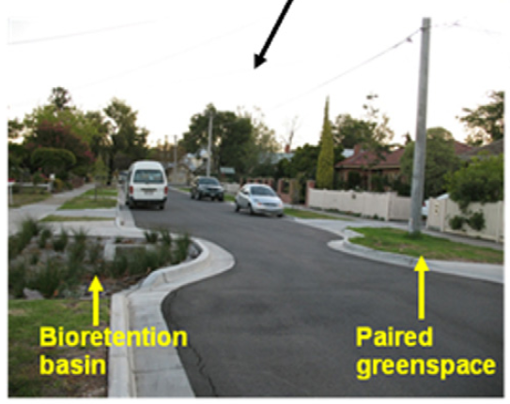
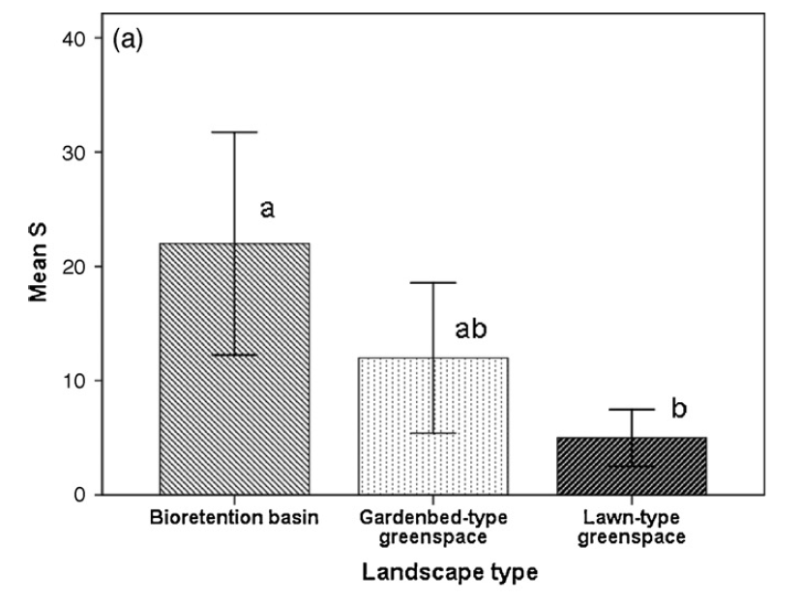
2. Biofilters – animal community development
Higher animal diversity in biofilters, compared to nearby gardens and lawns
Kazemi et al 2009 – Ecological Engineering

Slide 12
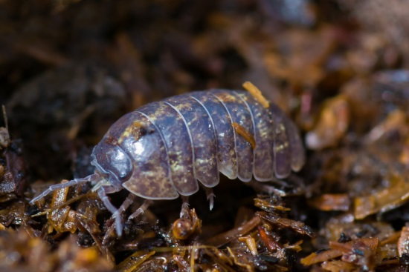
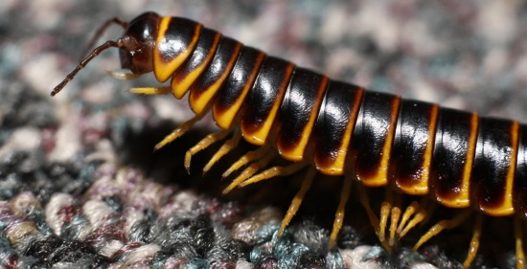
2. Biofilters – animal community development
20 biofilters as a chronosequence
10 in Melbourne, 10 in Brisbane (potentially)
Sort invertebrate abundance, biomass, and community structure
Also:
canopy cover
distance to adjacent green spaces
Soil C, N, P
Soil moisture, veg cover

Slide 13
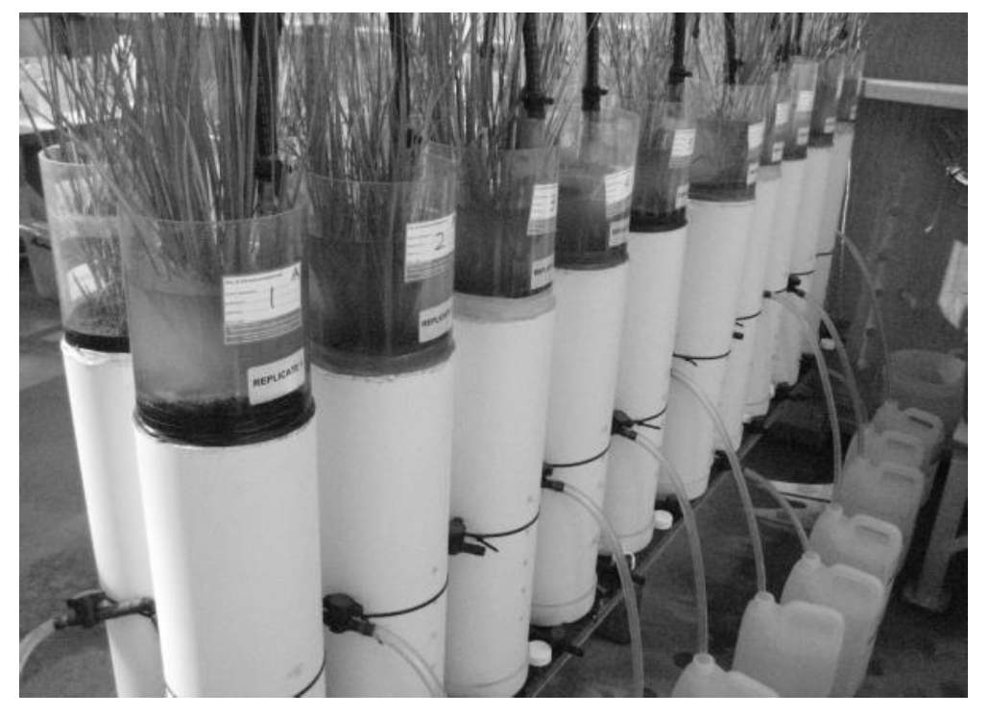
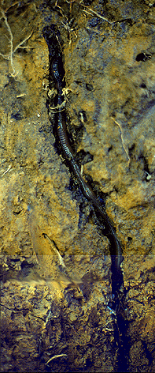
3. Biofilters – column study
Using Monash columns, examine effects of earthworms on N dynamics, plant growth, infiltration

