Slide 1
UCI Water PIRE Budget (2014)
30,000 foot view
Estimated Costs: $1,367,936
UCI Matching funds
CEE $30,000 (UPP Down Under)
Graduate Division: $112,486 (Grad support)
2014 Allocation from NSF: $1,153,058
2013 Carryover: $82,027
Current projection: $9,635 (probably more)

Slide 2
UCI Water PIRE Budget (2014)
Expenditure breakdown
UCI Graduate Students: $389,050 (+$112,486 match from Graduate Division)=$501,536
Subcontracts (UCLA, UCSD, SCCWRP, SmartStart): $366,118
Professional Staff Salary (Rippy and Stuvick): $143,266
UPP Down Under (Crude Estimate): $118,965 (+$30,000 match from CEE)
Faculty Summer Salaries: $139,297
Graduate Student Research Support In Australia: $117,250
Post-Doc/Staff Research Support in Australia: $33,990 + ?? Two trips per year for Rippy, Stuvick, Mehring, Winfrey (one trip for UPP Down Under, one trip for research)
K-12 Module Development/Teacher Workshops: $30,000

Slide 3
UCI Water PIRE Budget (2014)
UCI Graduate Students
NSF PIRE: $276,564; UCI Grad Div: $112,486 (including O/H savings); Total Cost: $389,050
Asal Askarizadeh (Layer 4): Full Year (pre-qual)
Morvarid Azizian (Layer 1): Full Year (pre-qual)
Kimberly Duong (Layer 3): Partial Year (pre-qual; pre-prelim)
Eric Huang (Layer 2): Full Year (post-qual)
Alireza Kalantari (Layer 1): Partial Year (post-qual)
Keah Ying Lim (Layer 2): Full Year (post-qual)
Kathleen Low (Cross-Cutting): Full Year (pre-qual)
Aliakbar Mehran (Layer 4): Full Year (post-qual)
Alice Robinson (Layer 3): Full Year (pre-qual)
Robert Stein (Layer 4): 1 quarter (post-post-post-post qual)
Layer 1 (2 students); Layer 2 (2 students); Layer 3 (2 students); Layer 4 (3 students); Crosscutting (1 student)

Slide 4
UCI Water PIRE Budget (2014)
UCI Post-docs/Staff
Dr. Megan Rippy: $78,781
Ms. Lindsey Stuvick: $64,486
James Beam: (50% time on the PIRE, supported by matching funds from UCI’s Office of Research and HSSoE)
Total Cost: $143,266

Slide 5
UCI Water PIRE Budget (2014)
Subcontracts
UCLA: $114,816
UCSD: $149,859
SCCWRP: $43,902 (+ carryover of $12,271)
Smart Start: $45,270
Total Cost: $366,118 (w/ O/H)

Slide 6
UCI Water PIRE Budget (2014)
UPP Down Under (Estimate)
Airline Tickets: $2500 x 12 students=$30,000 (CEE Contribution)
Room and Board (Trinity College): $1500x12=$18,000-> $27,810 (w/ O/H)
Field Costs (UoM): $2000x12=$24,000→ $37,080 (w/ O/H)
Participating faculty and post-docs:
$3500/week/participant x 10 = $35,000 -> $54,075(w/ O/H)
Jean-Daniel Saphores
David Feldman
+/- Amir AghaKouchak
+/- Rich Ambrose
Sunny Jiang
Megan Rippy
Lisa Levin
Andrew Mehring
Brandon Winfrey
Lindsey Stuvick

Slide 7
UCI Water PIRE Budget (2014)
Graduate Research in Australia
Crash house near UoM (Feb 1 through Sept 30): $40,000 (w/ O/H) ($5K/month, $166/night, $42 - $56/person/night )
Allocation: $5000 (research) + $3000 (r/b)+$2000 (tix)=$10,000 ->$15,450/person/trip (w/ O/H)
Alice Robinson (in Melbourne until March)
Eric Huang (returned October 2013)
Keah-Ying Lim (returned August, 2013)
Morvarid Azizian (leave July?)
Kathleen Low (Leave March/April?)
Total Estimated Cost: $15,450 x 5+$40,000=$117,250

Slide 8
UCI Water PIRE Budget (2014)
Post-doc/Staff/Faculty Research in Australia
Crash house near UoM (not budgeted here)
$2500 (tix) + $1400 (r/b) + $500 (transport)=$4,400 >$6,798/person/trip (w/ O/H)
Megan Rippy (x1)
Andrew Mehring (x1)
Brandon Winfrey (x1)
Lindsey Stuvick (x1)
Diego Rosso (x1)
Total Estimated Cost: $6,798 x 5 = $33,990 (w/ O/H)
NOT INCLUDING RESEARCH COSTS!!
Only $1400 budgeted for r/b per person, could be much larger depending on length of stay

Slide 9
UCI Water PIRE Budget (2014)
Faculty Salary
S. Grant: 2 months (P.I.)
S. Jiang: 1 month (UPP Down Under + Layer 2)
J. Saphores: 2 weeks (Layer 3)
D. Feldman: 2 weeks (PIRE Textbook)
B. Sanders: 2 weeks (Layer 4)
A. AgaKouchak: 2 weeks (Outreach)
Total: $80,000 -> $139,297

Slide 10
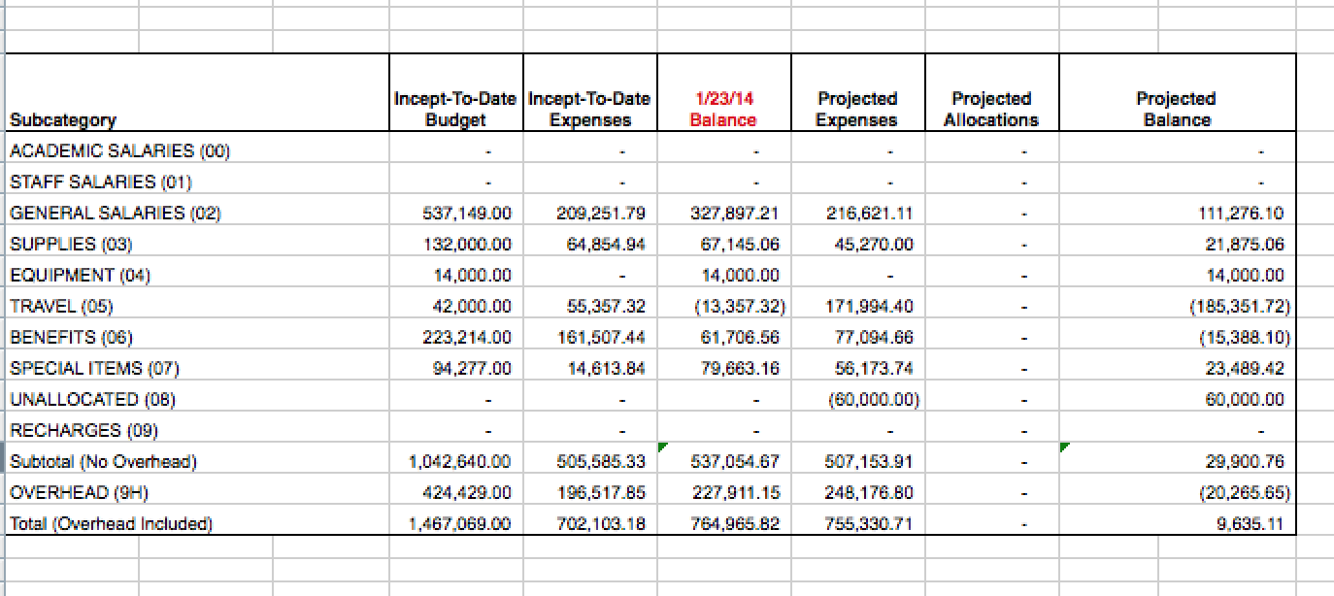
UCI Water PIRE Budget (2014)
Conventional budget projection breakdown for 2014:

