Slide 1
Undergraduate PIRE Program

Slide 2
US participants traveling to Australia
12 undergrads from UCI, UCLA, UCSD
+/- 1 UCI grad student (Laura Weiden)
4 UCI faculty members (Sunny Jiang, Stanley Grant, Jean-Daniel Saphores, David Feldman)
2 post-docs (Andrew Mehring from UCSD, Megan Rippy from UCI)
1 HSSoE staff (Nicole Patterson—chaperone)

Slide 3
Lecturers on the US Side
6 UCI faculty (P. Bowler, S. Grant, JD Saphores, D. Feldman, J. Brouwer, D. Rosso)
3 External PIRE Affiliates (K. Schiff, A. Sengupta, R. Boon)
4 UCI/UCSD post-docs (Zengchao Hao, Megan Rippy, Brandon Winfrey, Andrew Mehring)
1 UCI Professional Staff (R. Demerjian)

Slide 4
Australian participants
2 faculty from UoM (A. Hamilton, M. Aurora)
5 faculty from Monash (A Deletic, R. Brown, J. Lindsay, P. Raschky, L. Frost)
6 post-docs/graduate students from Monash (G. Chandrasena, Y Li, K. Zhang, E. Payne, W. Feng, H. Fowdar)
1 graduate student from UoM (A. Mccluskey)

Slide 5
Key Support Staff
Leyla Riley (UCI, HSSoE)-- logistics
Nicole Patterson (UCI, HSSoE) -- chaperone
Lorrie Aguilar (UCI, CEE) – logistics
James Beam (UCI, CEE) -- logistics
Michelle Mackay (UoM, School of Engineering) -- logistics

Slide 6
Week 1: UCI Urban Water Bootcamp
Introduction: logistics and preparation
Lectures: climate change, resource economics, water governance, wastewater treatment and reuse, stormwater capture and reuse
Field trips:
LA County Sanitation District’s Wastewater Reclamation Plant;
Orange County Groundwater Replenishment System;
UCI’s stormwater drainage system;
San Joaquin stormwater treatment wetlands

Slide 7
Week 2 and 3: Field sampling in Melbourne
Lectures: Melbourne’s water supply, indicator bacteria/viruses, wetland plants/animals, measuring physical parameters
Field trip: world’s largest wastewater stabilization pond
Field sampling: Royal Park Treatment Wetland, Hampton Park Treatment Wetland, Wikes Reserve Biofilter, Lynbrook Estates Biofilter and Constructed Wetland, Edithvale Natural Wetland, Hereford Biofilter
Monash Mini-conference: Biofilters for stormwater management (Day 1); the social science of urban water management (Day 2)

Slide 8
Undergraduate Field Program
6 field sites in six days
At each site measure/quantify:
Dissolved Oxygen, pH, conductivity, temperature
Fecal Indicator Bacteria (E. coli and Enterococcus) by MF (EPA 1600 and 1603)
Human pathogens by QPCR
Chlorophyll, TSS, PAR, nutrients (phosphate, sulphate, and nitrogen species)
Invertebrate and plant communities

Slide 9
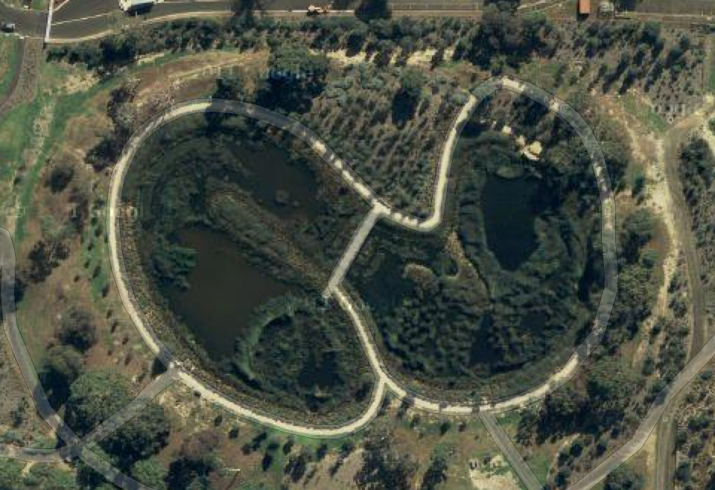
Site #1: Royal Park Constructed Treatment Wetland (B) (July 3, 2013)
I5
M5
I4
M3
M4
O5
M2
I3
O4
M1
O3
I2
O2
O1
I1

Slide 10
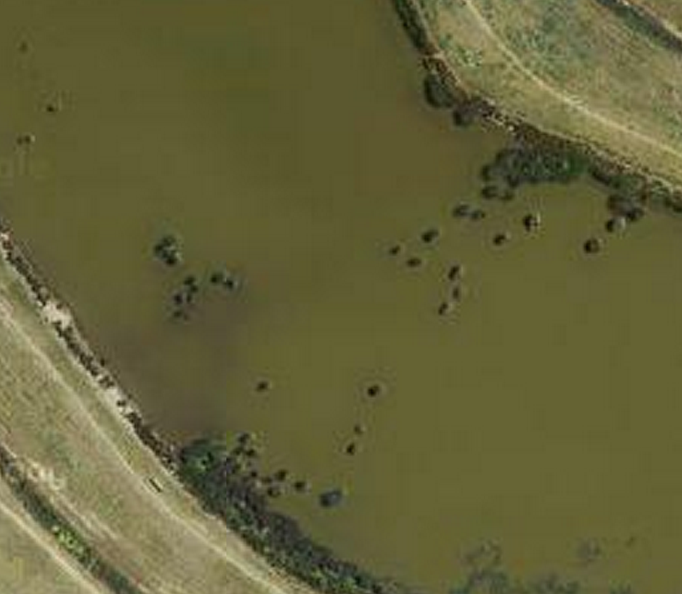
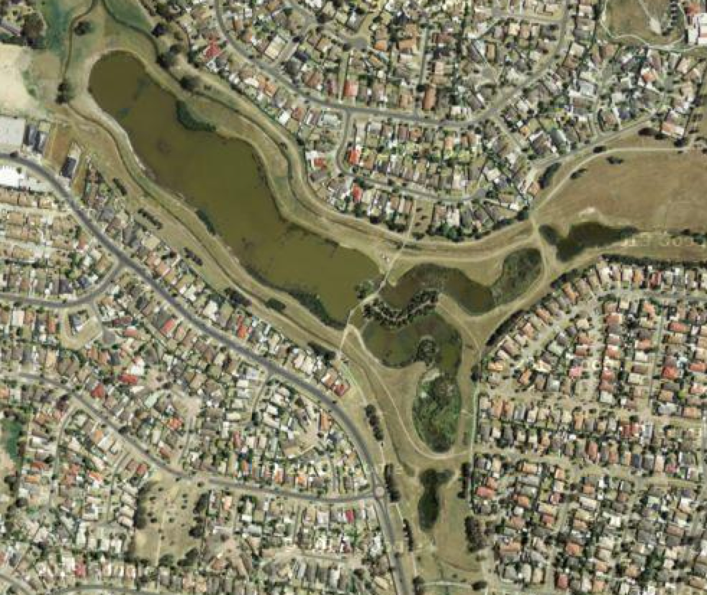
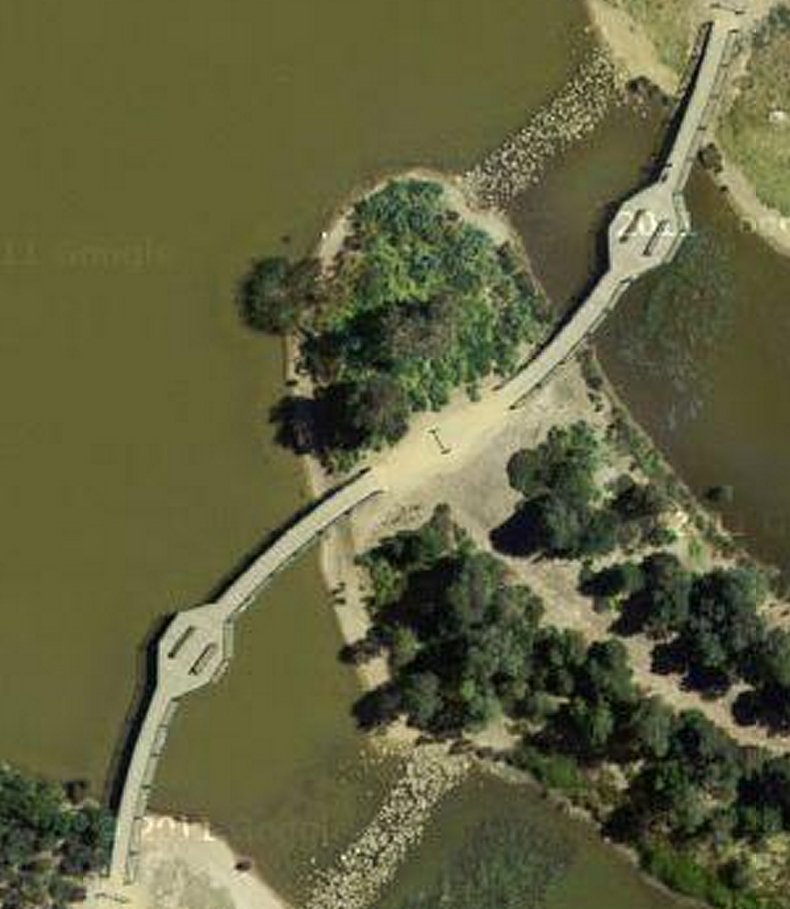
Site #2: Hampton Park Treatment Wetland (July 4, 2013)
O
MD1
MD2
MD3
MD4
MD5
A1
A
A3
B3
M8
M7
M6
B1
M5
M4
M3
M2
B
M1

Slide 11
Site #3: Wikes Reserve Biofilter (The Basin, Victoria) (July 5, 2013)
Outlet Sump
Outlet Tank
T
O
A1
B1
C1
A2
B2
C2
Biofilter
Centrifugal Trash Collector
I3
A3
B3
C3
I1
I2
Sedimentation
Basin

Slide 12
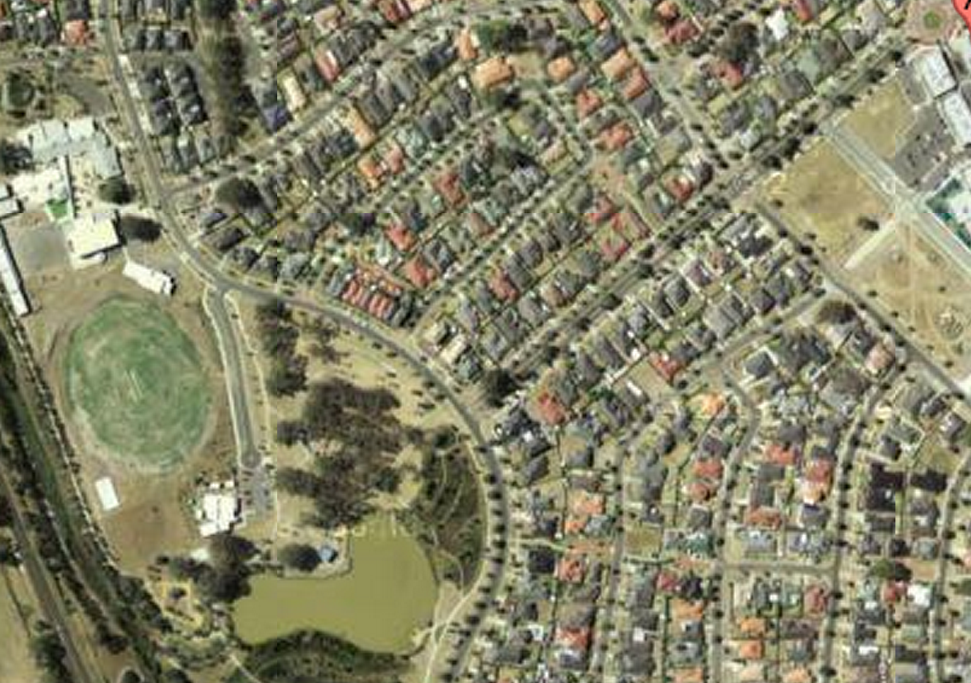
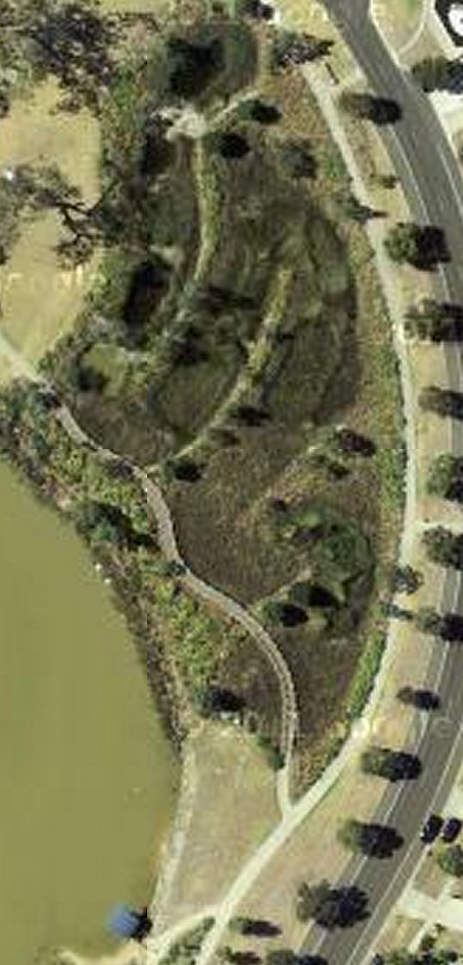
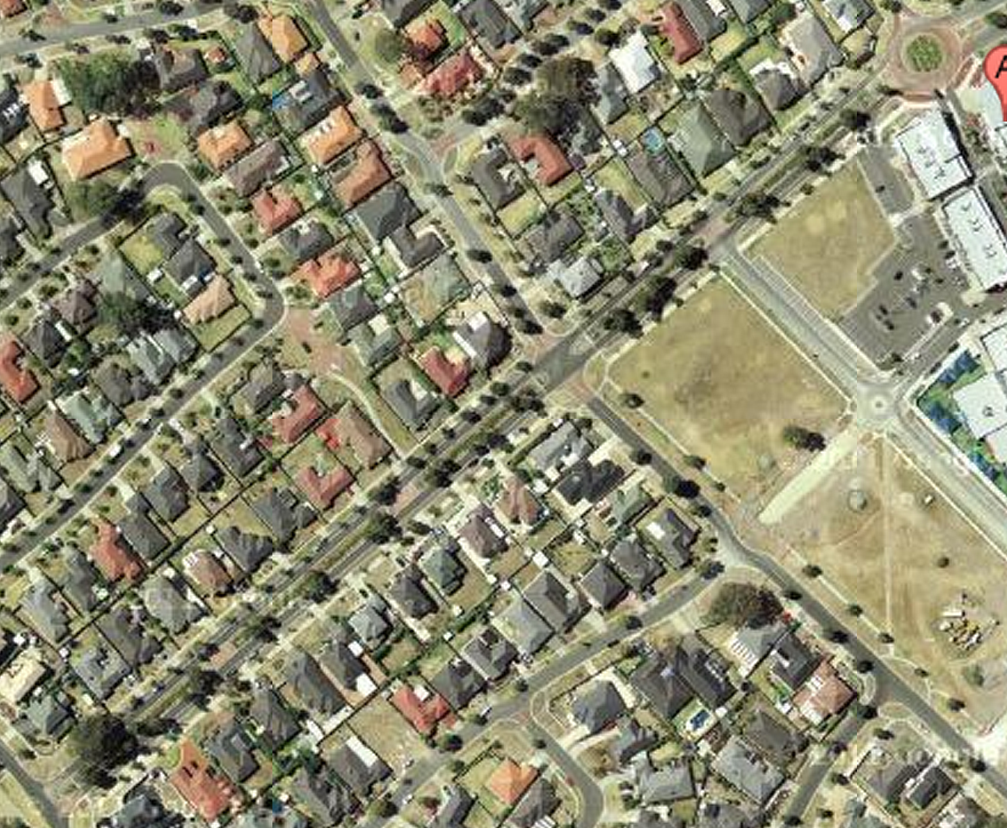
Site #4: Lynbrook Estates Biofilter (A) and Treatment Wetland (B) (July 8, 2013)
I
P1
P5
P2
P6
P3
P4
P7
B1
B2
B3
B4
B5
L

Slide 13
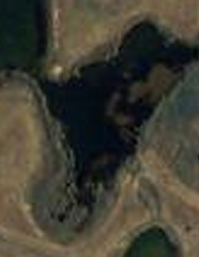
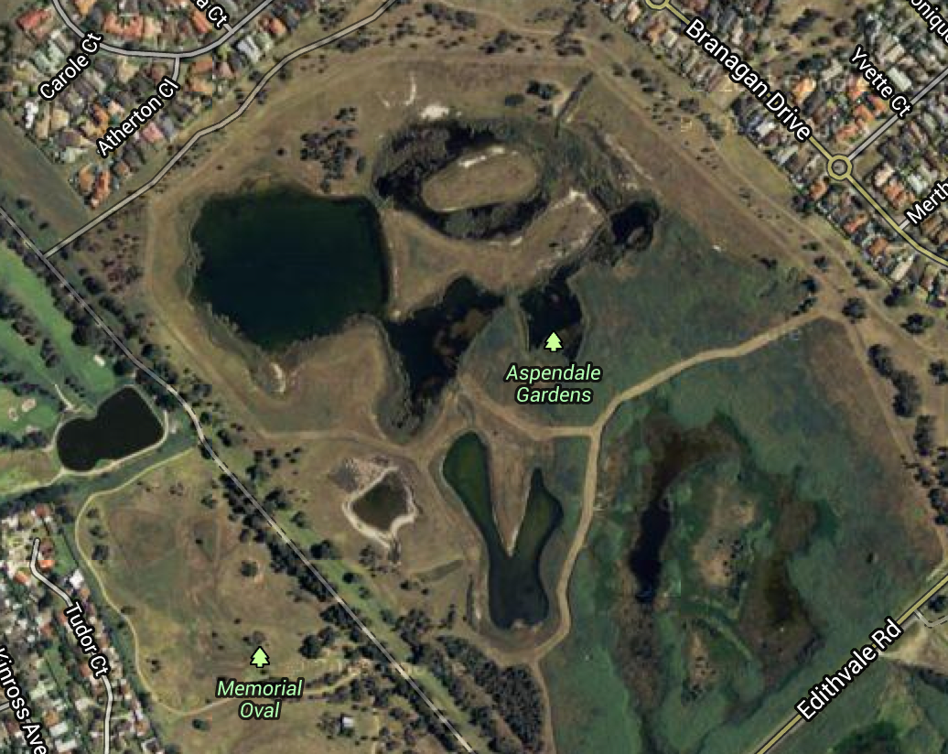
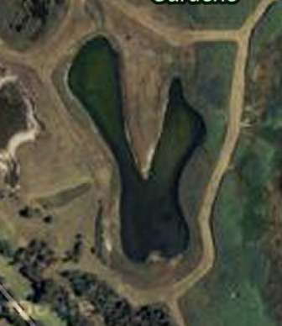
Site #5: Edithvale Natural Wetland (July 9, 2013)
P2-4
P2-2
P1-4
21
21
P1-3
P2-3
P2-1
P1-2
P1-1
P1-7
P3-3
P1
P3-1
21
21
P3-2
P1-5
21
P1-6

Slide 14
Week 4,5,6: Data analysis, posters, presentations, and videos
Lectures: QPCR, Basic statistics, advanced statistical tools (PCA, GLM, MLR, bootstrap methods), science communication, wetland plants, wetland animals
Field trip: Tour of SIO, collections visit, microscope observations, tour of Birch Aquarium
Data Analysis, Posters, Presentations, Videos: 4 teams
UPP Down Under Symposium

Slide 15
My observations:
Too much programming—everyone experienced serious burn out (staff, students, post-docs, faculty worked 24/7 in Australia)
Field work diffuse and not hypothesis driven (our initial foray into Melbourne LID features)
Not sustainable—some components would be difficult to repeat every year (e.g., Monash mini-conference)
Experience was not parlayed into K-12 modules—one of the few failures of FY1

