Slide 1
Hyporheic Exchange and Urban Water Demand Studies

Slide 2
Hyporheic Exchange over Dunes and Ripples
High
Turbulent Stream Flow
Pressure
Low
Sediment (Hyporheic Zone)

Slide 3
Hyporheic Exchange over Dunes and Ripples
High
Turbulent Stream Flow
Pressure
Low
Downwelling
Upwelling
Sediment (Hyporheic Zone)

Slide 4
Microbial Metabolism
High
Turbulent Stream Flow
Total N
Pressure
DOC
O₂
Low
Strong redox
gradients
Strong nutrient gradients
Aerobic respiration:
Nitrification:
Denitrification:

Slide 5
“River’s Liver”
High
Turbulent Stream Flow
Total N
Viruses
Bacteria
P
Cd
Pressure
DOC
CEC
Pb
H⁺
O₂
Heat
Cu
Zn
Low
POM
Bacteria and viruses (along with other POM) can be sequestered in, or mobilized from, the hyporheic zone

Slide 6
Habitat
High
Turbulent Stream Flow
REDD
Pressure
Low
The HZ also serves as habitat for plants, fish eggs (redd), and macroinvertebrates

Slide 7
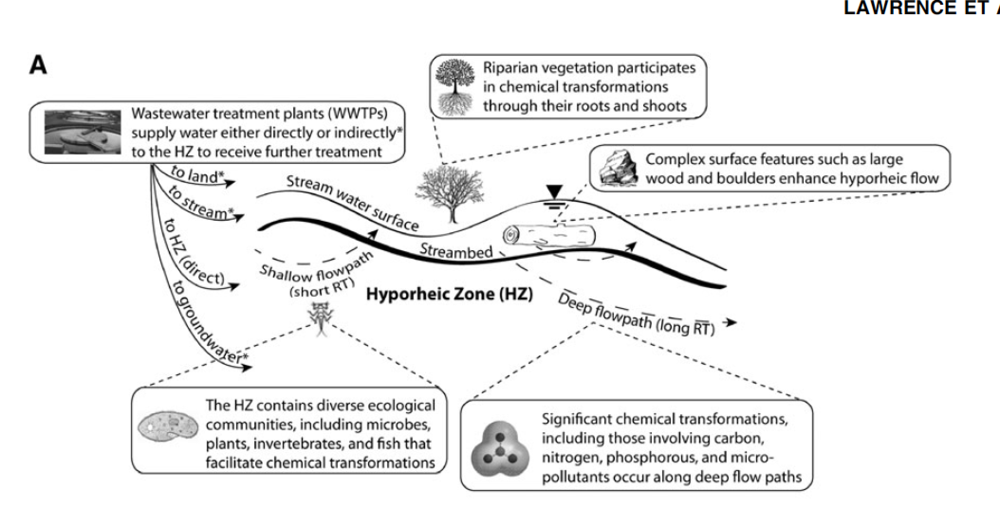
Hyporheic Zones: the next constructed wetland?
Lawrence et al (2013) “Hyporheic Zone in Urban Streams: Review and Opportunities for Enhancing Water Quality and Improving Aquatic Habitat by Active Management” Environmental Engineering Management, 30: 480-501

Slide 8
Goal: develop predictive tools of pollutant removal in the hyporheic zone
Theoretical studies of hyporheic exchange and pollutant removal (S. Grant, S. Elghobashi, I. Marusic, D. Chung, M. Azizian; A. Kalantari)
Laboratory-scale experimental studies of pollutant removal (P. Cook, A. Mccluskey)
Field-scale extrapolations of theoretical and lab-scale studies (M. Stewardson)

Slide 9
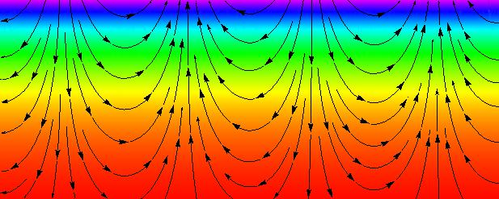
unit cell
Figure 1.

Slide 10
A.
B.
first-order reaction in sediment domain
C.
D.
Figure 2.

Slide 11
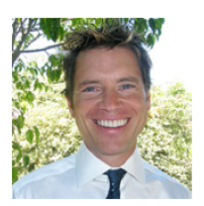
Modeling Drought Response at the City Scale
Kathleen Low
Stanley Grant

Slide 12
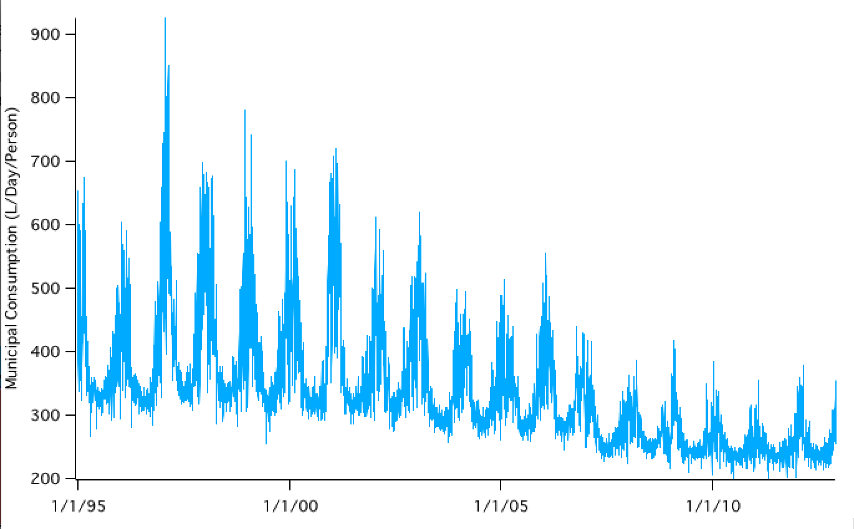
Melbourne per capita water consumption

Slide 13
Melbourne decreased its per capita potable water consumption by a whopping 46% over 12 years (458 to 247 L/person-day)

Slide 14
Melbourne decreased its per capita potable water consumption by a whopping 46% over 12 years (458 to 247 L/person-day)
=300 GL of water saved in 2012
>3X maximum annual capacity of OC GWRS (88 GL)
>water supplied by LA Aqueduct in 2010/11 (228 GL)

Slide 15
Melbourne decreased its per capita potable water consumption by a whopping 46% over 12 years (458 to 247 L/person-day)!
=300 GL of water saved in 2012
>3X maximum annual capacity of OC GWRS (88 GL)
>water supplied by LA Aqueduct in 2010/11 (228 GL)
How did Melbourne do it?

Slide 16
Participants
Kathleen Low, Andrew Hamilton, David Feldman, Amir AghaKouchak, Murray Peel, Mike Stewardson

