Slide 1
Biofilter Plant Ecology- Research Status
PIRE Meeting Jan 25, 2014
Brandon Winfrey

Slide 2
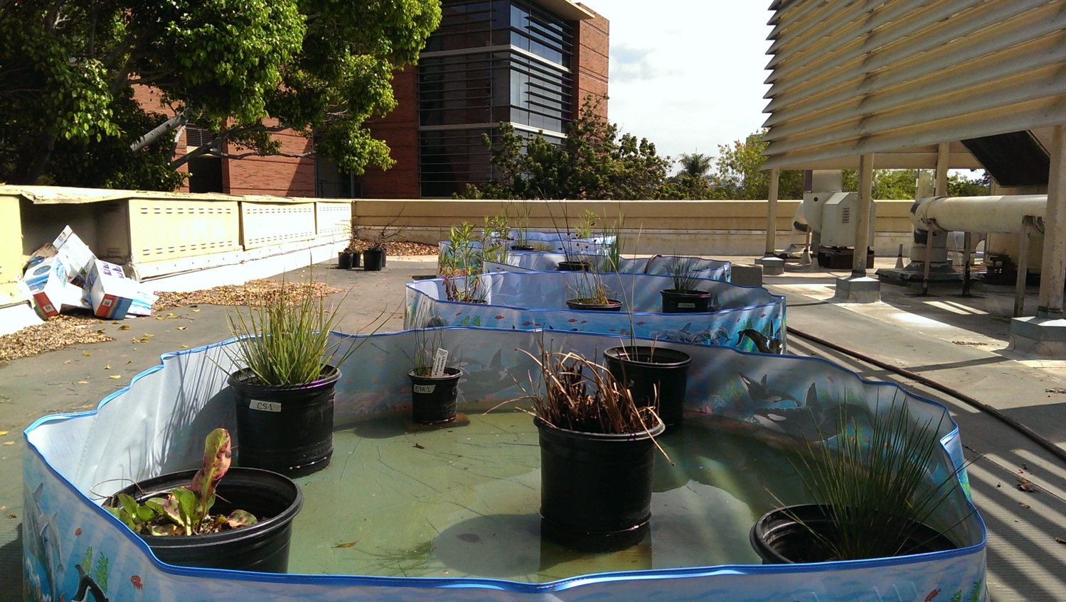
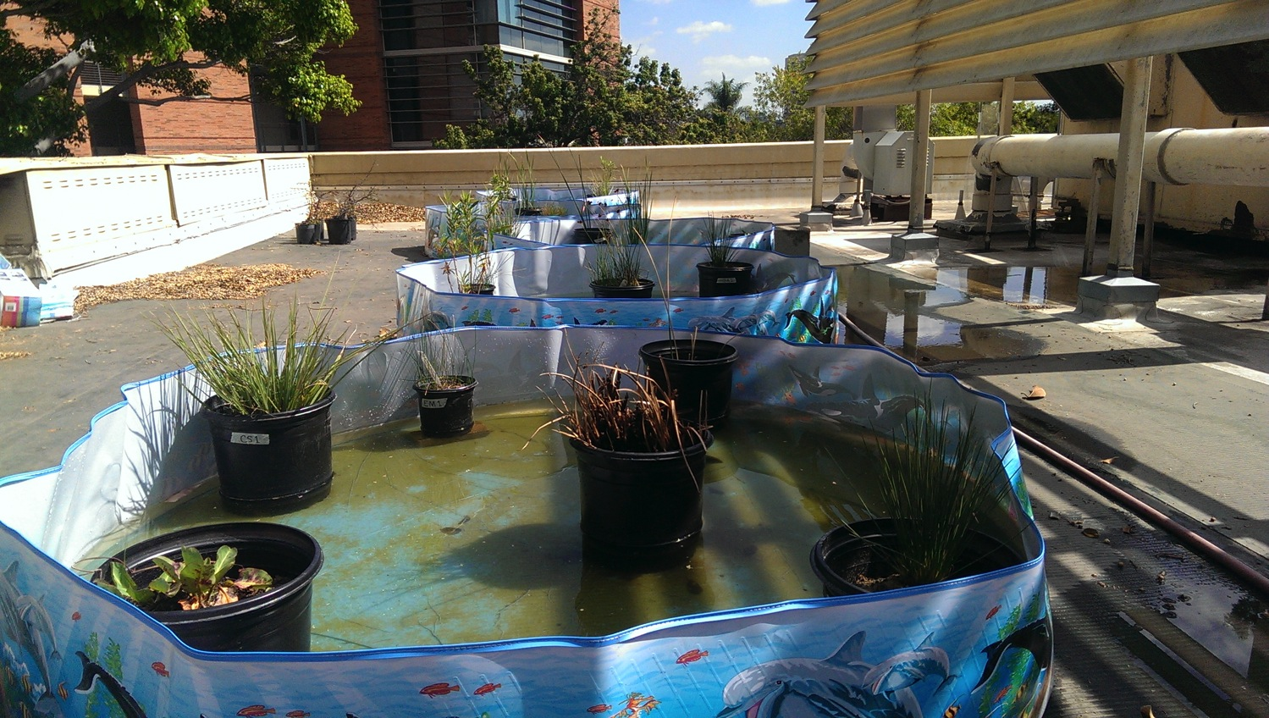
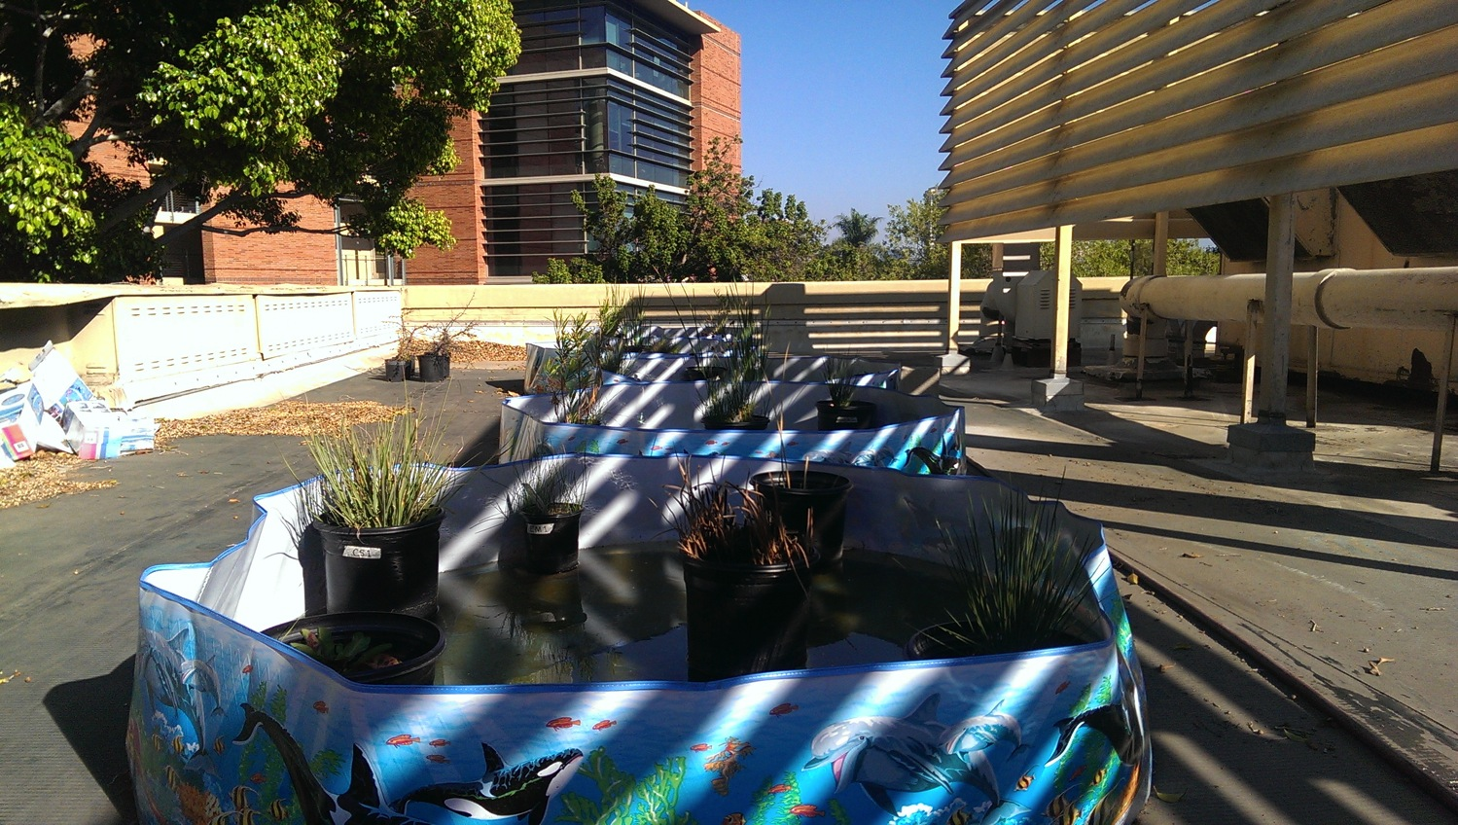
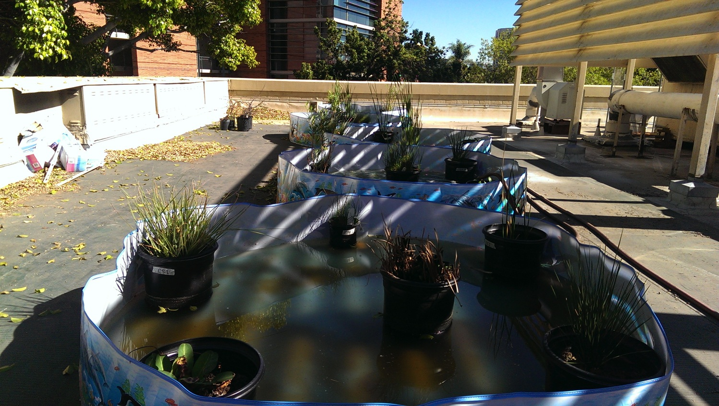
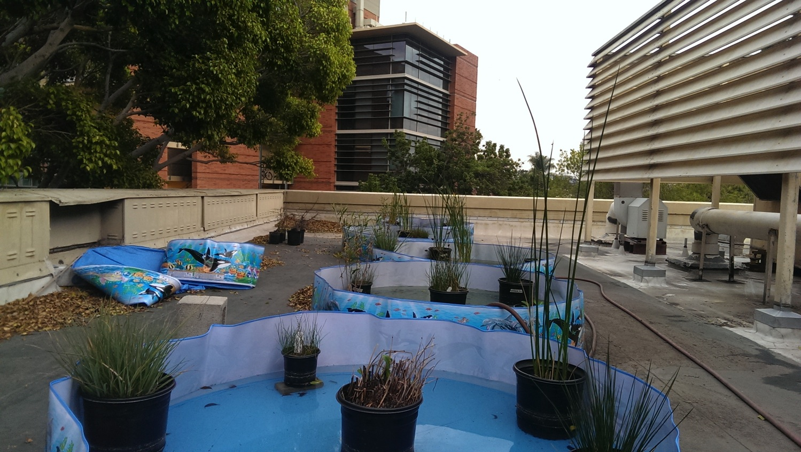
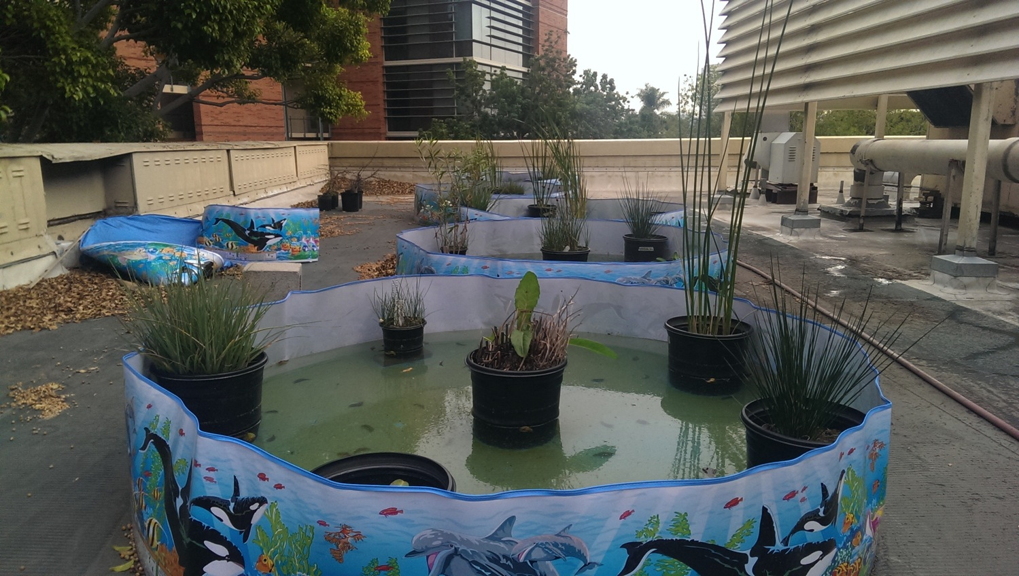
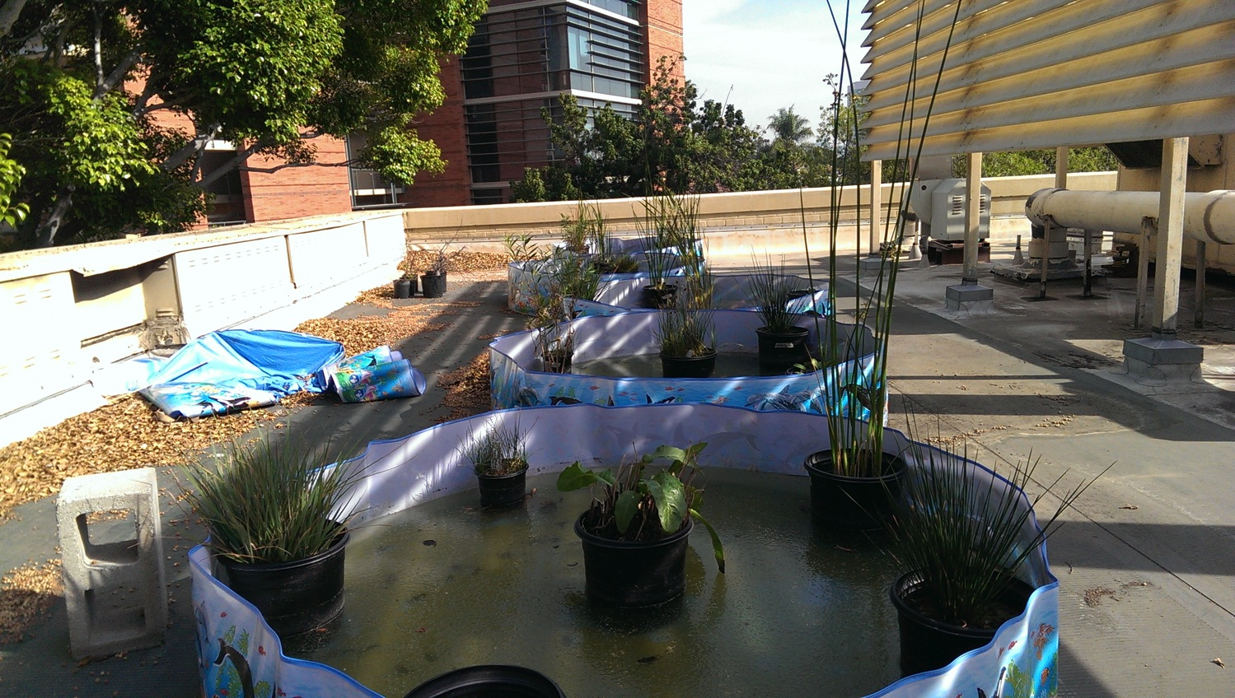

Slide 3
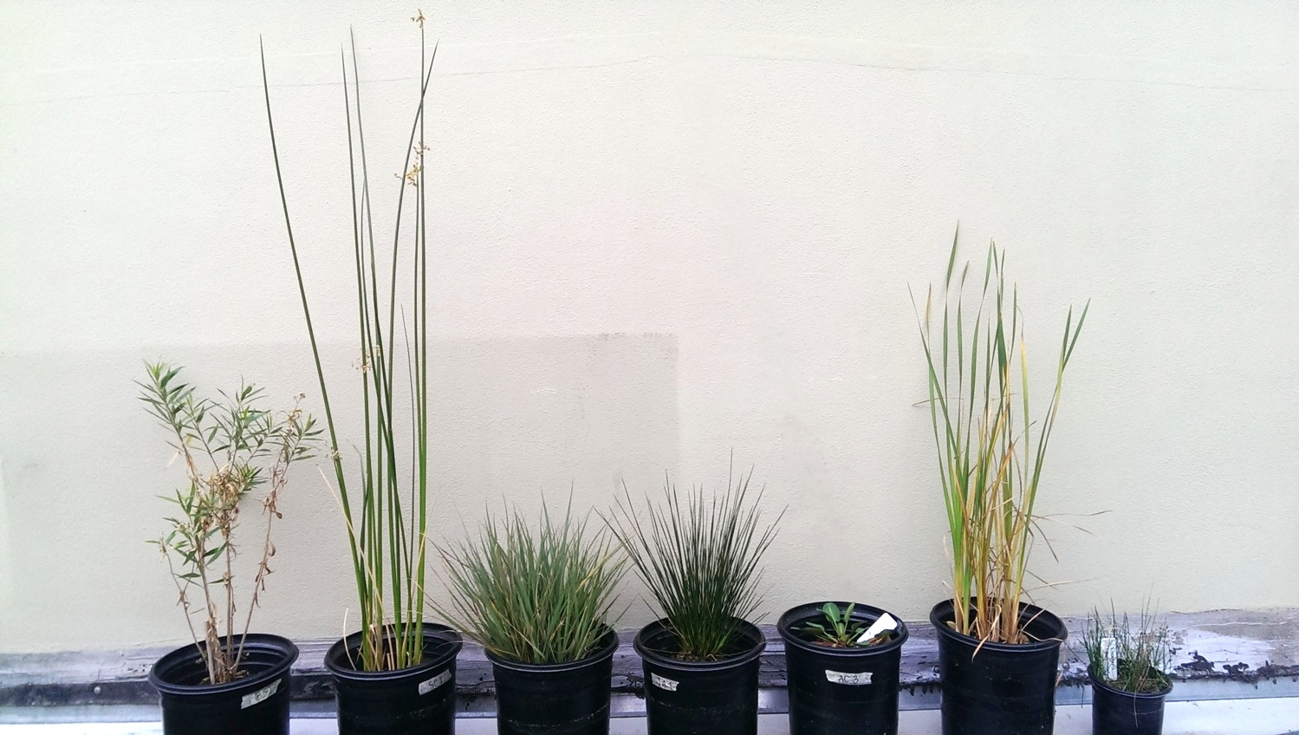
BS = Baccharis salicifolia (mulefat)
SC = Schoenoplectus californicus (California bulrush)
CS = Carex spissa (San Diego sedge)
JA = Juncus acutus (spiny rush)
AC = Anemopsis californica (yerba mansa)
TL = Typha latifolia (broadleaf cattail)
EM = Eleocharis macrostachya (common spikerush)
BS
SC
CS
JA
AC
TL
EM

Slide 5
Which Plants Do the Work in a Stormwater Biofilter?
Functional Diversity
Root morphology and physiology
Growth rate
C:N ratio
Preferential uptake
Drought/Water tolerance
Growth form (rhizomatous, cluster, seed dispersal, clonal, etc.)
Hypothesis: Greater treatment performance when functional diversity is higher.

Slide 6
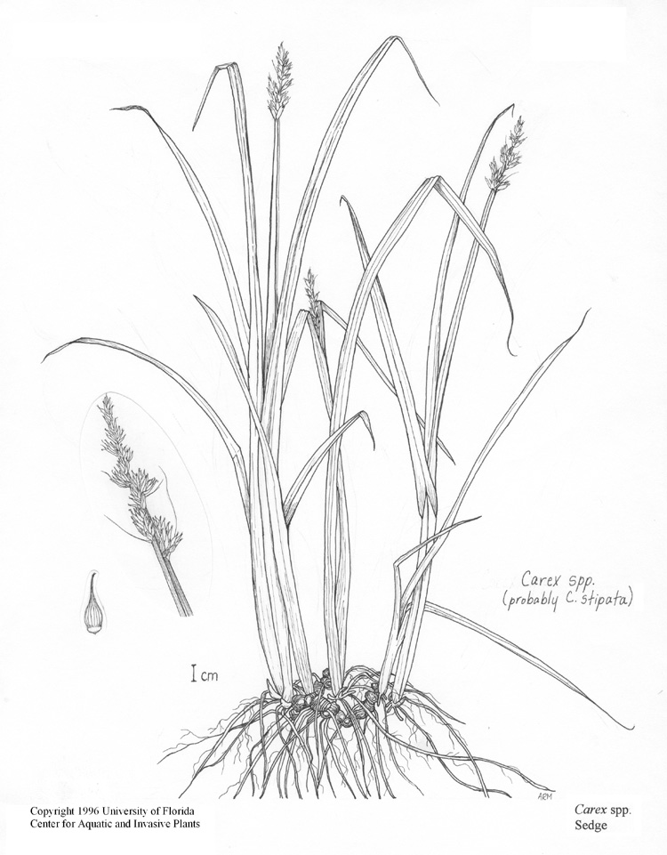
Carex sp.
C. spissa or C. pansa
Rhizomatous growth
Extensive roots
Medium drought tolerance
Facultative wetland species
Widely used in stormwater biofilters
CA native

Slide 7
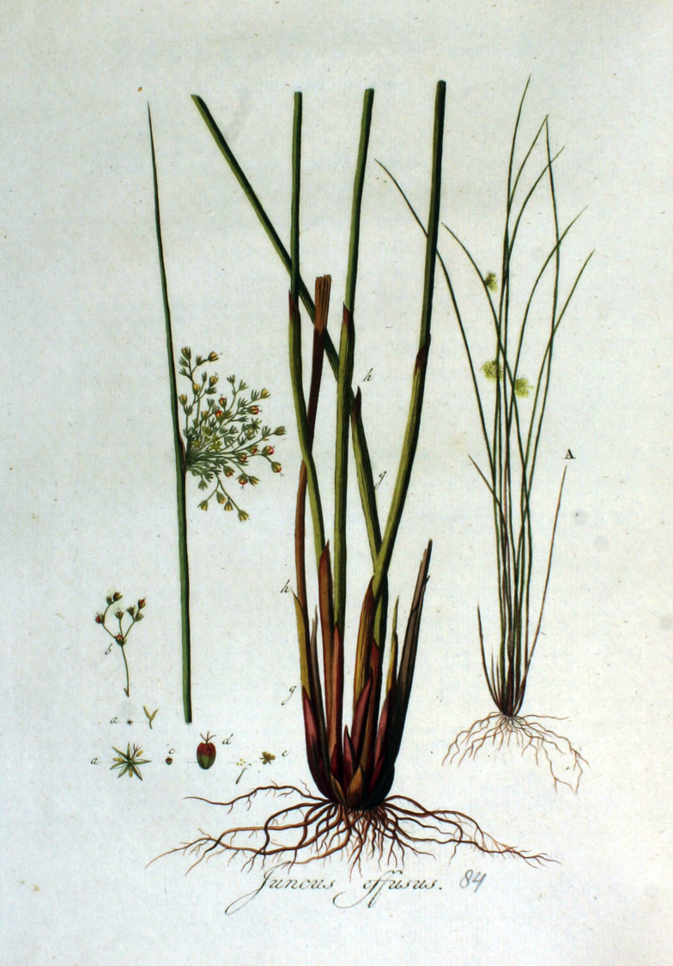
Juncus effusus
Cluster/colony growth
Shallow, less extensive roots
High drought tolerance
Facultative wetland species
Widely used in stormwater biofilters
CA native

Slide 8
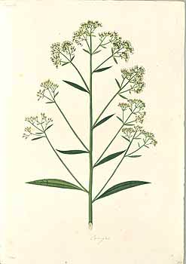
Baccharis salicifolia
Dioecious shrub
Deep roots
Low/medium drought tolerance
Facultative wetland species
Widely used in stormwater biofilters
CA native

Slide 9
B = Baccharis salicifolia C = Carex sp. J = Juncus effusus
Three species- 3 monocultures, 3 dicultures, 1 triculture, 1 control, replicated 3 times.
B
C
B
J
C
C
C
J
C
B
Control
J
C
J
J
J
C
B
J
B
J
B
C
C
B
C
B
J
C
J
J
J
C
Control
J
J
C
B
J
J
C
J
J
B
J
B
C
B
C
C
C
J
B
Control
C
B
J
C
J
J
B
B
B
J
C
B

Slide 10
Species Diversity/Functional Diversity and Treatment Performance
About 12 studies on constructed wetlands
2 on biofilters
Biofilter mesocosms will use specifications from Australian work.
Treatment performance during simulated storm event.
Test N and P (maybe metals)
Later, possibly pesticides, pathogens, GHGs, and metals.
Use mesocosms to test colonization by animals and animal seeding experiments

